Slide 1
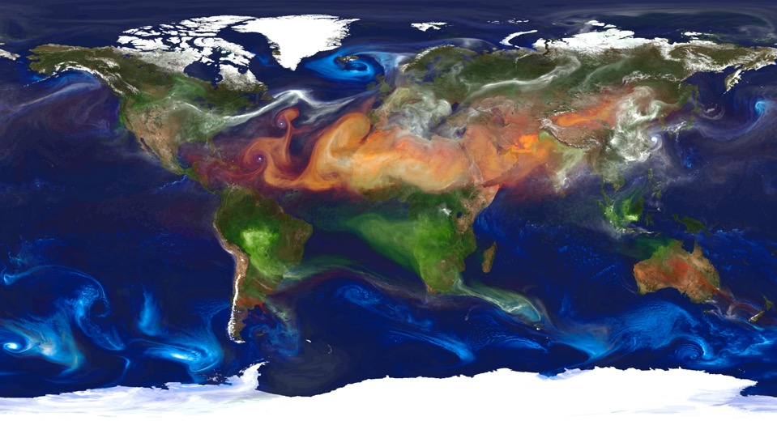
Protocol Training
Aerosols

Slide 2
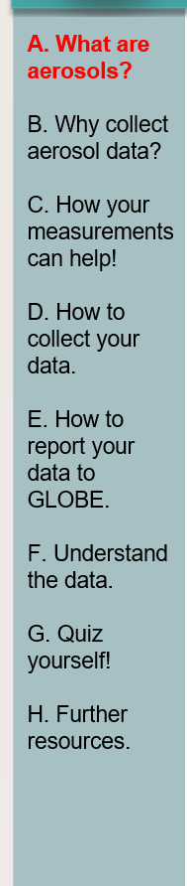
Overview and Learning Objectives
Overview
This module:
Describes how to measure aerosol optical thickness (AOT) using one of two instrument options (GLOBE Sun Photometer or Calitoo)
Learning Objectives
After completing this module, you will be able to:
Describe what aerosols are and what AOT measurements mean
List reasons why it is important to collect measurements of AOT
Identify appropriate conditions and locations to take AOT measurements

Slide 3
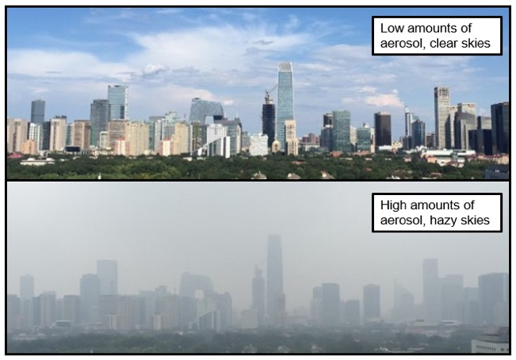
With every breath, you inhale millions of solid and liquid particles called aerosols. Despite their small size, aerosols have a significant impact on climate and health. They may also affect visibility. On days when there are lower amounts of aerosols, distant details are easily visible. During a pollution event, the skies are hazy, and visibility is reduced.

Slide 4
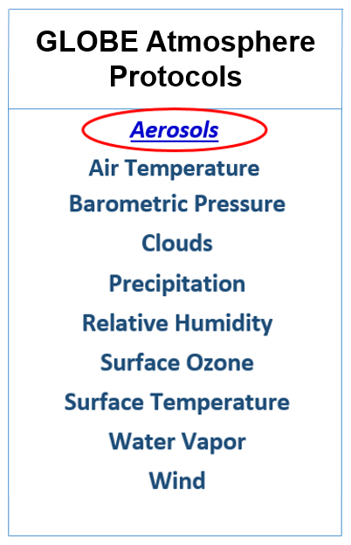
What are Aerosols?
Aerosols are mixtures of liquid or solid particles suspended in a gas, for example, air.
These particles range in size from a fraction of a micrometer (µm, or one millionth of a meter) to a few hundred micrometers.
They are formed by natural processes or as a result of human activity.
Smoke, bacteria, salt, pollen, dust, various pollutants, ice, and tiny droplets of water are all aerosols.
They have mixed effects on the energy balance of the atmosphere.

Slide 5
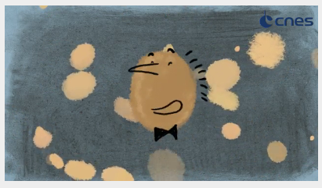
Meet Aero-SOL
This video, produced by the French Space Agency CNES, explains the role of aerosols in Earth’s climate and how scientists make measurements of aerosols from orbiting satellites. Climate Mission: Secrets of Aerosols and Clouds
Click here for a YouTube version of this video that can be closed-captioned.
Click here for a described version of this video.
Notes:
Need to pick just one video

Slide 6
There Are Many Ways to Measure Aerosols And Many Names for Aerosol Data
There are many methods available to determine how much aerosol is present during an observation. Different measurement types use different terminology for aerosols, some of which you may see in other places. Below is a short summary of some common terms.
Term | Explanation
Aerosol | A mixture of solid and liquid particles suspended in air
Aerosol optical depth/thickness (AOT) | The measurement terminology used by GLOBE, explained further in this eTraining
Particulate matter or PM (PM2.5 or PM10) | A term most commonly used for particles collected from air, often in order to study their chemical composition
micrograms per meter cubed (μg/m³) | PM is expressed as concentration, or amount of substance X in a fixed amount of total sample

Slide 7
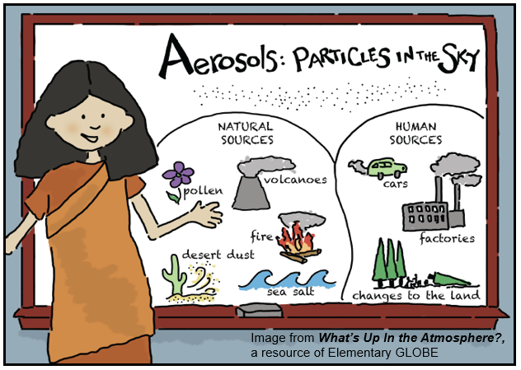
Aerosols: Particles in the Sky
Aerosols come from many different sources. Some are anthropogenic, or human-caused, and some are natural. Various sources emit different sized particles which can alter the effects those aerosols have on planet Earth.

Slide 8
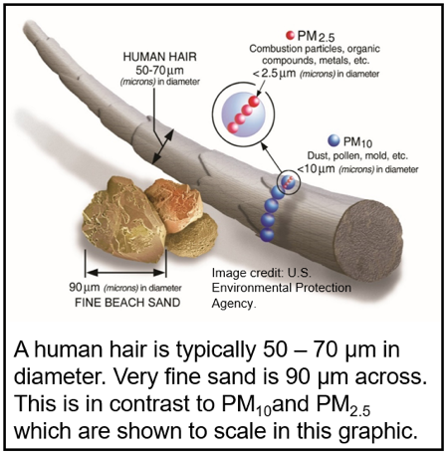
A Closer Look at Particles
The size of a particle gives scientists clues about its origin and composition. Larger particles tend to form when salt, sand, or ash is blown into the air by strong winds. Dust, pollen, and mold all form medium-sized aerosols, while the smallest particles come from combustion processes or chemical reactions.
Particles are sometimes labeled in terms of diameter. PM₁₀ and PM_{2.5} are particles that are smaller than 10 and 2.5 µm across, respectively.
Notes:
Which of the following are aerosols?
Pollen, mold spores
Water vapor, carbon dioxide
Volcanic ash, dust
A and C
Correct answer: D. Water vapor and carbon dioxide are gaseous combustion products, not solid or liquid phase aerosol components. While water vapor can condense or freeze into an aerosol, in its gaseous phase it is not considered an aerosol.

Slide 9
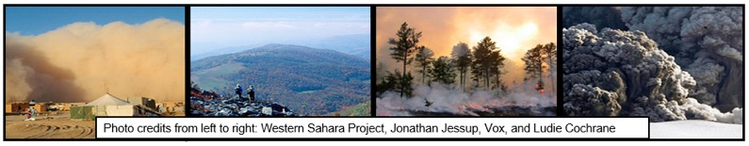
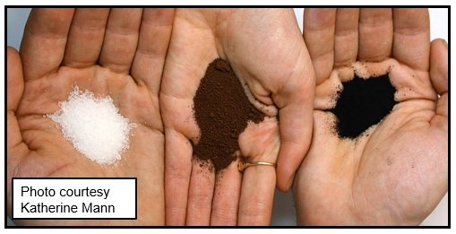
Aerosols Come In Different Sizes
The size of a particle defines how it will interact with different colors of light. Every particle type has a characteristic combination of light interactions that scientists use as “fingerprints” to identify aerosols of various sizes and compositions.
Aerosols come from many sources. Sea salt, dust, and volcanic ash (shown right) tend to form larger particles, while soot and particles formed from chemical reactions are usually much smaller.

Slide 10
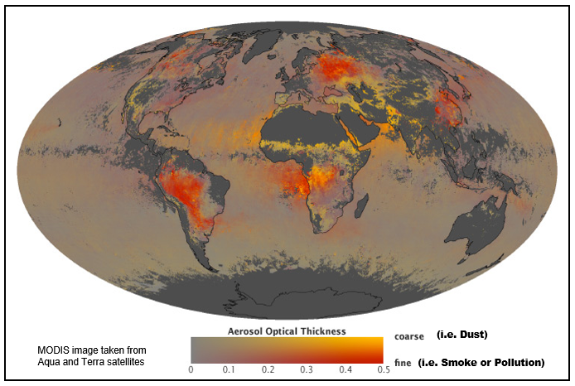
Aerosols From Different Sources Have Different Sizes
This map shows the diversity in particle size as well as the amounts of aerosols across the world as seen from space. Yellow areas have lots of dust or sand, while red areas are indicative of pollution or smoke.

Slide 11
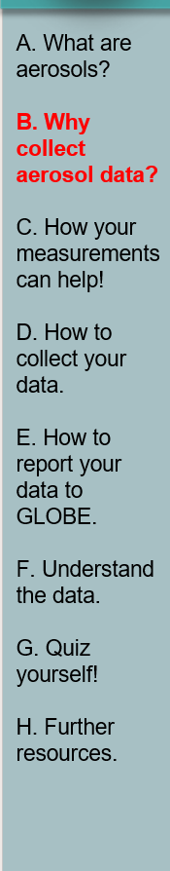
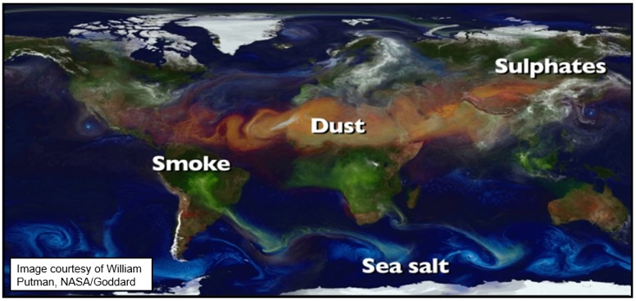
Aerosols Impact Air Quality Across the Globe
Aerosols can form in one part of the world and travel many miles to affect the air quality in distant regions. Regular measurements help scientists make better predictions about the effects these global travelers will have on our health and the health of our environment. This map of Earth shows many types of aerosols emitted across the globe and how what may seem like very local air quality problems can, in fact, travel across the world to have large impacts on far-away places.
Click here for an animated version of this map showing global aerosols from 2005-2007

Slide 12
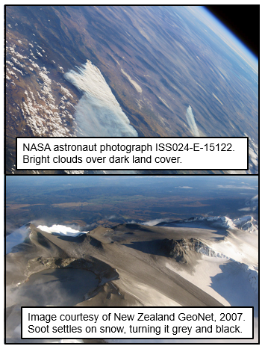
Aerosols Can Affect Climate Directly
By increasing or decreasing the amount of sunlight that reaches the Earth’s surface, aerosols can have direct heating or cooling effects on climate. Some aerosols (top), like light-colored sulfates from volcanoes or human activities, reflect light away from the surface and have a cooling effect. Others (below) can settle onto previously bright areas and cause warming, like black carbon on snow leading to increasing melting.
See here for more information on how dark-colored aerosols can influence snow melt.

Slide 13
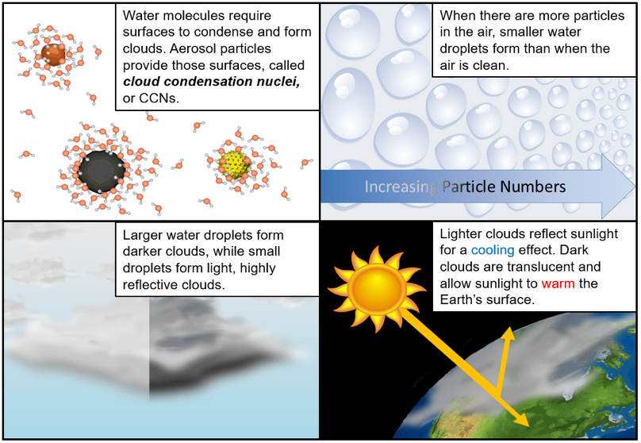
Aerosols Influence Earth’s Climate Through Clouds

Slide 14
Aerosols Influence Many Things On Earth, But We Still Have Lots of Questions
How do aerosol concentrations vary with seasons?
How are aerosols related to weather and climate?
How does smoke from large fires affect sky color and clarity?
How long do volcanic emissions stay in the atmosphere, and where do they go?
How do industrial facilities and agricultural activities affect aerosols?
Scientists around the world collect data to answer these and many other questions about aerosols and their effects on our global environment.

Slide 15
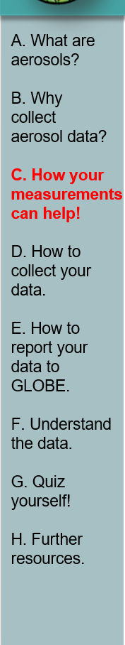
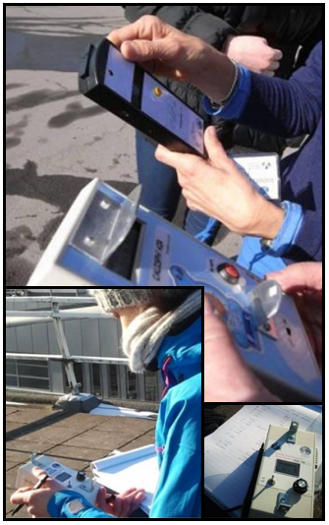
GLOBE Measurements Help Scientists:
Your observations are valuable contributions to the scientific community and may be used by educators, students, researchers, and the general public to increase environmental awareness and STEM literacy, as well as advance Earth system science.

Slide 16
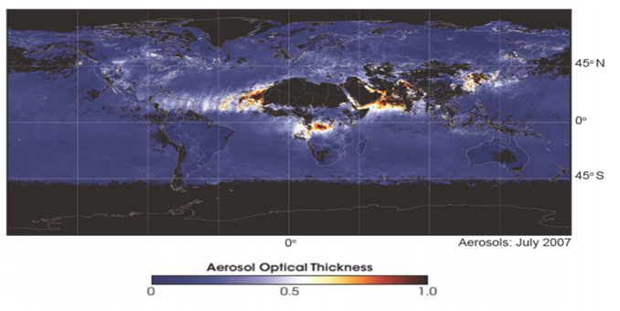
Scientists Quantify Aerosols Using Measurements of Aerosol Optical Thickness
Aerosol Optical Thickness (AOT, also called aerosol optical depth) is a measure of how much of the Sun’s light is prevented from reaching the Earth’s surface due to scattering and absorption by aerosols.
This map (and more like it) shows measurements of aerosol optical thickness as seen from space. Clear skies usually have low AOT values (0.1 or lower) while regions with AOT values greater than 0.3 are often experiencing an aerosol event such as a wildfire, a dust storm, or a pollution event. Note that AOT values greater than 1, while not shown here, are possible.

Slide 17
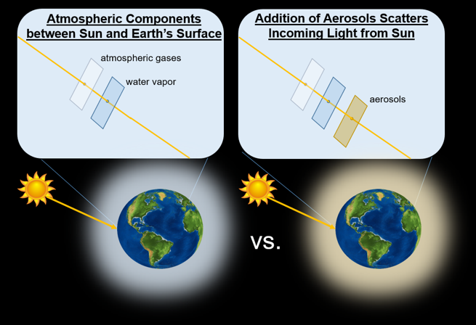
What is Aerosol Optical Thickness?
Aerosol optical thickness is a comparison of the amount of light from the Sun that could reach the Earth’s surface if no aerosols were in the way and the amount of sunlight actually measured from your atmospheric study site.

Slide 18
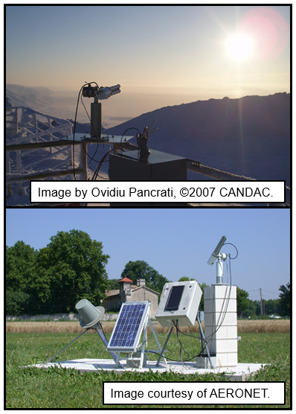
We Measure AOT from the Ground
Sun photometers like those shown on the right measure AOT from the ground looking upwards, towards the Sun. These instruments measure AOT at several wavelengths to learn about the size distribution and sources of the aerosols. The larger the optical thickness, the less light reaches Earth’s surface. The more aerosols in the atmosphere, the greater the AOT value will be.
More aerosol ↔ Higher AOT
↕ ↕
Less light at the surface

Slide 19
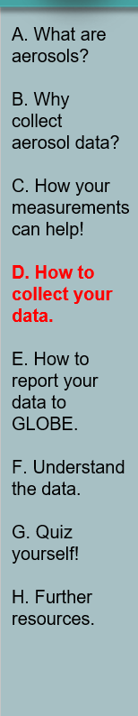
Before You Begin the Aerosols Protocol
Before you begin taking Aerosol observations, you will need to have already identified your Atmosphere Study Site. In order to submit aerosol measurements, you must also collect Clouds and Barometric Pressure observations. Please review these protocols first.

Slide 20
How to Collect: Overview
Where? At your Atmosphere Site (see Documenting Your Atmosphere Study Site)
When? Mid-morning, or any time you have an unobstructed view of the Sun (meaning no clouds between you and the Sun!)
How? Using GLOBE Sun photometer or a Calitoo
  Shade or Microtops instruments are not covered in this training
Other observations:
  Clouds (required for all aerosol measurements)
  Barometric Pressure (required if using a GLOBE Sun photometer)
  Sky Color & Visibility (optional)
  Current Air Temperature (optional)
  Relative Humidity (optional)

Slide 21
What You Will Need
Required:
GLOBE Sun photometer OR a Calitoo
Watch, smart device, GPS, or other instrument that reports time to the second (recorded as HH:MM:SS)
Aerosols Data Sheet
GLOBE Cloud Chart
Field guides for cloud cover and cloud type
Pen or pencil
Clipboards
Optional:
Barometer**
Hygrometer or sling psychrometer
Thermometer for air temperature
Field guides for barometric pressure, relative humidity (digital hygrometer or sling psychrometer), and air temperature
** Pressure may also be obtained from local weather station, but we do not recommend using the built-in sensor on the Calitoo.

Slide 22
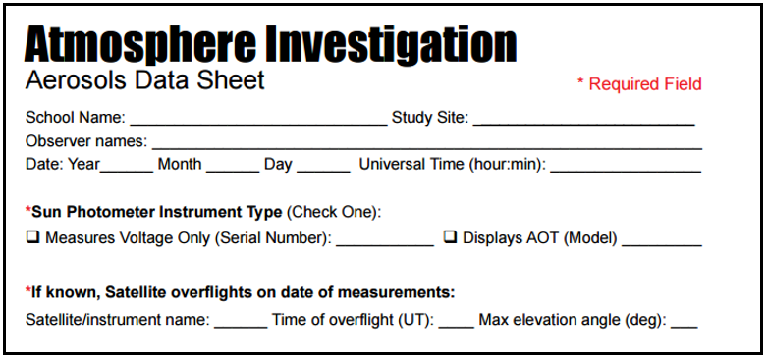
Be Sure to Record Everything About Your Study Site to Make Your Data Count!
Without this critical information about your atmosphere study site, you won’t be able to enter your data into GLOBE. You also won’t be able to calculate accurate AOT values or compare them against future measurements. Experimental context is vital for scientific discovery!

Slide 23
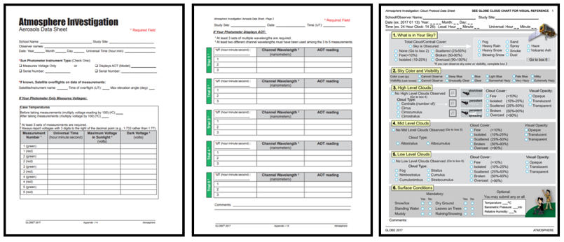
Complete the Entire Protocol for the
Most Investigation Opportunities

Slide 24
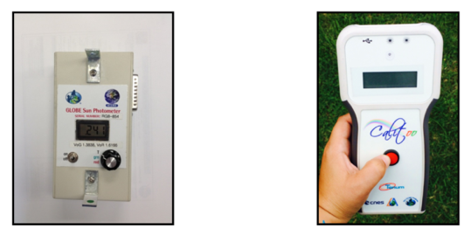
Instrument Options
GLOBE Sun Photometer | Calitoo Photometer
Reads voltage at 2 wavelengths | Reads AOT at 3 wavelengths
--- | “blue” at 465 nm
“green” at 505nm | “green” at 540 nm
“red” at 625 nm | “red” at 619 nm
Click HERE for a video on using the GLOBE Sun Photometer | Click HERE for instructions on using the Calitoo

Slide 25
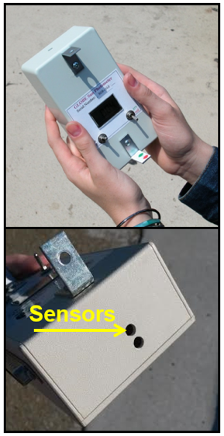
Using a GLOBE Sun Photometer (1)
This instrument records voltage. The GLOBE website calculates AOT values. Your GLOBE Sun photometer will collect the following data:
Voltage at red and green wavelengths
Voltages with sensors shielded from the Sun (the “dark voltages”)
Instrument temperature before and after you begin your measurements
You must also collect the following information:
Date and time
Instrument serial number
Barometric pressure at your site
Cloud cover and cloud type
You may collect:
Current air temperature
Sky color and visibility

Slide 26
Using a GLOBE Sun Photometer (2)
Turn on the instrument.
Turn the measurement dial to temperature “T” and record the initial temperature.
Turn the dial to green or “grn.”
Point the top of the photometer at the Sun. Align the light dot coming through the top tab of the photometer with the target dot on the bottom tab.
Cover the light sensors completely and record the maximum voltage for the “dark voltage.”
Uncover the sensors and record the maximum voltage.
Turn the measurement dial to red.
Repeat steps 5 and 6 for the red voltage.
Repeat steps 2-8 at least three times.
Turn the measurement dial to temperature “T” and record the end temperature.

Slide 27
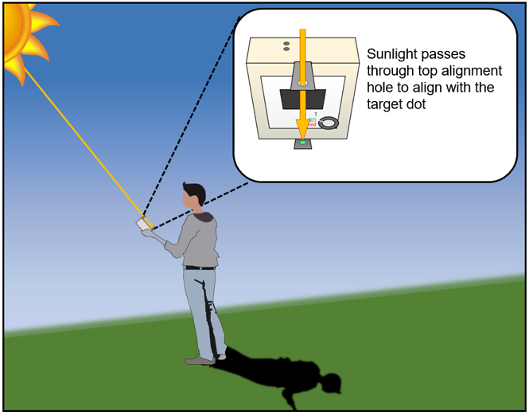
Using a GLOBE Sun Photometer (3)
Aligning with the Sun

Slide 28
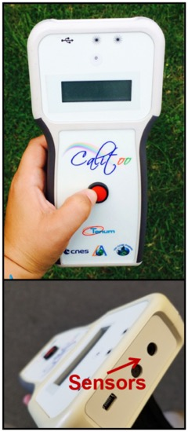
Using a Calitoo (1)
This instrument records AOT. Your Calitoo will collect the following data:
AOT at red, green, and blue wavelengths
GPS location and elevation
You must also collect the following information:
Date and time
Instrument serial number
Cloud cover and cloud type
You may collect:
Current air temperature*
Sky color and visibility
Barometric pressure at your site*
* Do not use the Calitoo for these measurements. It does not provide accurate measurements of its surroundings.

Slide 29
Using a Calitoo (2)
Turn the instrument on by pressing and holding the front button down.
Wait until the GPS signal is found. The screen will show “>>” or “<<“ when searching and “3D” when the location is locked.
Make sure the instrument is in the measuring mode.
Point the top of the Calitoo directly at the Sun. Align the Sun dot on the front of the instrument with the center of the target.
Keeping the Sun dot aligned, press the button on the front of the instrument. The values on the screen will fluctuate.
When the values are maximized, press the button again. The screen will display the AOT values you just measured.
Press the button again*. The screen will say “Recording #/999 OK?” where # is the number of measurements saved on the Calitoo including this new one.
To store the data, hold the button down until the screen says “Recorded!”
Repeat steps 3-8 at least twice more.
* You will want to practice with this instrument before taking measurements. The length of time required for each button press varies slightly for different instruments. Make sure the messages on the screen match those in the instructions and consult the additional documentation if you encounter problems.

Slide 30
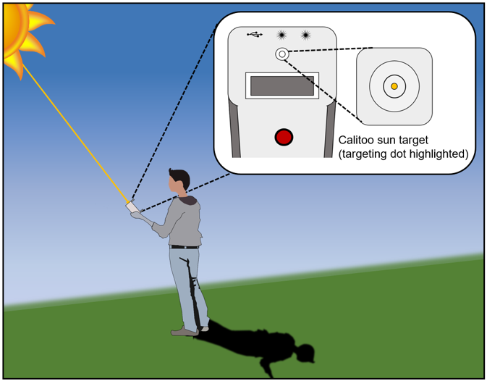
Using a Calitoo (3)
Aligning with the Sun

Slide 31
Common AOT Measurement Mistakes
The Sun photometer must be aligned correctly with the Sun to make accurate measurements. Follow the instructions for aligning your photometer carefully, and refer to the additional, instrument specific eTraining modules if you encounter difficulties.
NO CLOUDS MAY OBSTRUCT THE LINE OF SIGHT (NO CLOUDS IN FRONT OF THE SUN) FOR YOUR MEASUREMENT! Clouds will cause artificially high AOT values.
Keep the instruments indoors until right before you are ready to make a measurement. Don’t let your Sun photometer get too cold or too hot– large changes in temperature can cause the instruments to report inaccurate measurements.
Record your measurements both on the instrument (if applicable) and on paper or another medium; it is easy to lose data from an instrument and having a backup record will prevent losing entire measurements.

Slide 32
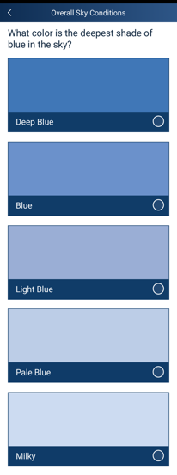
Sky Color and Visibility Observations Give Your Data Context
Sky color is a visual indication of the quantity of aerosols in the atmosphere. Aerosols tend to scatter all wavelengths of light, making the sky look more white. A deep blue sky suggests very few aerosols. A milky sky suggests there are lots of aerosols.
Note: Sky color can only be observed from a clear section of sky, with no clouds in view.
How to observe sky color:
Turn your back to the Sun.
Look at the sky halfway between the horizon and straight up (45°).
Pick the shade that most closely matches your sky.
You want to match the color of the sky, not the clouds, so if it’s too cloudy you may not to be able to observe sky color.

Slide 33
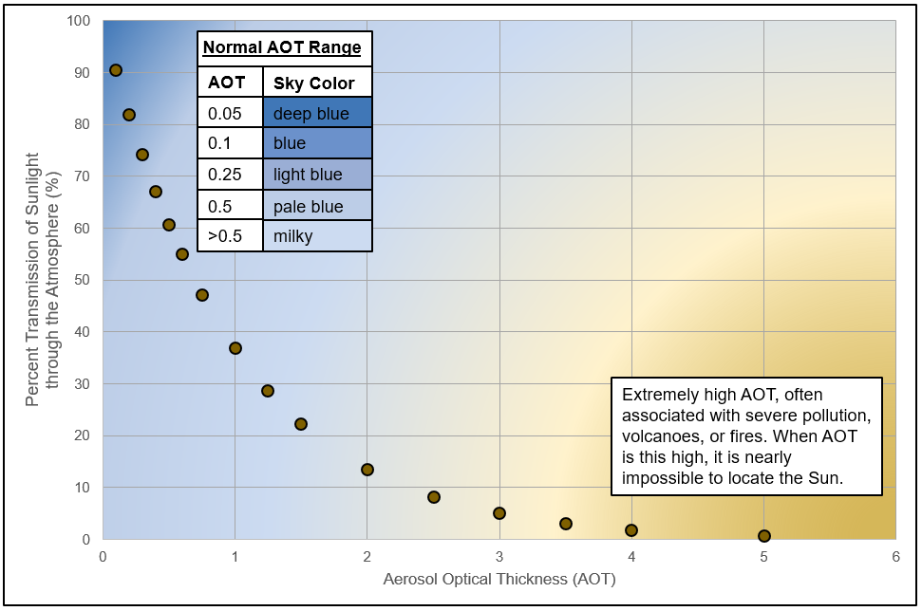
As AOT Increases, the Amount of Light Reaching Earth’s Surface Directly Decreases Rapidly, Going to Near Zero in Severe Pollution Events

Slide 34
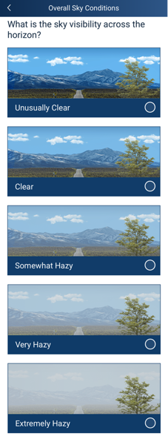
Sky Color and Visibility Observations Give Your Data Context
Sky visibility is an indication of the quantity of the aerosols close to the surface of the ground. The more aerosols there are, the more haze will appear. For more information on sky color and visibility, please consult the Clouds Protocol.
How to observe visibility:
Look at a landmark in the distance.
Try to use the same landmark every time.
Tip: It can be helpful to take a picture of your sky day-to-day to notice the difference between visibility observations. In addition, the clearest sky for your area will be seen just after a front or a storm moves through your area.

Slide 35
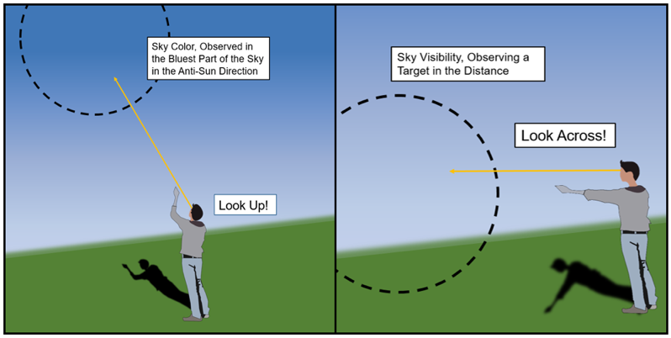
How to Observe: Sky Conditions
Here’s a good reminder for the difference between observing sky color and sky visibility, and where to look as you observe each.

Slide 36
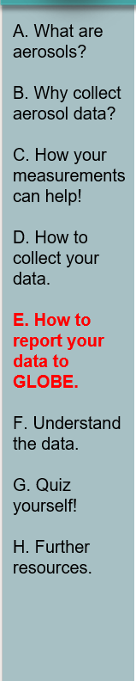

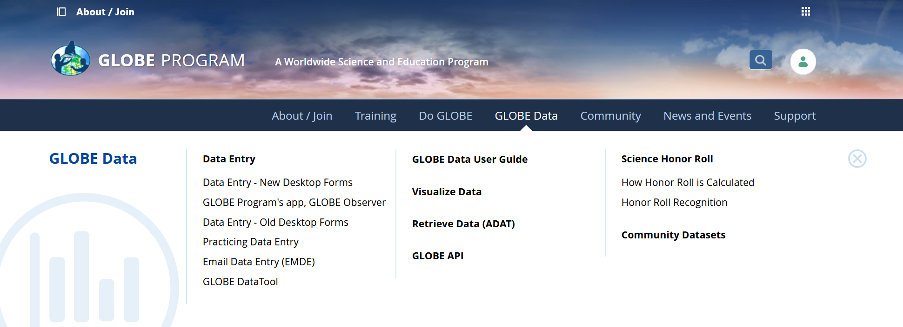
Entering Aerosol Data in the GLOBE Observer Data Entry System
Two Options for Uploading Data:
These methods all allow users to submit environmental data – collected at defined sites, according to protocol, and using approved instrumentation – for entry into the official GLOBE science database.
Download the GLOBE Observer mobile app from the App Store.
Data Entry: Visit globe.gov, click on the “GLOBE Data” tab, then underneath “Data Entry” click on “Data Entry – New Desktop Forms”.
Note 1: You will need a GLOBE teacher, trainer, or scientist account to submit GLOBE data.
Note 2: It may take some time after you enter your data for it to appear in the GLOBE data visualization system.

Slide 37
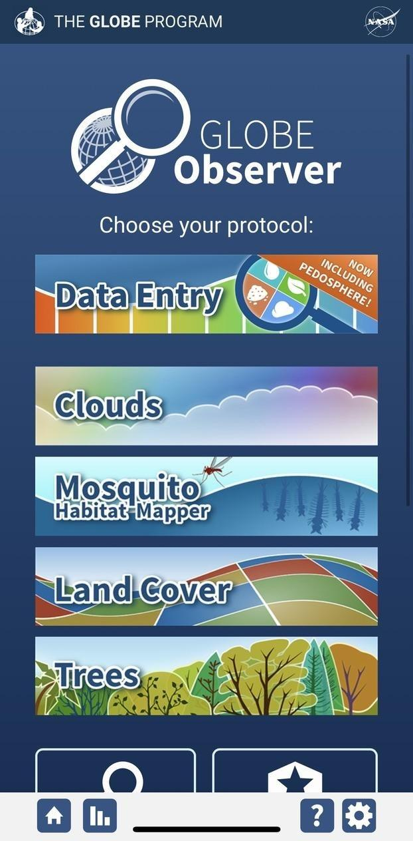
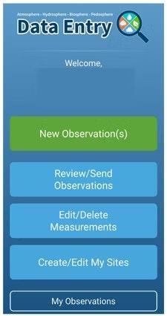
The steps below will walk you through entering your Atmosphere Study Site Information in the GLOBE Observer App, which you can access using your GLOBE or GLOBE Observer login.
2. Click "Create/Edit My Sites"
1. Click “Data Entry”

Slide 38
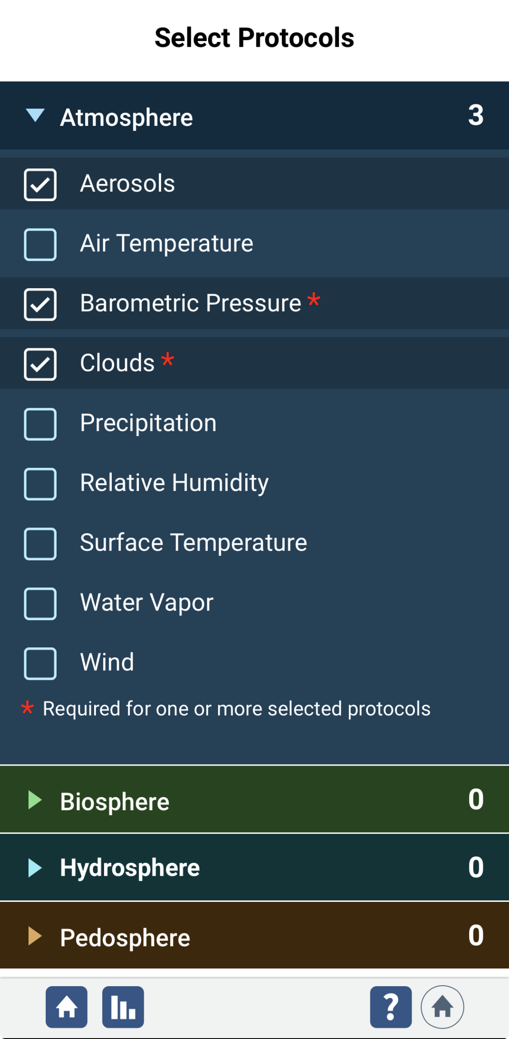
3. Click on the arrow next to "Atmosphere" and select “Aerosols“. The other necessary protocols will be automatically selected.

Slide 39
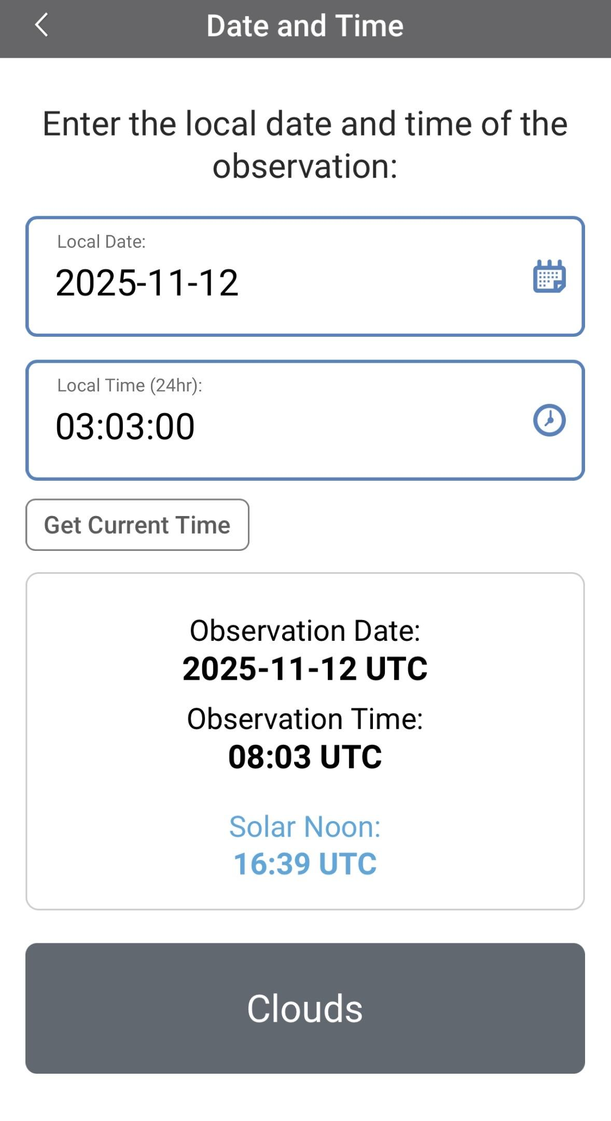
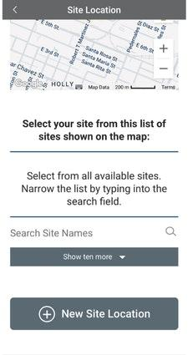
4. At the bottom of the screen, click “Continue”. When prompted, enter site location details (latitude, longitude, and elevation). Choose an existing site or identify a new site by clicking “+ New Site Location”
5. Check to see if the “Date and Time” are correct, if it is not, click
“Get Current Time” to update it. Then click “Clouds” to move on

Slide 40
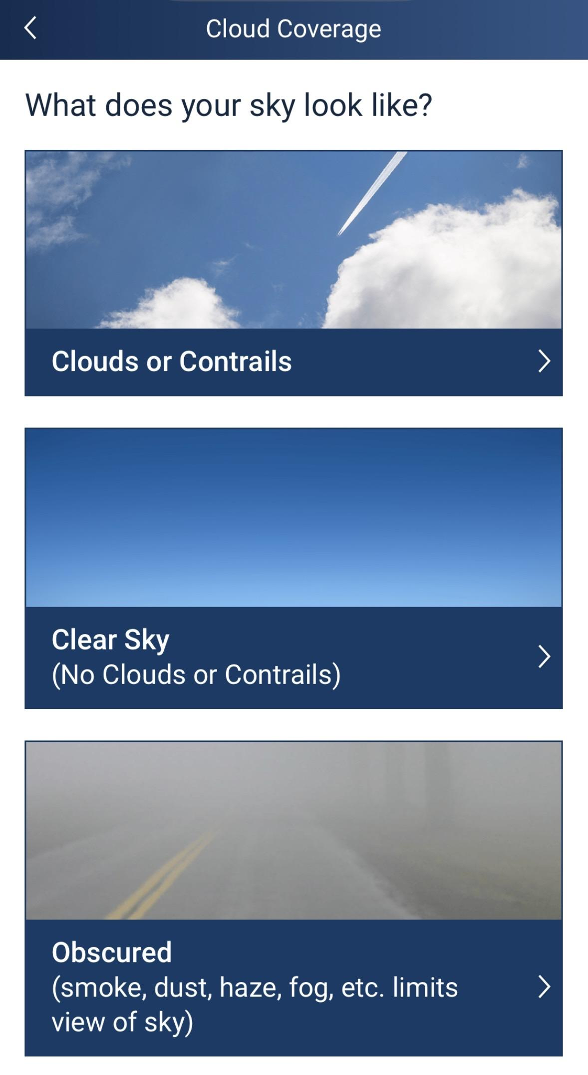
6. Click the “Cloud Coverage” level that best describes your current observation

Slide 41
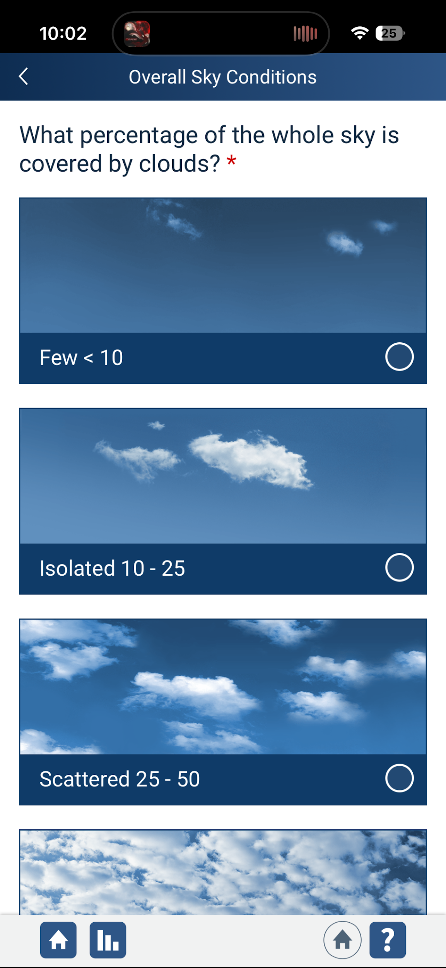
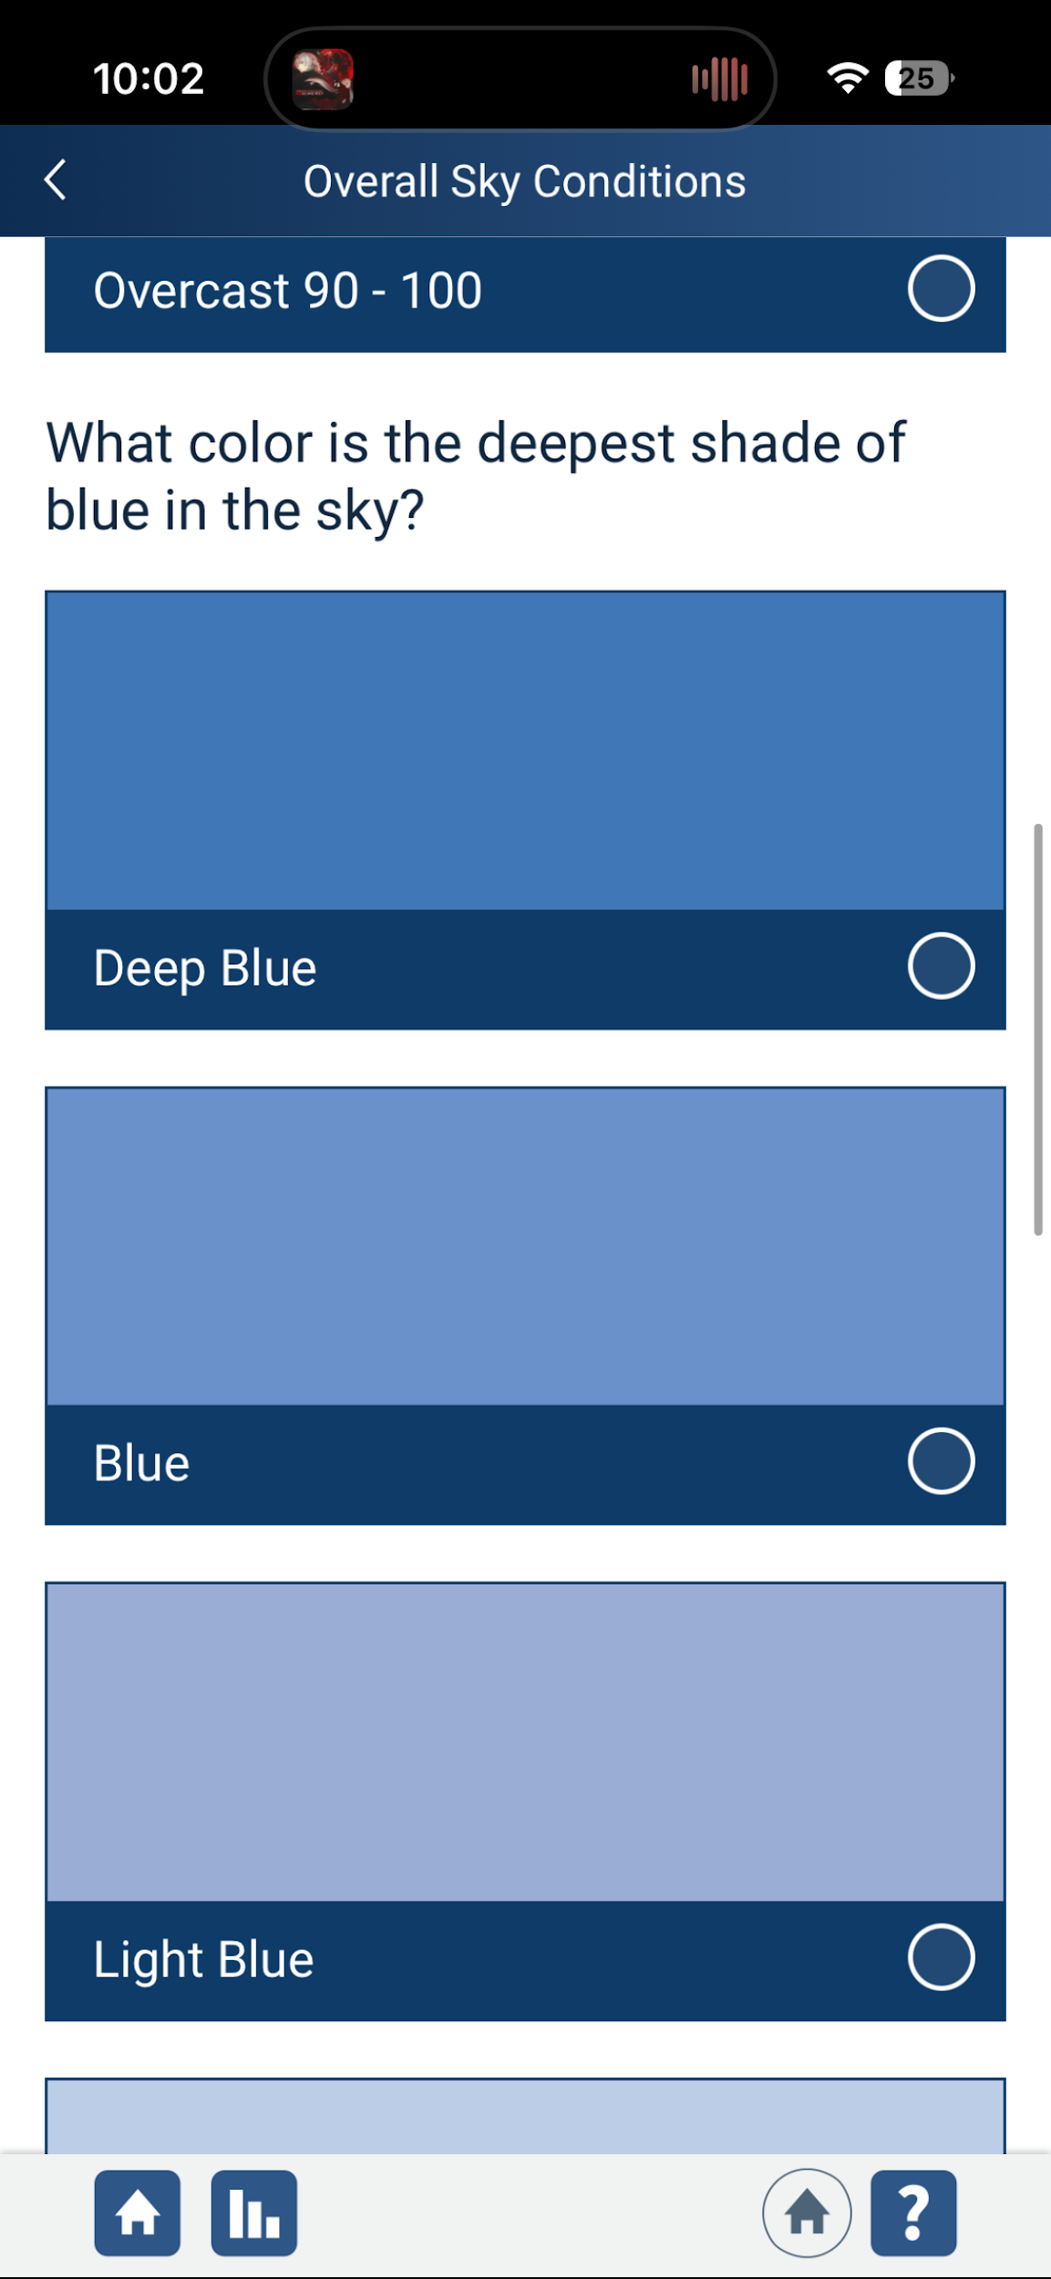
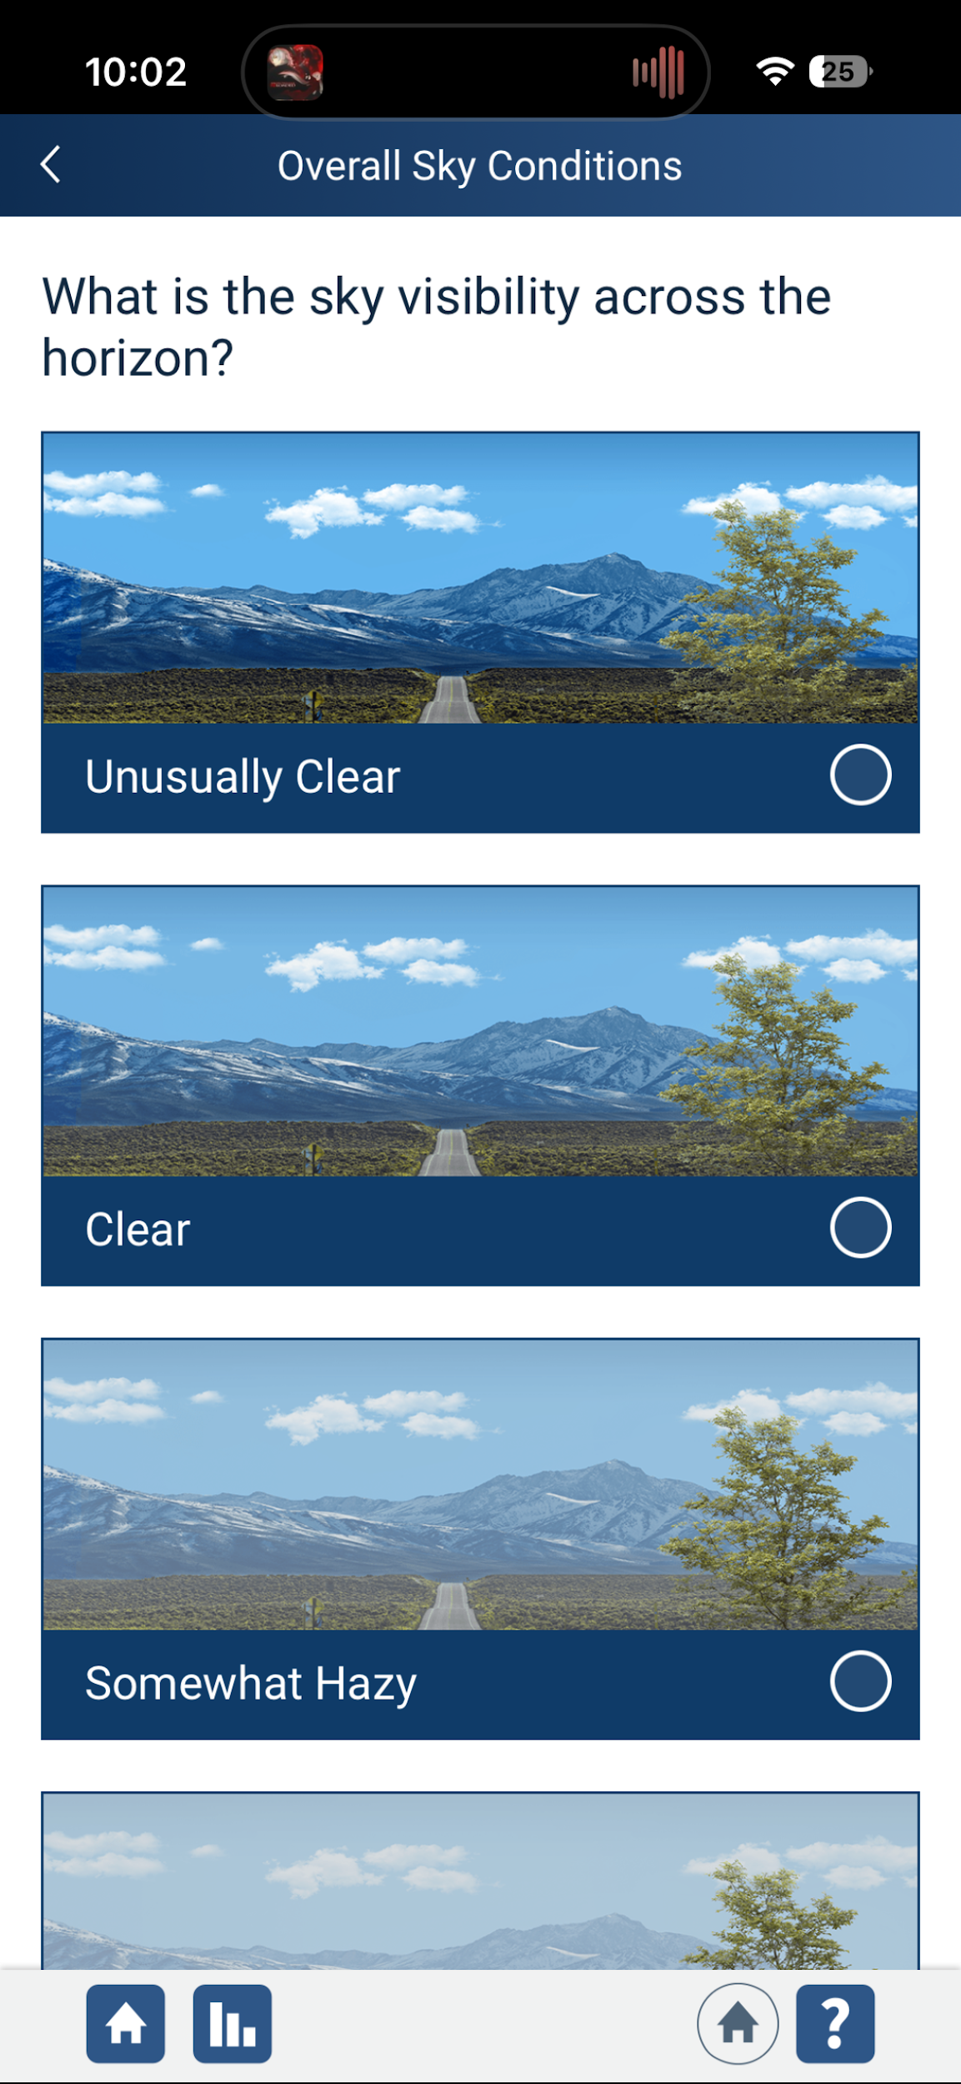
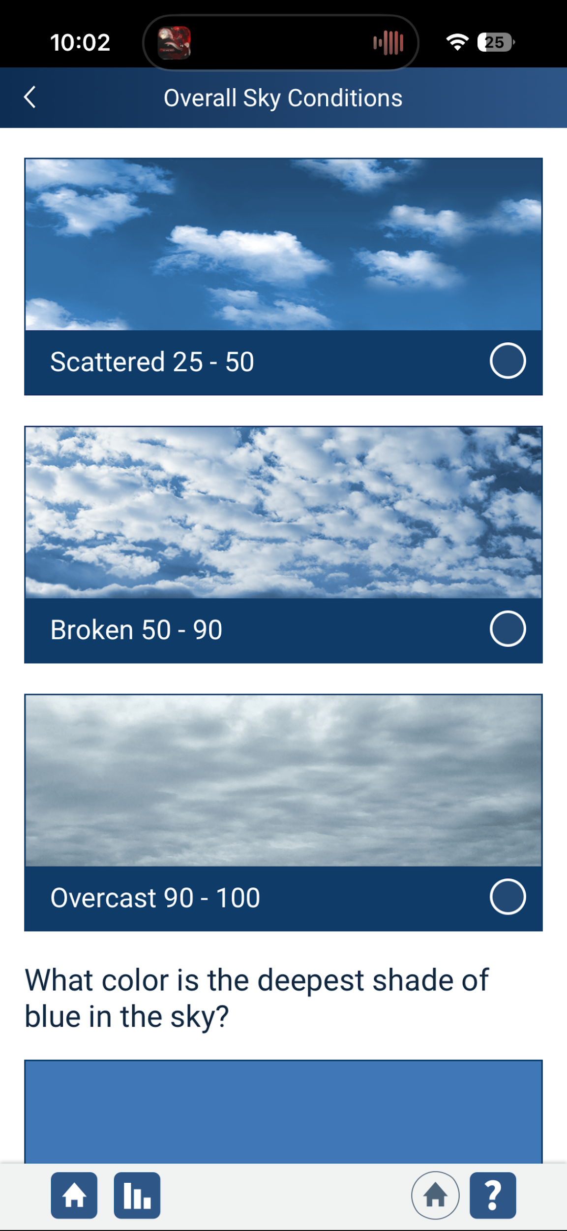
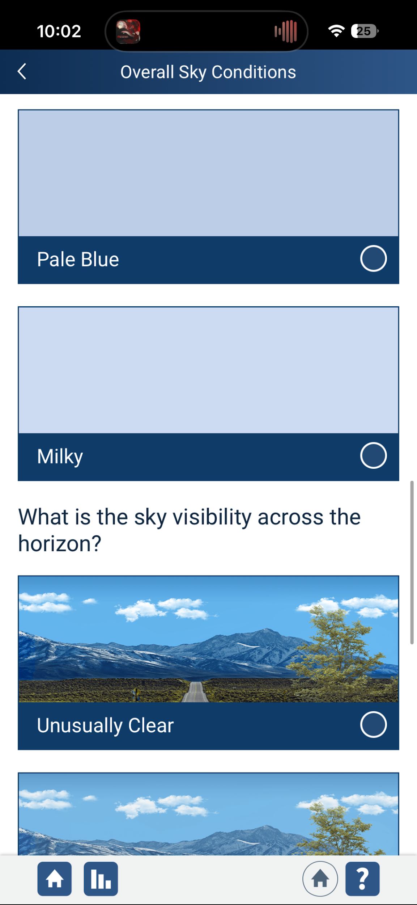
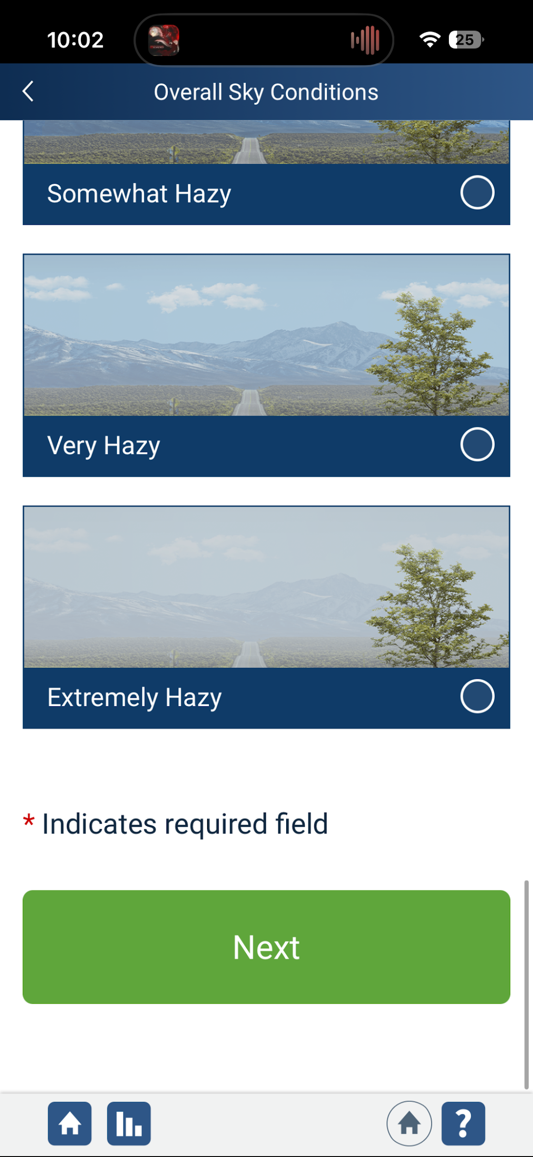
7a. Click on the “Overall Sky Conditions” options that best describe your current “Cloud Coverage”. There will be multiple sections to scroll through and select choices in. Below are the options that appear if you selected “Clouds or Contrails” before

Slide 42
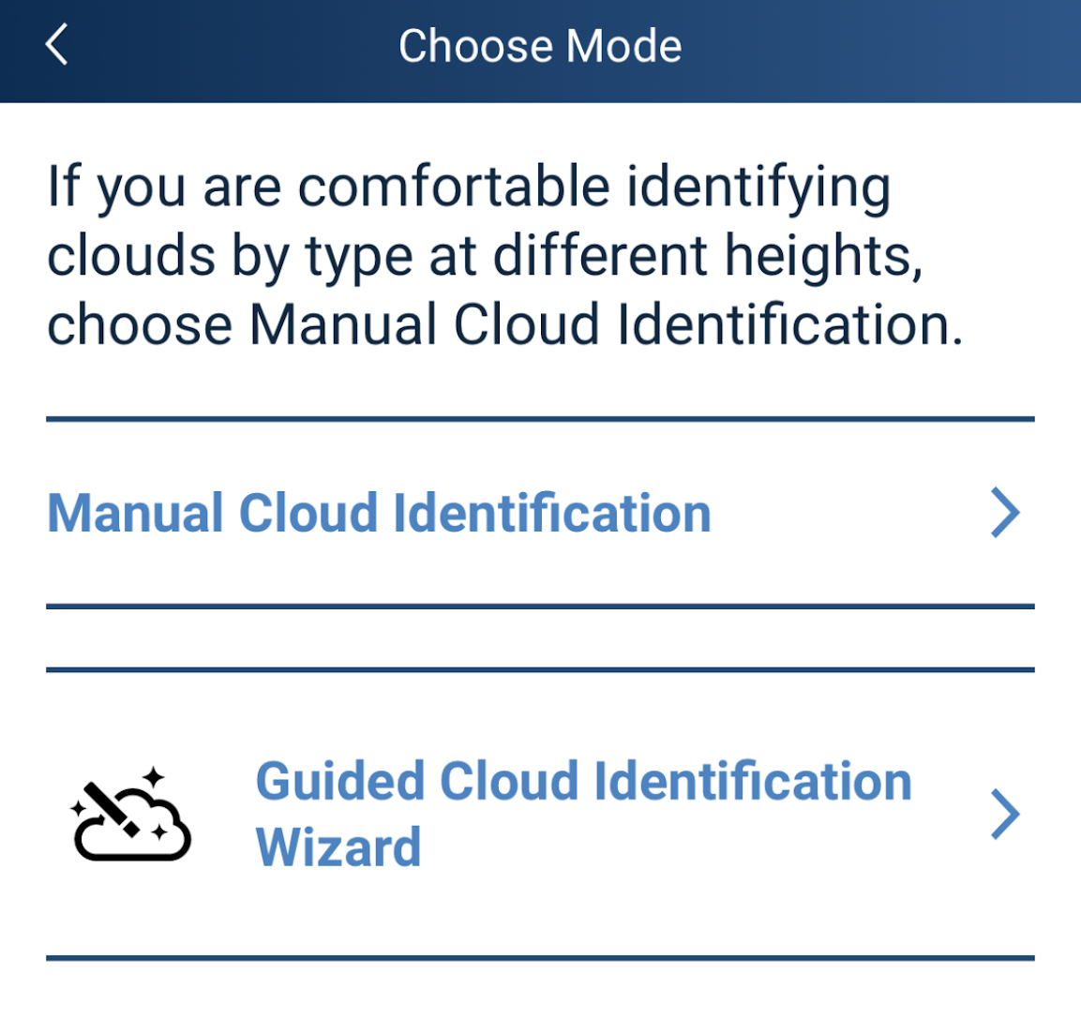
7a.i “Clouds or Contrails” continued: After selecting “Overall Sky Conditions” you will see a screen asking you identify the cloud types. If you already know how to identify clouds, you may proceed to “Manual Cloud Identification”, otherwise, click on “Guided Cloud Identification Wizard” for a briefing on cloud identification

Slide 43
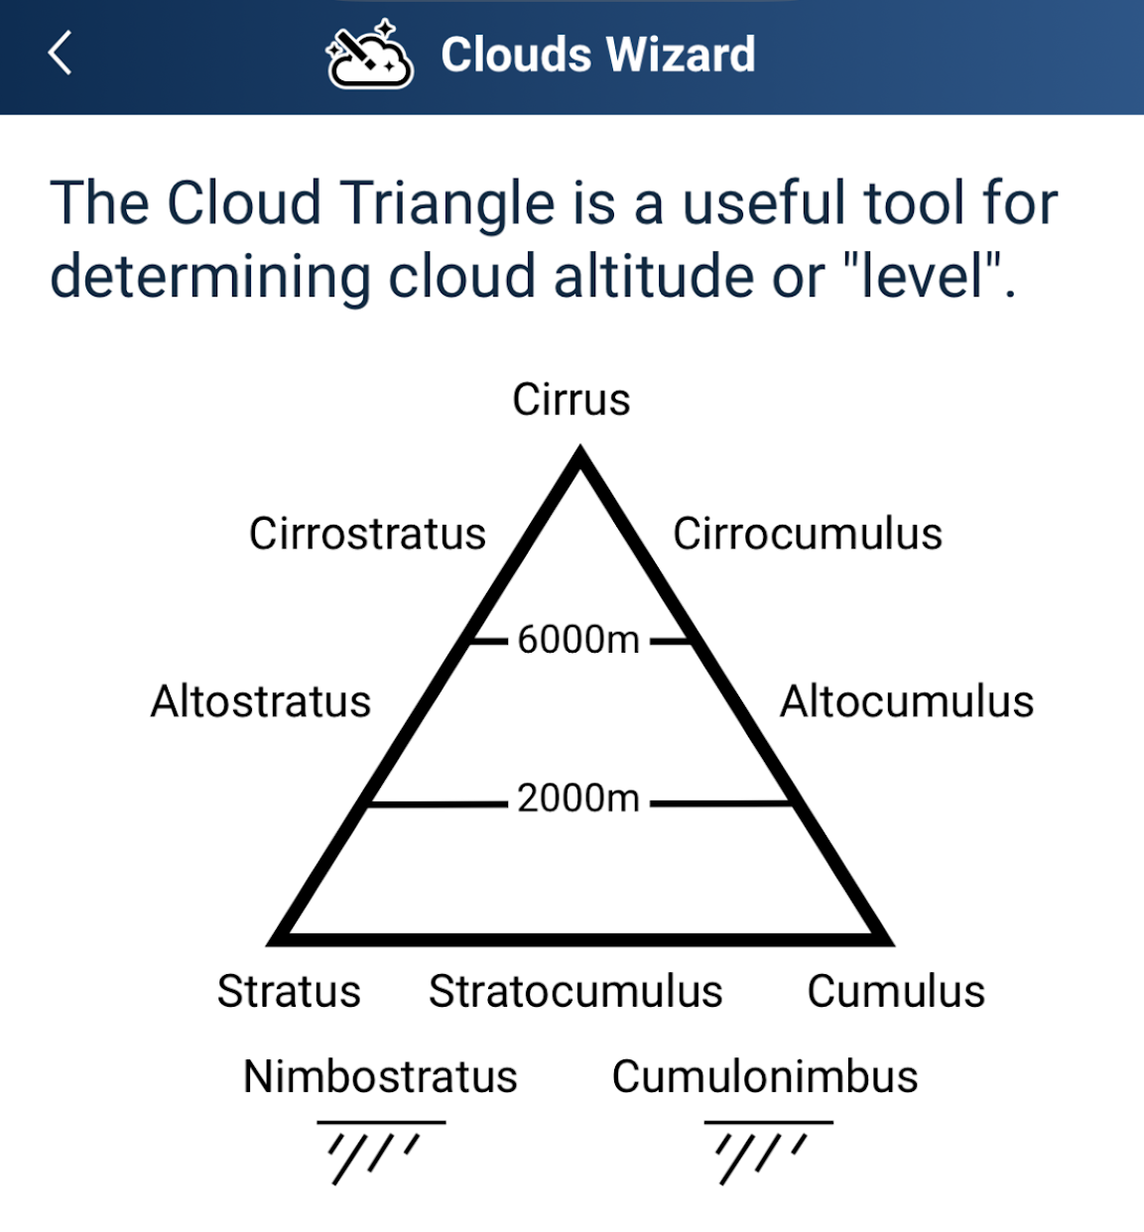
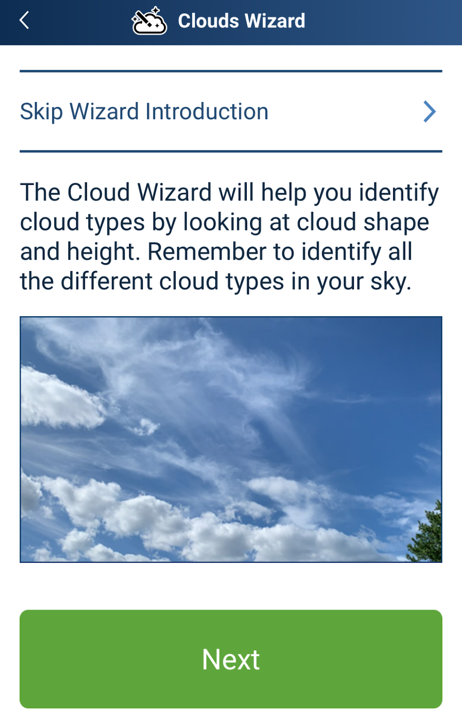
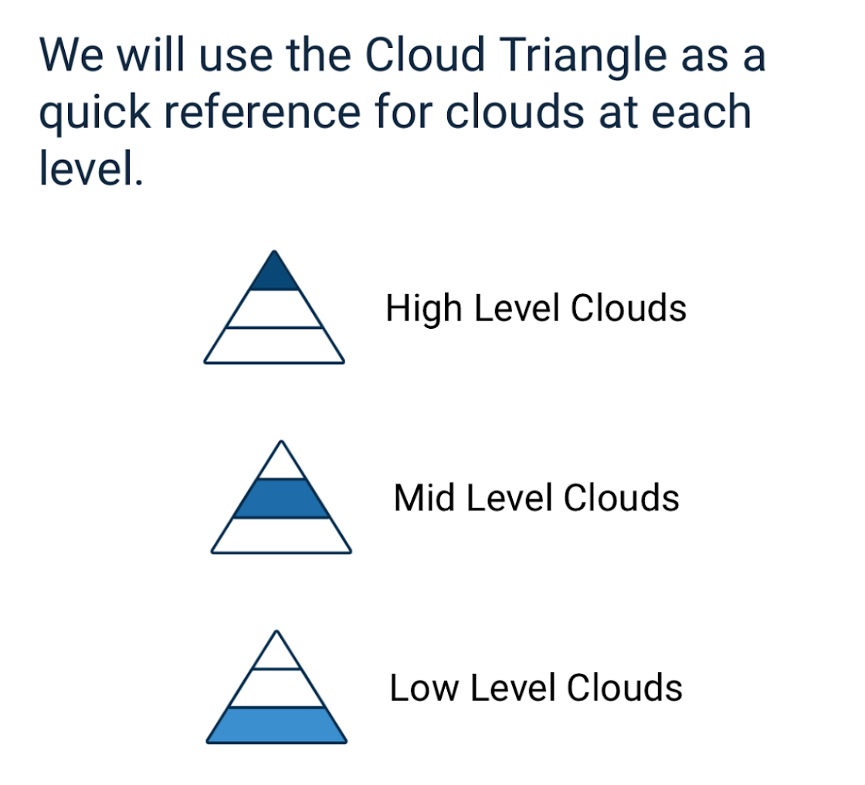
7a.i “Clouds or Contrails” continued: The Guided Cloud Identification Wizard will remind you identify all the different cloud types before showing you the “Cloud Triangle that you will reference to determine cloud height. It also shows the types of clouds likely to appear at certain altitudes.

Slide 44
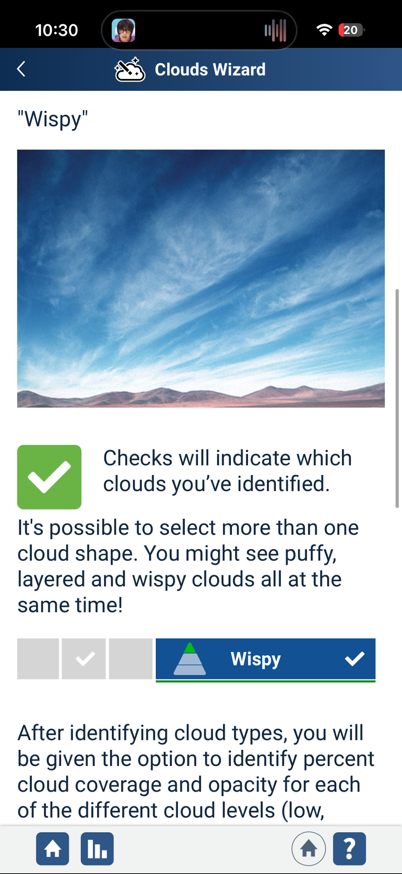


7a.i “Clouds or Contrails” continued: The Guided Cloud Identification Wizard will list the way to identify clouds based on how they look. You can select multiple cloud shapes. Afterwards, you will be given the option to identify cloud coverage and opacity for each of the different levels of the Cloud Triangle by pressing “Observe”. This is not necessary to move forward with submitting the observation

Slide 45


7a.i “Clouds or Contrails” continued: To identify cloud coverage and opacity percentage, you must press and move the arrows to change the percentages. The images will give you a visual sense of what the percentage ranges represent. When you’re done, send your data to GLOBE!

Slide 46


7a.ii “Clouds or Contrails” continued: After completing the Guided Cloud Identification Wizard, you will have to select the number and type of contrails you observe.

Slide 47


7a.ii “Clouds or Contrails” continued: Please select either “No” or “Yes” depending on if the cloud’s appearance matches the one being described for rain clouds.

Slide 48



7a.ii “Clouds or Contrails” continued: Please select either “No” or “Yes” depending on if the cloud’s appearance matches the one being described for puffy clouds.

Slide 49



7a.ii “Clouds or Contrails” continued: Please select either “No” or “Yes” depending on if the cloud’s appearance matches the one being described for layered clouds.

Slide 50


7a.ii “Clouds or Contrails” continued: Please select either “No” or “Yes” depending on if the cloud’s appearance matches the one being described for wispy clouds. After this, you will have completed the cloud identification and will be taken to a review of your identified clouds.

Slide 51




7a.ii “Clouds or Contrails” continued: After completing the visual identification, you will be asked to observe Cloud Cover and Visual Opacity. After learning how to observe both, you will be instructed to make observations for the clouds that you identified previously.

Slide 52
7b. Click on the “Overall Sky Conditions” options that best describe your current “Cloud Coverage”. There will be multiple sections to scroll through and select choices in. Below are the options that appear if you selected “Clear Sky” before

Slide 53




7c. Click on the “Overall Sky Conditions” options that best describe your current “Cloud Coverage”. There will one section with multiple sections. Below are the options that appear if you selected “Obscured” before

Slide 54


8. After completing your observations of clouds, select “Yes” or “No” on the various available surface conditions that appear during your observation. At the bottom, click the “Next” button to move on

Slide 55


11. If your photometer measures AOT directly, click “Yes” and select your photometer model (Either Shade, Calitoo, or Other). If it doesn’t, click “No” and enter your photometer serial number. After, click “Check Photometer” at the bottom

Slide 56


12. If you have information on a satellite overflight occurring during your observation date, click “Yes” and enter satellite/instrument name, the overflight time, and the maximum elevation angle. Otherwise, click “No” and proceed to enter the wavelength and AOT readings for your trials/samples. At the bottom, click the “Barometric Pressure” button when finished
13. Enter Barometric Pressure type and measurement details. Then click “Review” to view your observation summary, and then click “Finish” to submit the observation

Slide 57


Visualize and Retrieve Data
GLOBE provides the ability to view and interact with data measured across the world. Select our visualization tool to map, graph, filter and export data that have been measured across GLOBE protocols since 1995.
These step-by-step tutorials on using the visualization system will assist you in finding and analyzing data: PDF version PowerPoint version
http://vis.globe.gov/GLOBE/

Slide 58

Visualize and Retrieve Data
Select the date for which you need data, add the protocol layers, and you can see where data is available.

Slide 59

Measurement Tips
You will be able to tell when a cloud moves across the Sun, interrupting your measurement. There will be a sudden, sometimes dramatic change in your raw signal, even if the cloud is a very thin cirrus cloud that is difficult to see with your eyes.
  When using a GLOBE Sun photometer, the voltage will decrease (AOT calculated on the GLOBE site would go up).
  When using a Calitoo, the raw signal displayed during measurement will decrease, which will be translated by the instrument as a higher AOT value once the measurement is finalized.

Slide 60

Graphing Your Measurements
If you make measurements throughout the day, you can observe how aerosol concentrations change.
These measurements were made with a GLOBE Sun photometer. The green and red markers correspond to the two measurement wavelengths available on a GLOBE Sun photometer.

Slide 61

By Graphing Your Measurements
You Might Observe Major Aerosol Plumes
In June of 2015, a series of wildfires in the plains of Canada sent huge plumes of smoke east over the Midwest and East coastal regions of the United States. These fires burned for weeks, sending “rivers of smoke” across the continent. Scientists could even see the smoke from space!

Slide 62

By Graphing Your Measurements
You Might Observe Major Aerosol Plumes (1)
Thousands of kilometers away at NASA Langley, GLOBE scientists measuring aerosols using a Sun photometer saw substantially increased AOT values. They also observed that the sky was extremely hazy and milky in color– air pollution in action!

Slide 63

By Graphing Your Measurements
You Might Observe Major Aerosol Plumes (2)
When scientists compared their Sun photometer AOT measurements with AOT taken from satellites, they saw that the smoke plume was in fact the cause of the elevated readings!

Slide 64

Aerosols: Local Phenomena, Global Impact
Aerosols come from many sources, both natural and man-made, and have an important role to play in global climate, air quality, and environmental health. GLOBE aerosol measurements help scientists learn more about the origins of particles in our atmosphere as well as determine where these global travelers go before falling back to the Earth’s surface.
By participating in GLOBE aerosol measurement studies, you are helping to tell the stories of local atmospheric phenomena that can have global impacts. You are helping scientists find answers to the question: what is up in the atmosphere?

Slide 65

Quiz Questions
Challenge yourself to answer these questions and check whether you have achieved the learning objectives of this module.
What are aerosols?
What processes contribute to the formation of aerosols?
What is aerosol optical thickness (AOT) and how does it relate to the quantity of aerosols in the atmosphere?
What parameters measured in other GLOBE protocols are important to consider when making aerosol measurements?
What kinds of effects do aerosols have on global climate?
What kinds of effects do aerosols have on local atmospheric phenomena?
How do different aerosols affect cloud formation?

Slide 66

GLOBE Learning Activities & Resources
The following activities will help you become familiar with the GLOBE Atmosphere materials and the GLOBE data visualization platform.
Atmosphere Learning Activities Introduction
Observing Visibility and Sky Color
Calculating Relative Air Mass
Making a Sundial
Draw Your Own Visualization
Learning to Use Visualizations - An Example with Elevation and Temperature
Questions about this module? Contact GLOBE: help@nasaglobe.gov
Notes:
Keep something about understanding data???

Slide 67
Credits
Slides:
Virginia (Jill) Teige, NASA Langley Research Center, USA.
Dr. Margaret Pippin, NASA Langley Research Center, USA.
Jessica Taylor, NASA Langley Research Center, USA.
Images:
NASA Langley Research Center, USA, unless otherwise noted.
More Information:
GLOBE Program
Version 11/12/2025. If you edit and modify this slides set for use for educational purposes, please note “modified by (and your name and date)” on this page. Thank you.
Modified by GLOBE Implementation Office – Science, Training, Education and Public Engagement

