Slide 1

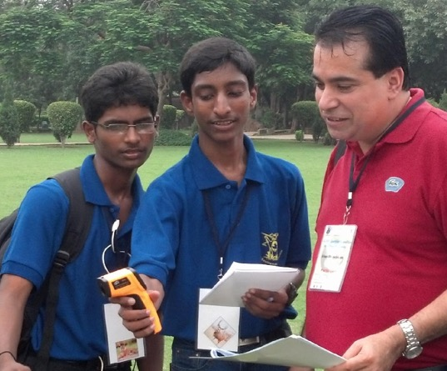
Protocol Training Slides for
Surface Temperature
Photo credit: Kevin Czajkowski

Slide 2
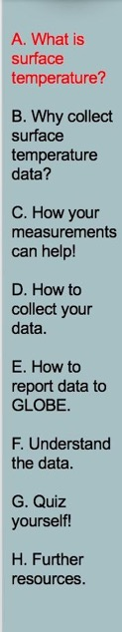
Overview and Learning Objectives
Overview
This module:
Describes how to take surface temperature measurements
Provides instructions on how to enter your data on the GLOBE website
Learning Objectives
After completing this module, you will be able to:
Describe and define surface temperature
List reasons why it is important to collect surface temperature data
Determine the correct locations to take surface temperature readings
Upload data to the GLOBE website
Visualize data using GLOBE and formulate your own questions about weather
Estimated time needed for completion of this module: 1.5 hours

Slide 3
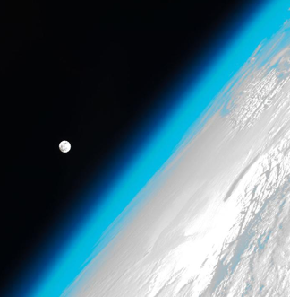
The Atmosphere
Extremely thin blanket of air extending about 300 miles from Earth’s surface to edge of space
Protects us from the blasts of heat and radiation coming from the Sun
Image: NASA
Link to GLOBE Teacher’s Guide Atmosphere Protocol

Slide 4
Surface Temperature
Is the radiating temperature emitted as electromagnetic energy of the Earth’s surface including vegetation, paved surfaces, and the ground, etc.
Varies depending on the ground cover and the time of day
Affects all aspects of the Earth’s Energy Budget
Aerosols
Air Temperature
Albedo
Barometric Pressure
Clouds
Precipitation
Relative Humidity
Surface Ozone
Surface Temperature
Water Vapor
Wind

Slide 5
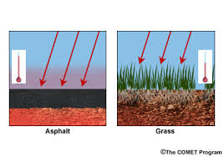
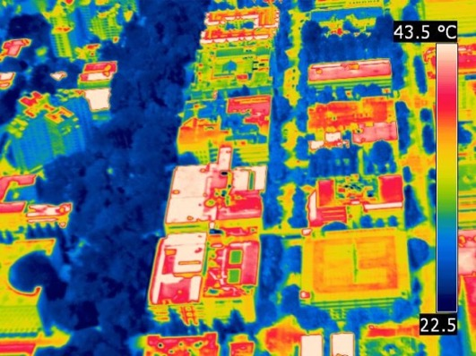
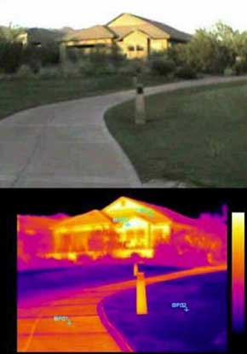
Surface temperature is the temperature at the Earth’s surface, including the land, water and structures
Not all surfaces have the same temperature!

Slide 6
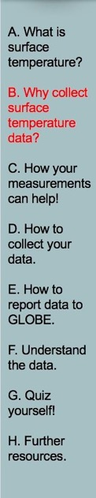
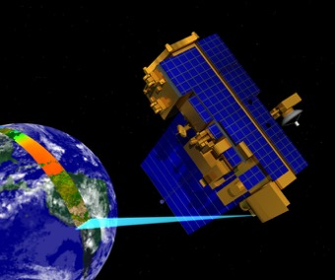
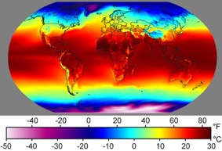
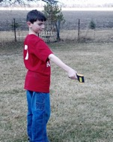
Recording surface temperature is important-1
1. Your observations are valuable contributions to the scientific community and may be used by educators, students, researchers, and the general public to increase environmental awareness and STEM literacy, as well as advance Earth system science.
Image: Windows to the Universe
Image: NASA
Find out more about
NASA’s MODIS Imagery
Image: Kevn Czajkowski

Slide 7
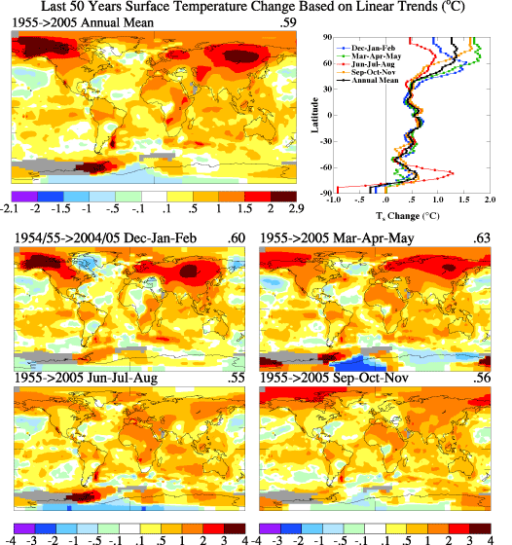
Recording surface temperature is important-2
2. To help understand seasonal changes in Earth’s surface.
Image: NASA GISS

Slide 8
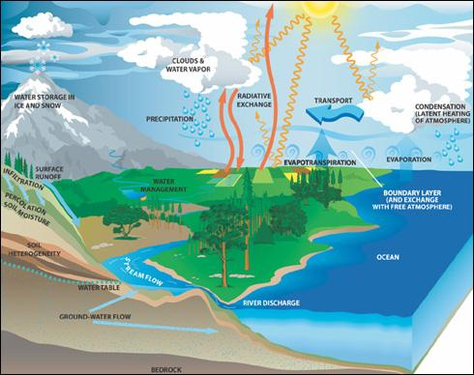
Recording surface temperature is important-3
3. To help understand the rate of heat and moisture exchange between the atmosphere and Earth.
Image: NASA

Slide 9
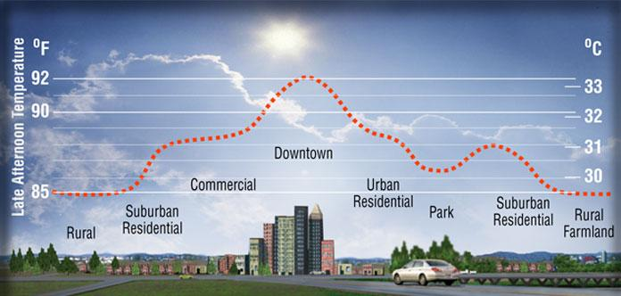
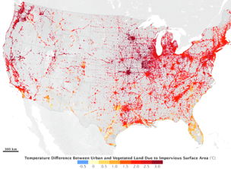
Recording surface temperature is important-4
4. To assist in urban planning and to help understand the Urban Heat Island Effect.

Slide 10
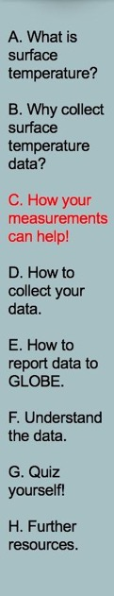
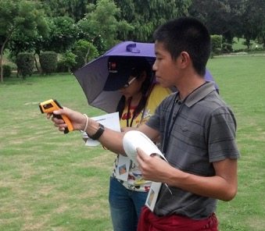


YOUR measurements can help researchers understand and predict
How do urban areas affect the temperature around them?
What is the contribution of changing land use and land cover on local energy budgets?
How are land surface temperatures changing over the long-term?
How your data compares with data from NASA satellites?

Slide 11
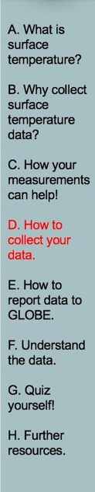
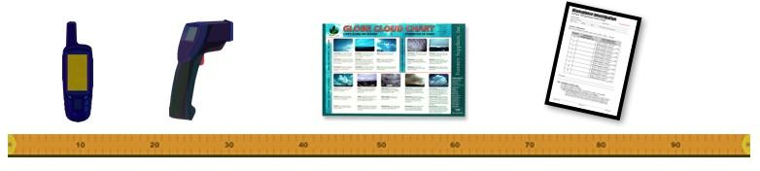
What you need to collect data:
Instruments | Your eyes, GPS unit, Infrared Thermometer, Meter Stick
References | GLOBE cloud chart
When | Good: Any time Better: Within one hour of local solar noon Best: Within +/- 15 minutes of a satellite overpass
Where | A good observation site (See Documenting your atmosphere study site)
Form | Surface Temperature Data Sheet

Slide 12

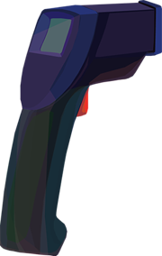
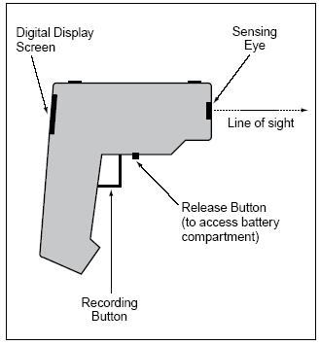
Instrument: Infrared Thermometer
Measures infrared (heat) radiation emanating from a surface and converts it to temperature.
Surface temperature can be observed by sensing the infrared part of the electromagnetic spectrum.

Slide 13
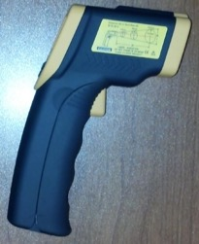
Infrared Thermometer Specifications
Accuracy: ±2 °C
Range: make sure that the instrument’s temperature range is large enough to capture the variations in your area.
Where do I get one?
Handheld infrared thermometers can be purchased from a number of stores and online retailers. Prices range from $25-$300 USD
Maintenance of instrument:
-proper cleaning of lenses is important since accumulated particles on the lens can reduce the accuracy
-do not use solvents to clean the lens

Slide 14
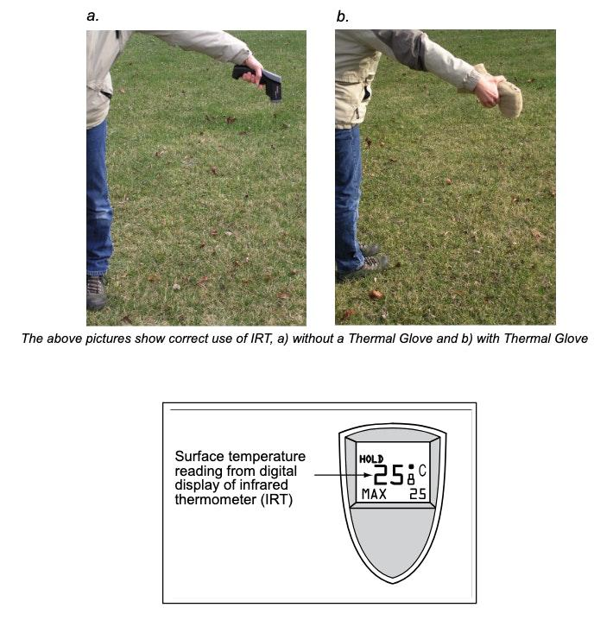
Calibrate your Infrared Thermometer
1. When the air temperature at the study site varies by more than 5℃ from the air temperature where the hand-held infrared thermometer (IRT) has been stored, either wrap the IRT in a thermal glove before going to your study site or place the IRT outdoors for at least 60 minutes before data collection.
Notes:
Calibrate with bucket of ice water
-point IRT perpendicular to water surface about 5 cm away
-reading should be within –2° C to +2° C
The IRT sensor is susceptible to large differences in air temperature. If you enclose the IRT in the adapted oven mitt (thermal glove), this will ensure the IRT stays insulated and will provide accurate readings.
Some IRT units are equipped with a laser that will shine from the front of the thermometer along the approximate line of sight, causing a red dot to appear where the surface temperature is measured. Make sure students do not aim this laser beam directly at eyes or off surfaces that could reflect in someone’s eyes.
Wrap your IRT in the Thermal Glove when the air temperature at your study site varies more than 5 degrees Celsius from the air temperature of where the IRT has been stored. The IRT with the thermal glove has been tested to work for 60 minutes. The thermal glove is made from a standard oven mitt. The oven mitt used to make the thermal glove MUST be constructed of 100% terry cloth; inside and outside. An actual-size pattern of the thermal glove with hole designations for the IRT’s sensing eye and digital display screen is shown in the Surface Temperature Protocol section of the 2003 Teacher’s Guide.

Slide 15
Data Collection Procedure
2. Complete the top section of the Surface Temperature Data Sheet.
3. Take cloud observations by following the GLOBE Cloud protocol tutorials.
4. If there is no snow on the ground anywhere in your site, then check either “Wet” or “Dry” for the Site’s Overall Surface Condition field on your Surface Temperature Data Sheet. If snow is present, check “Snow.”
5. Select nine homogenous (the same surface type throughout) observation spots in open areas of your site, ensuring they are at least 5 meters apart from each other. The observation spots should be located away from trees and buildings that cast shadows on the land, and in areas that have not been recently disturbed by human or animal activity. (Note: Take readings at the nine observation spots within seconds of each other.)
6. Go to one of the nine observation spots and stand so you do not cast a shadow on the spot.
7. Record the current time and its corresponding Coordinated Universal Time (UTC) on your Surface Temperature Data Sheet.
Notes:
Calibrate with bucket of ice water
-point IRT perpendicular to water surface about 5 cm away
-reading should be within –2° C to +2° C
The IRT sensor is susceptible to large differences in air temperature. If you enclose the IRT in the adapted oven mitt (thermal glove), this will ensure the IRT stays insulated and will provide accurate readings.
Some IRT units are equipped with a laser that will shine from the front of the thermometer along the approximate line of sight, causing a red dot to appear where the surface temperature is measured. Make sure students do not aim this laser beam directly at eyes or off surfaces that could reflect in someone’s eyes.
Wrap your IRT in the Thermal Glove when the air temperature at your study site varies more than 5 degrees Celsius from the air temperature of where the IRT has been stored. The IRT with the thermal glove has been tested to work for 60 minutes. The thermal glove is made from a standard oven mitt. The oven mitt used to make the thermal glove MUST be constructed of 100% terry cloth; inside and outside. An actual-size pattern of the thermal glove with hole designations for the IRT’s sensing eye and digital display screen is shown in the Surface Temperature Protocol section of the 2003 Teacher’s Guide.

Slide 16
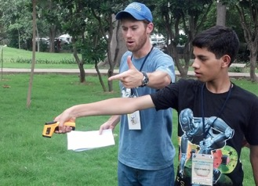
Collecting Data using an Infrared Thermometer
HOW?
8. Hold the IRT (wrapped in a thermal glove when necessary) with your arm extended straight out and point the instrument straight down at the ground.
9. Hold the IRT as still as possible. Press and release the recording button (Note: You MUST release the recording button for the instrument to register your spot’s surface temperature).
10. Read and record the surface temperature from the digital display screen located on the top of the IRT. (Note: Surface temperature is recorded in Celsius to the nearest tenth degree, e.g., 25.8°C)
11. If there is snow on the ground, measure and record the snow depth in millimeters at the observation spot. Refer to the Solid Precipitation protocol field guide for measuring the depth of snow on the ground.
12. Repeat steps 7–11 at each of the remaining eight observation spots.
13. Describe any other information that explains the environmental conditions of the day or the site in the Comments field.
Photo credit: Kevin Czajkowski
Notes:
Calibrate with bucket of ice water
-point IRT perpendicular to water surface about 5 cm away
-reading should be within –2° C to +2° C
The IRT sensor is susceptible to large differences in air temperature. If you enclose the IRT in the adapted oven mitt (thermal glove), this will ensure the IRT stays insulated and will provide accurate readings.
Some IRT units are equipped with a laser that will shine from the front of the thermometer along the approximate line of sight, causing a red dot to appear where the surface temperature is measured. Make sure students do not aim this laser beam directly at eyes or off surfaces that could reflect in someone’s eyes.
Wrap your IRT in the Thermal Glove when the air temperature at your study site varies more than 5 degrees Celsius from the air temperature of where the IRT has been stored. The IRT with the thermal glove has been tested to work for 30 minutes. The thermal glove is made from a standard oven mitt. The oven mitt used to make the thermal glove MUST be constructed of 100% terry cloth; inside and outside. An actual-size pattern of the thermal glove with hole designations for the IRT’s sensing eye and digital display screen is shown in the Surface Temperature Protocol section of the 2003 Teacher’s Guide.

Slide 17
Data Collection: Overview
Choose a site that is homogenous at least 30 meters square (if possible). Can be grass, asphalt, etc.
Collect GPS data for the center of the site (latitude, longitude and elevation).
Pick nine random observation spots in the study site:
  Read and record surface temperature
  Record the time
  Measure and record snow depth (if present)
Use the Cloud Protocol to record cloud observations.
Record your data on the Surface Temperature Data sheet.
Notes:
Calibrate with bucket of ice water
-point IRT perpendicular to water surface about 5 cm away
-reading should be within –2° C to +2° C
The IRT sensor is susceptible to large differences in air temperature. If you enclose the IRT in the adapted oven mitt (thermal glove), this will ensure the IRT stays insulated and will provide accurate readings.
Some IRT units are equipped with a laser that will shine from the front of the thermometer along the approximate line of sight, causing a red dot to appear where the surface temperature is measured. Make sure students do not aim this laser beam directly at eyes or off surfaces that could reflect in someone’s eyes.
Wrap your IRT in the Thermal Glove when the air temperature at your study site varies more than 5 degrees Celsius from the air temperature of where the IRT has been stored. The IRT with the thermal glove has been tested to work for 60 minutes. The thermal glove is made from a standard oven mitt. The oven mitt used to make the thermal glove MUST be constructed of 100% terry cloth; inside and outside. An actual-size pattern of the thermal glove with hole designations for the IRT’s sensing eye and digital display screen is shown in the Surface Temperature Protocol section of the 2003 Teacher’s Guide.

Slide 18
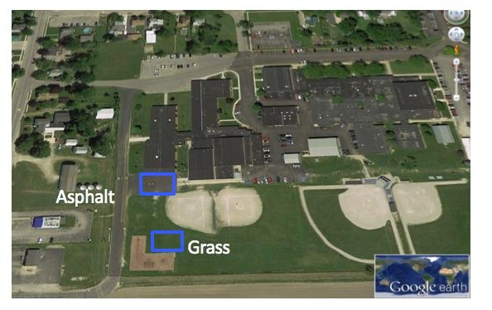
1. Choose homogenous study areas.
Choose study areas that are as large as possible and that have homogeneous cover. free from shadows from trees or buildings, ensures that you’re measuring representative surface temperatures. Be sure to document the size of your homogeneous site. Setting up the site properly means fewer biasing factors and more useful, comparable data for scientists worldwide.
Notes:
Calibrate with bucket of ice water
-point IRT perpendicular to water surface about 5 cm away
-reading should be within –2° C to +2° C
The IRT sensor is susceptible to large differences in air temperature. If you enclose the IRT in the adapted oven mitt (thermal glove), this will ensure the IRT stays insulated and will provide accurate readings.
Some IRT units are equipped with a laser that will shine from the front of the thermometer along the approximate line of sight, causing a red dot to appear where the surface temperature is measured. Make sure students do not aim this laser beam directly at eyes or off surfaces that could reflect in someone’s eyes.
Wrap your IRT in the Thermal Glove when the air temperature at your study site varies more than 5 degrees Celsius from the air temperature of where the IRT has been stored. The IRT with the thermal glove has been tested to work for 60 minutes. The thermal glove is made from a standard oven mitt. The oven mitt used to make the thermal glove MUST be constructed of 100% terry cloth; inside and outside. An actual-size pattern of the thermal glove with hole designations for the IRT’s sensing eye and digital display screen is shown in the Surface Temperature Protocol section of the 2003 Teacher’s Guide.

Slide 19
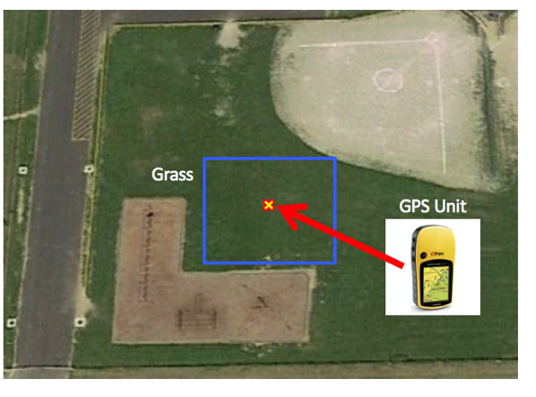
2. Collect GPS data of the center of each study area. If you are using the GLOBE Observer app on your phone, the latitude and longitude are automatically recorded.
Record latitude, longitude and elevation.
GPS Protocol
Notes:
Calibrate with bucket of ice water
-point IRT perpendicular to water surface about 5 cm away
-reading should be within –2° C to +2° C
The IRT sensor is susceptible to large differences in air temperature. If you enclose the IRT in the adapted oven mitt (thermal glove), this will ensure the IRT stays insulated and will provide accurate readings.
Some IRT units are equipped with a laser that will shine from the front of the thermometer along the approximate line of sight, causing a red dot to appear where the surface temperature is measured. Make sure students do not aim this laser beam directly at eyes or off surfaces that could reflect in someone’s eyes.
Wrap your IRT in the Thermal Glove when the air temperature at your study site varies more than 5 degrees Celsius from the air temperature of where the IRT has been stored. The IRT with the thermal glove has been tested to work for 30 minutes. The thermal glove is made from a standard oven mitt. The oven mitt used to make the thermal glove MUST be constructed of 100% terry cloth; inside and outside. An actual-size pattern of the thermal glove with hole designations for the IRT’s sensing eye and digital display screen is shown in the Surface Temperature Protocol section of the 2003 Teacher’s Guide.

Slide 20
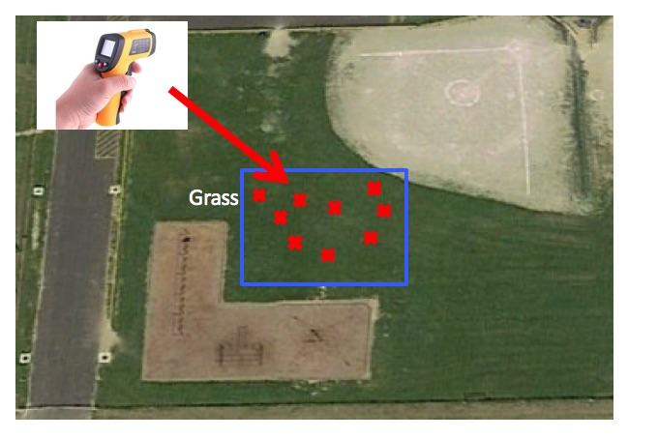
3. Take 9 random surface temperature readings
Take 9 random surface temperature readings within each study area. The 9 random observations ensure a good average for the site is observed.
Notes:
Calibrate with bucket of ice water
-point IRT perpendicular to water surface about 5 cm away
-reading should be within –2° C to +2° C
The IRT sensor is susceptible to large differences in air temperature. If you enclose the IRT in the adapted oven mitt (thermal glove), this will ensure the IRT stays insulated and will provide accurate readings.
Some IRT units are equipped with a laser that will shine from the front of the thermometer along the approximate line of sight, causing a red dot to appear where the surface temperature is measured. Make sure students do not aim this laser beam directly at eyes or off surfaces that could reflect in someone’s eyes.
Wrap your IRT in the Thermal Glove when the air temperature at your study site varies more than 5 degrees Celsius from the air temperature of where the IRT has been stored. The IRT with the thermal glove has been tested to work for 60 minutes. The thermal glove is made from a standard oven mitt. The oven mitt used to make the thermal glove MUST be constructed of 100% terry cloth; inside and outside. An actual-size pattern of the thermal glove with hole designations for the IRT’s sensing eye and digital display screen is shown in the Surface Temperature Protocol section of the 2003 Teacher’s Guide.

Slide 21
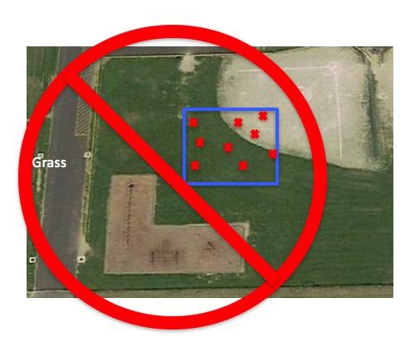
Caution!
Do not mix cover types in one study area.
In this case, the study area mistakenly has grass and bare ground.
Notes:
Calibrate with bucket of ice water
-point IRT perpendicular to water surface about 5 cm away
-reading should be within –2° C to +2° C
The IRT sensor is susceptible to large differences in air temperature. If you enclose the IRT in the adapted oven mitt (thermal glove), this will ensure the IRT stays insulated and will provide accurate readings.
Some IRT units are equipped with a laser that will shine from the front of the thermometer along the approximate line of sight, causing a red dot to appear where the surface temperature is measured. Make sure students do not aim this laser beam directly at eyes or off surfaces that could reflect in someone’s eyes.
Wrap your IRT in the Thermal Glove when the air temperature at your study site varies more than 5 degrees Celsius from the air temperature of where the IRT has been stored. The IRT with the thermal glove has been tested to work for 30 minutes. The thermal glove is made from a standard oven mitt. The oven mitt used to make the thermal glove MUST be constructed of 100% terry cloth; inside and outside. An actual-size pattern of the thermal glove with hole designations for the IRT’s sensing eye and digital display screen is shown in the Surface Temperature Protocol section of the 2003 Teacher’s Guide.

Slide 22
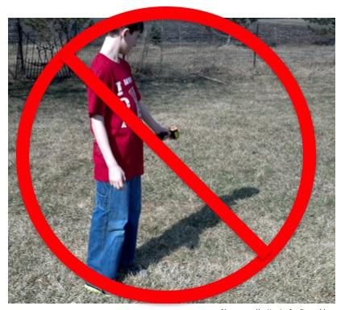
Caution! 1
Do not take the temperature of shadowed areas including the shadow that your body may cast.
Notes:
Calibrate with bucket of ice water
-point IRT perpendicular to water surface about 5 cm away
-reading should be within –2° C to +2° C
The IRT sensor is susceptible to large differences in air temperature. If you enclose the IRT in the adapted oven mitt (thermal glove), this will ensure the IRT stays insulated and will provide accurate readings.
Some IRT units are equipped with a laser that will shine from the front of the thermometer along the approximate line of sight, causing a red dot to appear where the surface temperature is measured. Make sure students do not aim this laser beam directly at eyes or off surfaces that could reflect in someone’s eyes.
Wrap your IRT in the Thermal Glove when the air temperature at your study site varies more than 5 degrees Celsius from the air temperature of where the IRT has been stored. The IRT with the thermal glove has been tested to work for 60 minutes. The thermal glove is made from a standard oven mitt. The oven mitt used to make the thermal glove MUST be constructed of 100% terry cloth; inside and outside. An actual-size pattern of the thermal glove with hole designations for the IRT’s sensing eye and digital display screen is shown in the Surface Temperature Protocol section of the 2003 Teacher’s Guide.

Slide 23
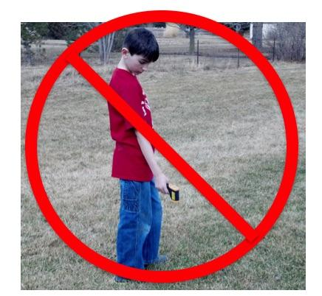
Caution! 2
Extend your arm in front of you to take the observations. You don’t want to measure the temperature of your feet.
.
Notes:
Calibrate with bucket of ice water
-point IRT perpendicular to water surface about 5 cm away
-reading should be within –2° C to +2° C
The IRT sensor is susceptible to large differences in air temperature. If you enclose the IRT in the adapted oven mitt (thermal glove), this will ensure the IRT stays insulated and will provide accurate readings.
Some IRT units are equipped with a laser that will shine from the front of the thermometer along the approximate line of sight, causing a red dot to appear where the surface temperature is measured. Make sure students do not aim this laser beam directly at eyes or off surfaces that could reflect in someone’s eyes.
Wrap your IRT in the Thermal Glove when the air temperature at your study site varies more than 5 degrees Celsius from the air temperature of where the IRT has been stored. The IRT with the thermal glove has been tested to work for 30 minutes. The thermal glove is made from a standard oven mitt. The oven mitt used to make the thermal glove MUST be constructed of 100% terry cloth; inside and outside. An actual-size pattern of the thermal glove with hole designations for the IRT’s sensing eye and digital display screen is shown in the Surface Temperature Protocol section of the 2003 Teacher’s Guide.

Slide 24
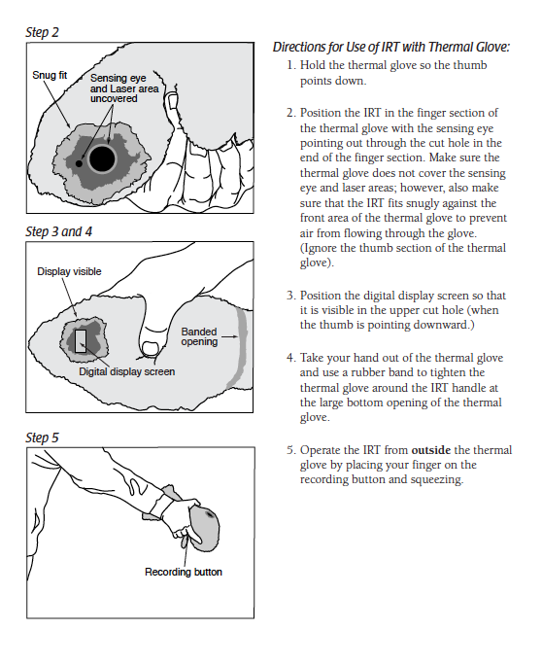
Caution! Thermal Shock
Prepare and acclimate the infrared thermometer properly.
When the air temperature at your study site varies more than 5° C from the air temperature of the storage location of the IRT, place the IRT outdoors for at least 60 minutes prior to data collection.
Or, you can make a thermal glove using a terry cloth oven mitt.
Notes:
Calibrate with bucket of ice water
-point IRT perpendicular to water surface about 5 cm away
-reading should be within –2° C to +2° C
The IRT sensor is susceptible to large differences in air temperature. If you enclose the IRT in the adapted oven mitt (thermal glove), this will ensure the IRT stays insulated and will provide accurate readings.
Some IRT units are equipped with a laser that will shine from the front of the thermometer along the approximate line of sight, causing a red dot to appear where the surface temperature is measured. Make sure students do not aim this laser beam directly at eyes or off surfaces that could reflect in someone’s eyes.
Wrap your IRT in the Thermal Glove when the air temperature at your study site varies more than 5 degrees Celsius from the air temperature of where the IRT has been stored. The IRT with the thermal glove has been tested to work for 60 minutes. The thermal glove is made from a standard oven mitt. The oven mitt used to make the thermal glove MUST be constructed of 100% terry cloth; inside and outside. An actual-size pattern of the thermal glove with hole designations for the IRT’s sensing eye and digital display screen is shown in the Surface Temperature Protocol section of the 2003 Teacher’s Guide.

Slide 25
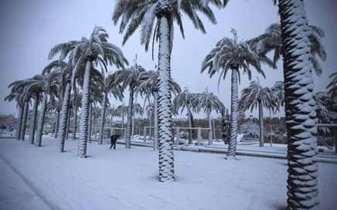
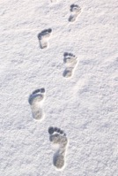
Measuring Surface Temperature in Snow
What if there is snow? Just measure the snow depth for each of the 9 observation locations, and then collect your surface temperature readings.
Your footprints will affect the snow but that is ok.
.
Notes:
Calibrate with bucket of ice water
-point IRT perpendicular to water surface about 5 cm away
-reading should be within –2° C to +2° C
The IRT sensor is susceptible to large differences in air temperature. If you enclose the IRT in the adapted oven mitt (thermal glove), this will ensure the IRT stays insulated and will provide accurate readings.
Some IRT units are equipped with a laser that will shine from the front of the thermometer along the approximate line of sight, causing a red dot to appear where the surface temperature is measured. Make sure students do not aim this laser beam directly at eyes or off surfaces that could reflect in someone’s eyes.
Wrap your IRT in the Thermal Glove when the air temperature at your study site varies more than 5 degrees Celsius from the air temperature of where the IRT has been stored. The IRT with the thermal glove has been tested to work for 30 minutes. The thermal glove is made from a standard oven mitt. The oven mitt used to make the thermal glove MUST be constructed of 100% terry cloth; inside and outside. An actual-size pattern of the thermal glove with hole designations for the IRT’s sensing eye and digital display screen is shown in the Surface Temperature Protocol section of the 2003 Teacher’s Guide.

Slide 26
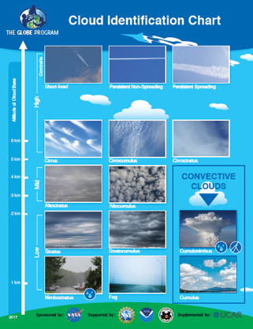
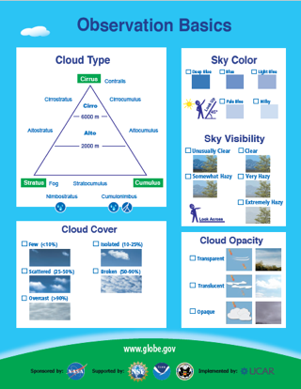
4. Record cloud and contrail data using the GLOBE Cloud Protocol
The GLOBE Cloud Chart can help you identify the clouds.
.
Notes:
Calibrate with bucket of ice water
-point IRT perpendicular to water surface about 5 cm away
-reading should be within –2° C to +2° C
The IRT sensor is susceptible to large differences in air temperature. If you enclose the IRT in the adapted oven mitt (thermal glove), this will ensure the IRT stays insulated and will provide accurate readings.
Some IRT units are equipped with a laser that will shine from the front of the thermometer along the approximate line of sight, causing a red dot to appear where the surface temperature is measured. Make sure students do not aim this laser beam directly at eyes or off surfaces that could reflect in someone’s eyes.
Wrap your IRT in the Thermal Glove when the air temperature at your study site varies more than 5 degrees Celsius from the air temperature of where the IRT has been stored. The IRT with the thermal glove has been tested to work for 60 minutes. The thermal glove is made from a standard oven mitt. The oven mitt used to make the thermal glove MUST be constructed of 100% terry cloth; inside and outside. An actual-size pattern of the thermal glove with hole designations for the IRT’s sensing eye and digital display screen is shown in the Surface Temperature Protocol section of the 2003 Teacher’s Guide.

Slide 27
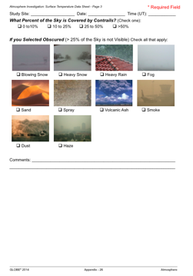
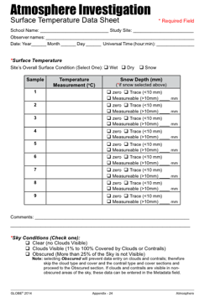
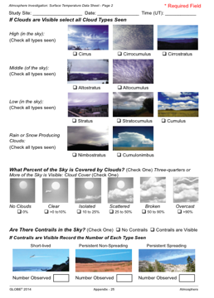
5. Record your data on the Surface Temperature Data Sheet
Notes:
Calibrate with bucket of ice water
-point IRT perpendicular to water surface about 5 cm away
-reading should be within –2° C to +2° C
The IRT sensor is susceptible to large differences in air temperature. If you enclose the IRT in the adapted oven mitt (thermal glove), this will ensure the IRT stays insulated and will provide accurate readings.
Some IRT units are equipped with a laser that will shine from the front of the thermometer along the approximate line of sight, causing a red dot to appear where the surface temperature is measured. Make sure students do not aim this laser beam directly at eyes or off surfaces that could reflect in someone’s eyes.
Wrap your IRT in the Thermal Glove when the air temperature at your study site varies more than 5 degrees Celsius from the air temperature of where the IRT has been stored. The IRT with the thermal glove has been tested to work for 30 minutes. The thermal glove is made from a standard oven mitt. The oven mitt used to make the thermal glove MUST be constructed of 100% terry cloth; inside and outside. An actual-size pattern of the thermal glove with hole designations for the IRT’s sensing eye and digital display screen is shown in the Surface Temperature Protocol section of the 2003 Teacher’s Guide.

Slide 28
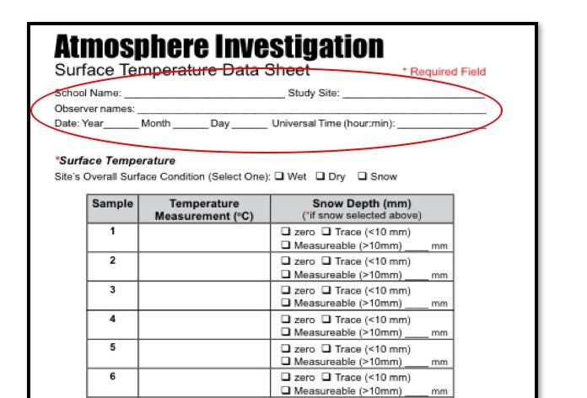
Be sure to enter your school, study site, observer names, date and time (local or UTC)
Notes:
Calibrate with bucket of ice water
-point IRT perpendicular to water surface about 5 cm away
-reading should be within –2° C to +2° C
The IRT sensor is susceptible to large differences in air temperature. If you enclose the IRT in the adapted oven mitt (thermal glove), this will ensure the IRT stays insulated and will provide accurate readings.
Some IRT units are equipped with a laser that will shine from the front of the thermometer along the approximate line of sight, causing a red dot to appear where the surface temperature is measured. Make sure students do not aim this laser beam directly at eyes or off surfaces that could reflect in someone’s eyes.
Wrap your IRT in the Thermal Glove when the air temperature at your study site varies more than 5 degrees Celsius from the air temperature of where the IRT has been stored. The IRT with the thermal glove has been tested to work for 60 minutes. The thermal glove is made from a standard oven mitt. The oven mitt used to make the thermal glove MUST be constructed of 100% terry cloth; inside and outside. An actual-size pattern of the thermal glove with hole designations for the IRT’s sensing eye and digital display screen is shown in the Surface Temperature Protocol section of the 2003 Teacher’s Guide.

Slide 29
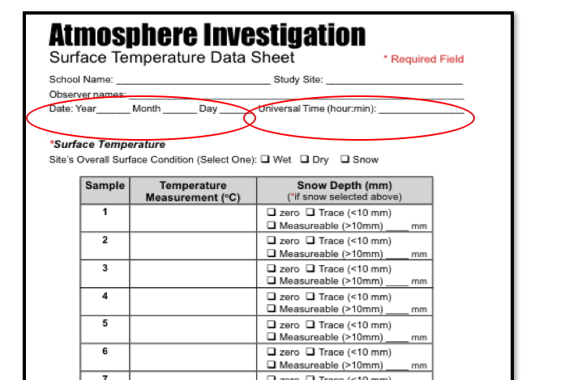
CAUTION – An observation without a date or time is worthless
Notes:
Calibrate with bucket of ice water
-point IRT perpendicular to water surface about 5 cm away
-reading should be within –2° C to +2° C
The IRT sensor is susceptible to large differences in air temperature. If you enclose the IRT in the adapted oven mitt (thermal glove), this will ensure the IRT stays insulated and will provide accurate readings.
Some IRT units are equipped with a laser that will shine from the front of the thermometer along the approximate line of sight, causing a red dot to appear where the surface temperature is measured. Make sure students do not aim this laser beam directly at eyes or off surfaces that could reflect in someone’s eyes.
Wrap your IRT in the Thermal Glove when the air temperature at your study site varies more than 5 degrees Celsius from the air temperature of where the IRT has been stored. The IRT with the thermal glove has been tested to work for 30 minutes. The thermal glove is made from a standard oven mitt. The oven mitt used to make the thermal glove MUST be constructed of 100% terry cloth; inside and outside. An actual-size pattern of the thermal glove with hole designations for the IRT’s sensing eye and digital display screen is shown in the Surface Temperature Protocol section of the 2003 Teacher’s Guide.

Slide 30
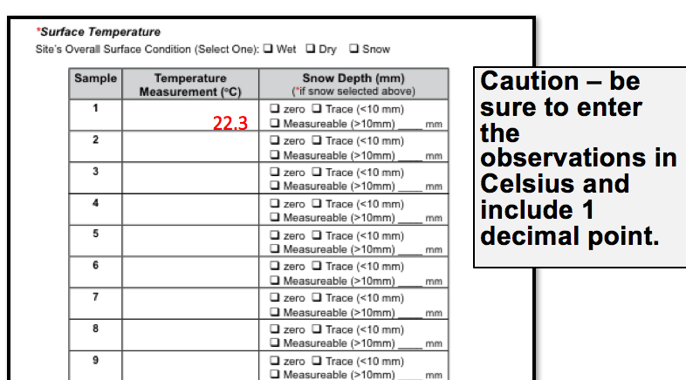
Enter the 9 surface temperature observations and snow depth, add comments of anything interesting about the observation.
Notes:
Calibrate with bucket of ice water
-point IRT perpendicular to water surface about 5 cm away
-reading should be within –2° C to +2° C
The IRT sensor is susceptible to large differences in air temperature. If you enclose the IRT in the adapted oven mitt (thermal glove), this will ensure the IRT stays insulated and will provide accurate readings.
Some IRT units are equipped with a laser that will shine from the front of the thermometer along the approximate line of sight, causing a red dot to appear where the surface temperature is measured. Make sure students do not aim this laser beam directly at eyes or off surfaces that could reflect in someone’s eyes.
Wrap your IRT in the Thermal Glove when the air temperature at your study site varies more than 5 degrees Celsius from the air temperature of where the IRT has been stored. The IRT with the thermal glove has been tested to work for 60 minutes. The thermal glove is made from a standard oven mitt. The oven mitt used to make the thermal glove MUST be constructed of 100% terry cloth; inside and outside. An actual-size pattern of the thermal glove with hole designations for the IRT’s sensing eye and digital display screen is shown in the Surface Temperature Protocol section of the 2003 Teacher’s Guide.

Slide 31

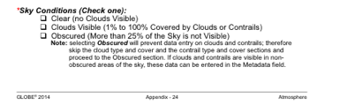
Do the cloud and contrail protocols.
Notes:
Calibrate with bucket of ice water
-point IRT perpendicular to water surface about 5 cm away
-reading should be within –2° C to +2° C
The IRT sensor is susceptible to large differences in air temperature. If you enclose the IRT in the adapted oven mitt (thermal glove), this will ensure the IRT stays insulated and will provide accurate readings.
Some IRT units are equipped with a laser that will shine from the front of the thermometer along the approximate line of sight, causing a red dot to appear where the surface temperature is measured. Make sure students do not aim this laser beam directly at eyes or off surfaces that could reflect in someone’s eyes.
Wrap your IRT in the Thermal Glove when the air temperature at your study site varies more than 5 degrees Celsius from the air temperature of where the IRT has been stored. The IRT with the thermal glove has been tested to work for 30 minutes. The thermal glove is made from a standard oven mitt. The oven mitt used to make the thermal glove MUST be constructed of 100% terry cloth; inside and outside. An actual-size pattern of the thermal glove with hole designations for the IRT’s sensing eye and digital display screen is shown in the Surface Temperature Protocol section of the 2003 Teacher’s Guide.

Slide 32

Record the sky condition.
If you can’t see the sky, check the reason.
Caution – If you click obscured, clouds cannot be entered.
Notes:
Calibrate with bucket of ice water
-point IRT perpendicular to water surface about 5 cm away
-reading should be within –2° C to +2° C
The IRT sensor is susceptible to large differences in air temperature. If you enclose the IRT in the adapted oven mitt (thermal glove), this will ensure the IRT stays insulated and will provide accurate readings.
Some IRT units are equipped with a laser that will shine from the front of the thermometer along the approximate line of sight, causing a red dot to appear where the surface temperature is measured. Make sure students do not aim this laser beam directly at eyes or off surfaces that could reflect in someone’s eyes.
Wrap your IRT in the Thermal Glove when the air temperature at your study site varies more than 5 degrees Celsius from the air temperature of where the IRT has been stored. The IRT with the thermal glove has been tested to work for 60 minutes. The thermal glove is made from a standard oven mitt. The oven mitt used to make the thermal glove MUST be constructed of 100% terry cloth; inside and outside. An actual-size pattern of the thermal glove with hole designations for the IRT’s sensing eye and digital display screen is shown in the Surface Temperature Protocol section of the 2003 Teacher’s Guide.

Slide 33
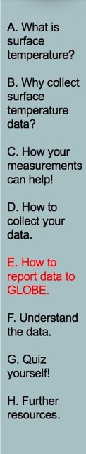

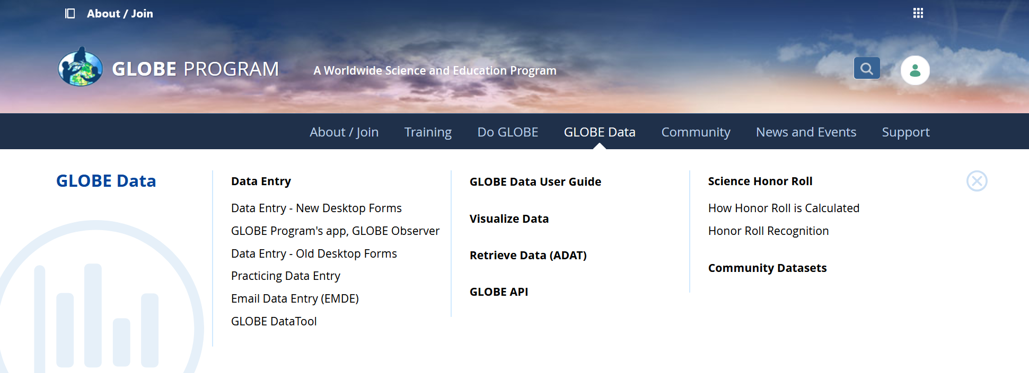
Entering Surface Temperature Data in the GLOBE Observer Data Entry System
Two Options for Uploading Data:
These methods all allow users to submit environmental data – collected at defined sites, according to protocol, and using approved instrumentation – for entry into the official GLOBE science database.
Download the GLOBE Observer mobile app from the App Store.
Data Entry: Visit globe.gov, click on the “GLOBE Data” tab, then underneath “Data Entry” click on “Data Entry – New Desktop Forms”.
Note 1: You will need a GLOBE teacher, trainer, or scientist account to submit GLOBE data.
Note 2: It may take some time after you enter your data for it to appear in the GLOBE data visualization system.

Slide 34
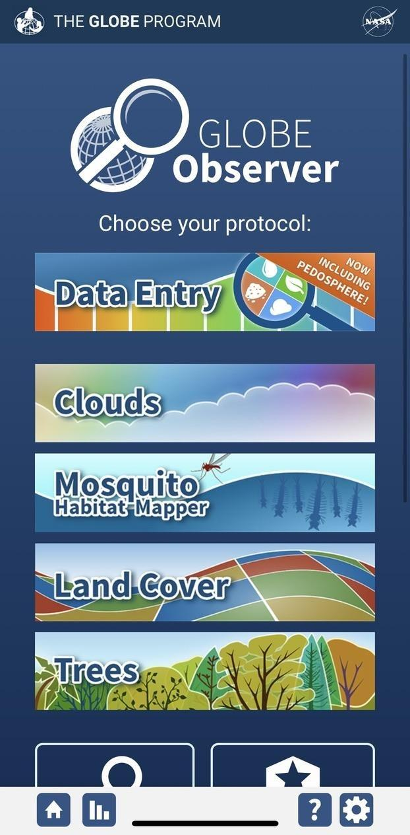
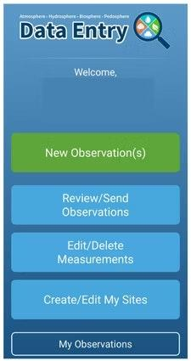
The steps below will walk you through entering your Atmosphere Study Site Information in the GLOBE Observer App, which you can access using your GLOBE or GLOBE Observer login.
2. Click "Create/Edit My Sites"
1. Click “Data Entry”

Slide 35
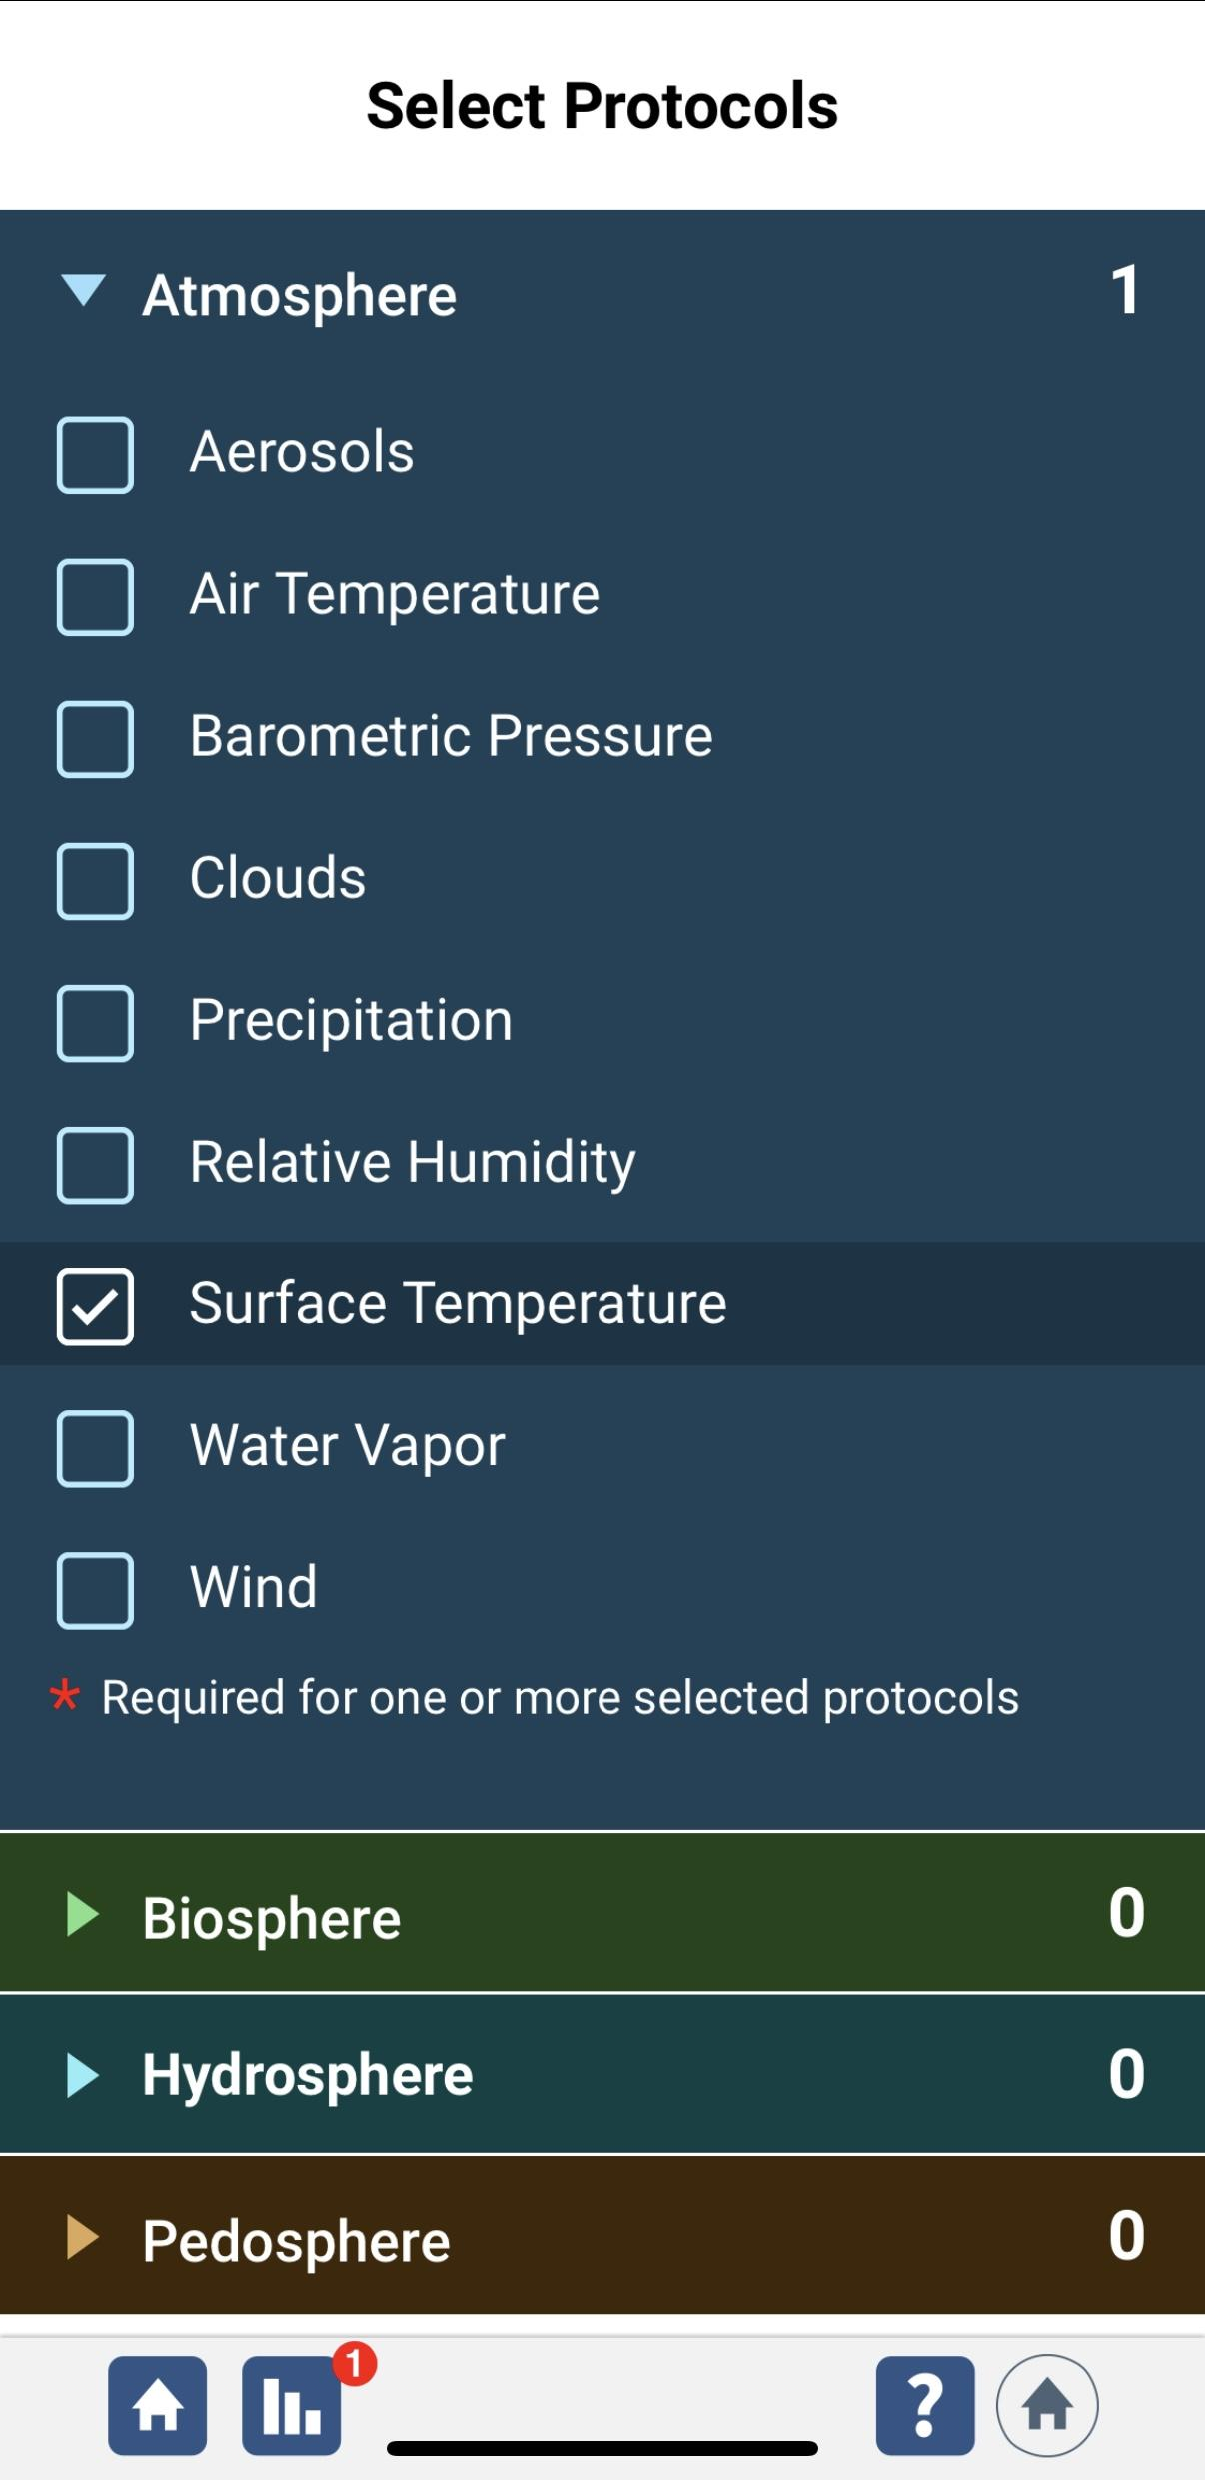
3. Click on the arrow next to "Atmosphere" and select “Surface Temperature“. The other necessary protocols will be automatically selected.

Slide 36
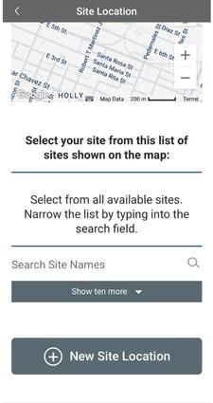
4. At the bottom of the screen, click “Continue”. When prompted, enter site location details (latitude, longitude, and elevation). Choose an existing site or identify a new site by clicking “+ New Site Location”

Slide 37
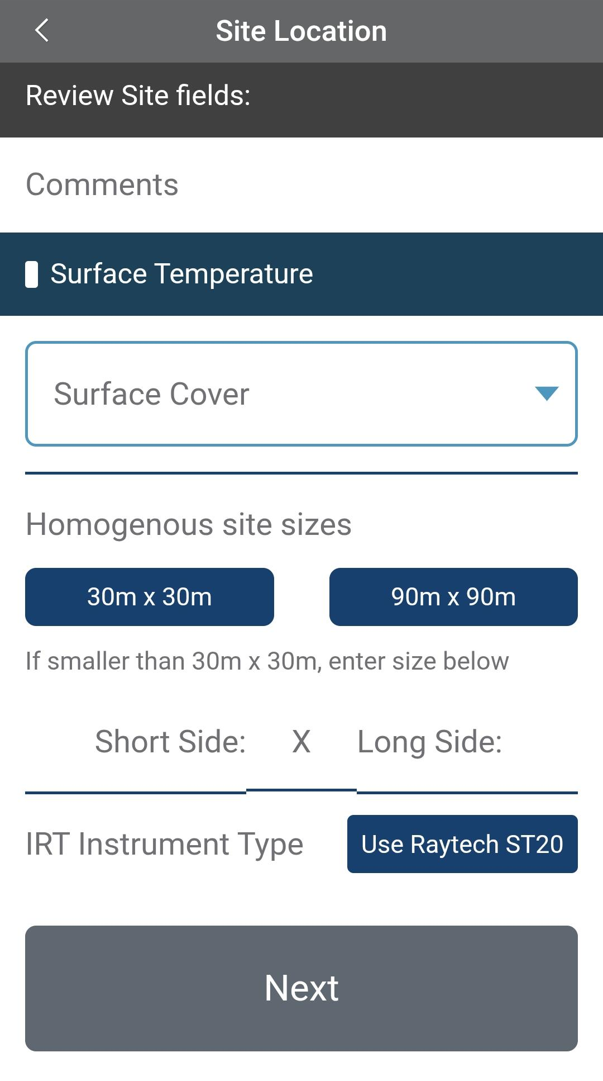
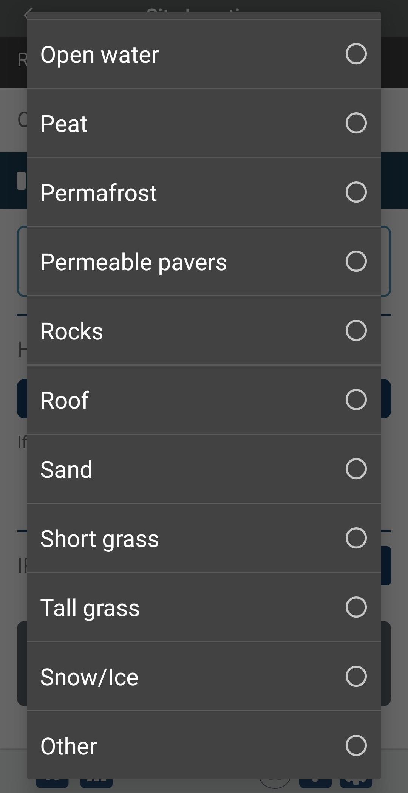
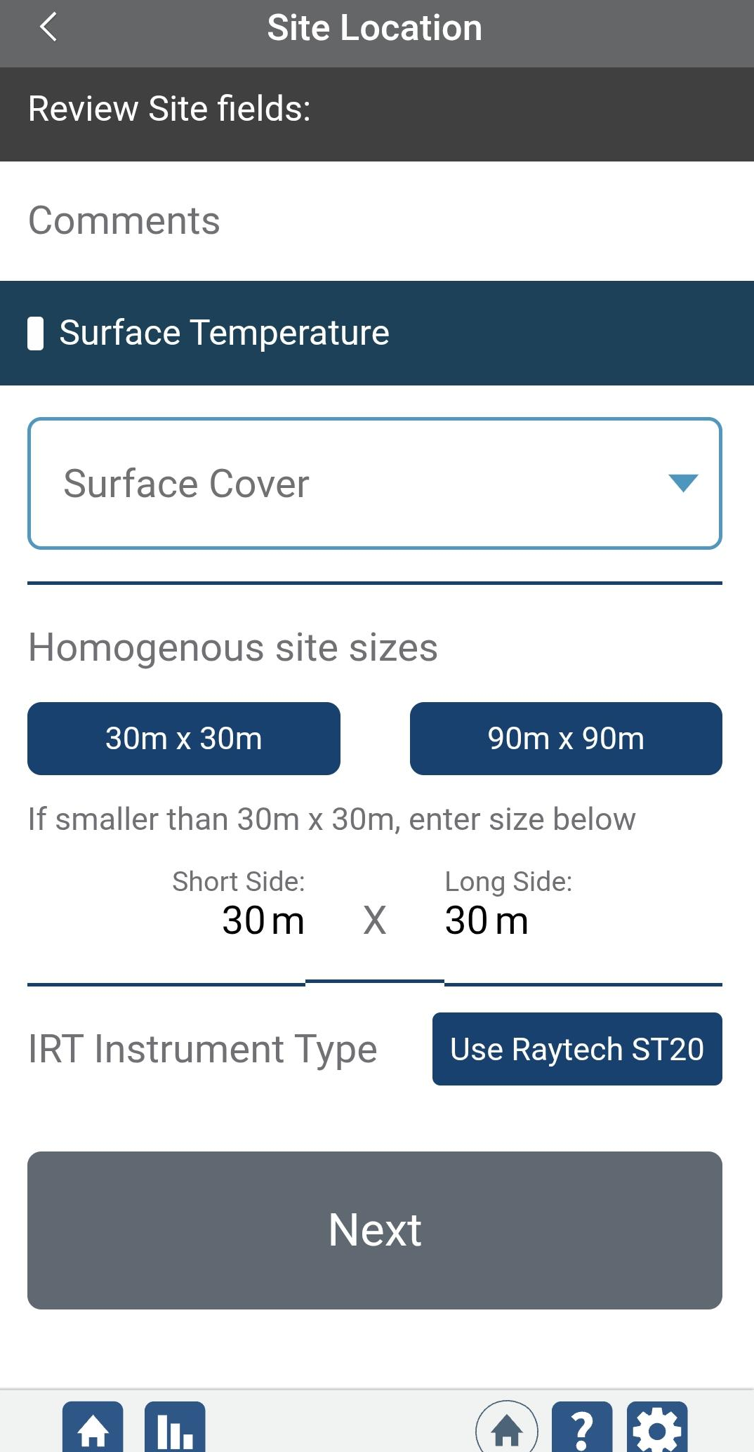
5. When identifying a new site location, click on Surface Cover and choose which option best matches that which you are observing. Then, write in the site size of the location where the observation is taking place. To move on, click “Next”

Slide 38

5. Check to see if the “Date and Time” are correct, if it is not, click
“Get Current Time” to update it. Then click “Surface Temperature” to move on

Slide 39



5. Now you will put in some information about your observation. “Click on Overall Surface Condition” to select from “Wet”, “Dry”, “Snow”. If selecting “Snow”, report snow depth too (in millimeters). Be sure to report surface temperature using Celsius/ °C in your measurements. Click “Review” when done

Slide 40


Visualize and Retrieve Data
GLOBE provides the ability to view and interact with data measured across the world. Select our visualization tool to map, graph, filter and export data that have been measured across GLOBE protocols since 1995.
These step-by-step tutorials on using the visualization system will assist you in finding and analyzing data: PDF version PowerPoint version
http://vis.globe.gov/GLOBE/

Slide 41

Visualize and Retrieve Data
Select the date for which you need data, add the protocol layers, and you can see where data is available.

Slide 42
Questions for you to investigate:
How does surface temperature compare with current air temperature? How does surface temperature compare with soil temperature at 5 cm and 10 cm?
How does surface temperature vary with land cover (e.g., bare soil, short grass, tall grass, concrete, asphalt, sand, forest litter)?
How does surface temperature vary with surface soil color?
How does the surface temperature of the ground, near the outside of the atmosphere shelter, compare with the current air temperature measured inside the shelter?
How does surface temperature change for different cover types (grass vs. asphalt for instance) on a cloudy day?
How does the time of year affect the surface temperature?
How does the surface temperature change for different cover types when it is wet versus when it is dry?

Slide 43

What have you learned?
What does surface temperature mean?
Why it is it important to collect surface temperature data?
What instruments are needed to collect surface temperature data?
Where can I purchase the instruments?
Where should I take my surface temperature measurements?
What data is collected?
How do I submit data to GLOBE?
What can I do with the data submitted to GLOBE?

Slide 44

Frequently Asked Questions (FAQs)
Should I turn on the red laser on the IRT to do my measurement?
Some IRT units are equipped with a laser and backlight. You can choose whether or not to activate these. If you choose to put them on, a red laser will shine from the sensing eye area along the approximate line of sight of the instrument when the recording button is pressed. This will cause a red dot to appear where the surface temperature is being measured. A backlight for the digital display screen will remain lit for seven seconds after the recording button is pressed and released.
Using the laser can help you more accurately locate the point where you are measuring the surface temperature. However, it will also reduce battery life and could possibly be a distraction to students. It is imperative that the laser beam NOT be aimed directly at eyes or off surfaces where it could reflect into anyone’s eyes. The laser and backlight option is controlled by a switch located above the battery in the battery compartment.

Slide 45
Further Resources
  For information on purchasing GLOBE supplies
  For information on infrared thermometers and how they work
  For information about the NASA MODIS Satellite Mission
  For information about GLOBE

Slide 46


Please provide us with feedback about this module. This is a community project and we welcome your comments, suggestions and edits!
Questions about Module? Contact GLOBE: help@nasaglobe.org
Power point Developers:
Kevin Czajkowski
Janet Struble
Mikell Lynne Hedley
Sara Mierzwiak
Photos unless otherwise identified:
Kevin Czajkowski
Funding Provided by NASA
Version 11/14/25. If you edit and modify this slide set for use for educational purposes, please note “modified by (and your name and date) “ on this page. Thank you.
Modified by GLOBE Implementation Office – Science, Training, Education, and Public Engagement

