Slide 1


Slide 2
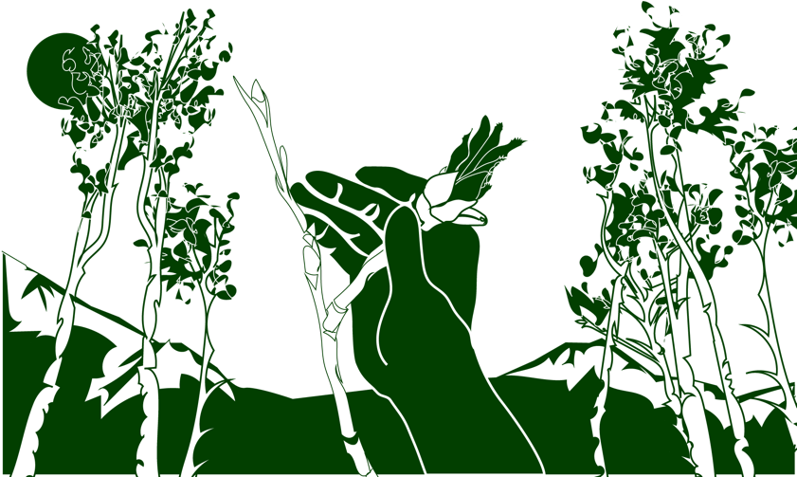
Overview
This module:
Describes how to select and define a GLOBE Phenology Protocol Study Site
Provides a step-by-step introduction of the protocol method
Learning Objectives
After completing this module, you will be able to:
Define phenology and what is meant by tree and shrub green-up
Describe the importance of quality control steps in the the collection of accurate data
Describe why green-up data is important for understanding our changing Earth system
Explain the difference between accuracy and precision
Identify a tree and shrub green-up study site and conduct measurements in the field
Upload data to the GLOBE database
Visualize data using GLOBE’s Visualization System

Slide 3
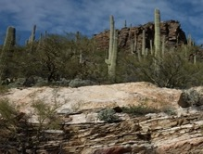
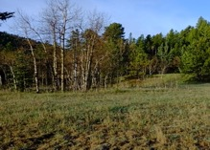
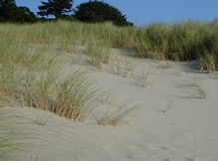
The Biosphere
The Biosphere is Earth’s zone of life. Every organism on Earth belongs to the biosphere. GLOBE has several ways to explore and measure components of the Biosphere through investigations in land cover, phenology, and carbon storage. Some GLOBE Hydrosphere investigations also include measurements of organisms: the macroinvertebrate and mosquito larvae protocols.
Tree and Shrub Green-Up is one of the GLOBE phenology protocols.
More information can be found in the:
Biosphere Introduction
Hydrosphere Introduction
Photo Credit: Shelley E. Olds

Slide 4
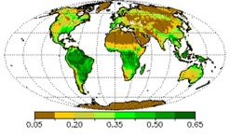
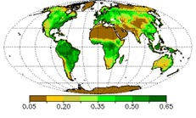
What is Green- Up?
Phenology is the study of living organisms’ response to seasonal and climatic changes in the environment in which they live.
The plant growing season is the period between green-up and green-down.
Plant green-up is initiated when dormancy (a state of suspended growth and metabolism) is broken by environmental conditions such as longer hours of sunlight and higher temperatures in temperate regions, or rains and cooler temperatures in desert areas.
March
1987
May
1987
Image: Normalized Difference Vegetation Index (NDVI), NASA

Slide 5
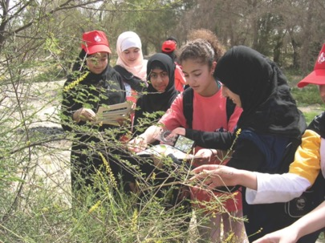
Green-up Cycles
For many places around the world, there is one green-up and green-down cycle, e.g., one warm and cold season.
There are places where multiple wet and dry seasons can occur in a single year, resulting in multiple green-up and green-down cycles.

Slide 6
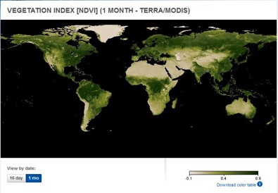
Satellite Measurements of Phenology
Many scientists use data from a NASA sensor, the Moderate Resolution Imaging Spectrometer (MODIS), to monitor the seasonal dynamics of vegetation.
Scientists also use a metric called the Normalized Difference Vegetation Index (or NDVI) to quantify the Earth’s greenness. NDVI is calculated from satellite data of red and near-infrared light, and can help monitor vegetation health, ecosystem disturbances, and changes in vegetation density over time. Learn more about NDVI in this My NASA Data Mini-lesson.
Watch an animation of NDVI from the NASA Visualization Studio to see the changes in greenness over time!

Slide 7
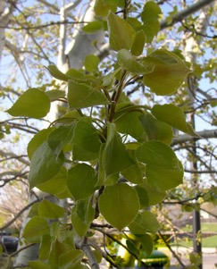
Why Collect Green-Up Data?
Scientists are very interested the timing of spring green-up and fall green-down. These plant phenological events are directly related to global carbon fixation and the amount of carbon dioxide in the atmosphere. They also affect and are affected by air temperature and humidity and soil moisture. Green- Up data are used by scientists to:
  calculate growing season length
  determine how environmental conditions such as air and soil temperature, precipitation, soil moisture, and day length affect plant growth
  monitor the effect of climate change on plants and animals
  help interpret satellite observations of greenness
  use in climate and ecological models
  predict forested or grassland area susceptibility to fire.

Slide 8
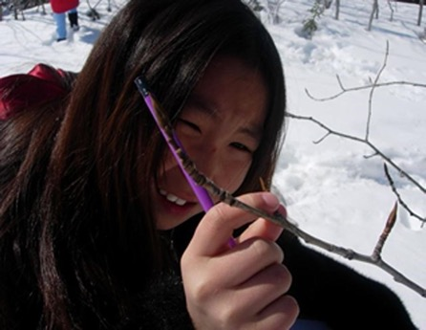
Why Collect Green-Up Data?
Your observations are valuable contributions to the scientific community and may be used by educators, students, researchers, and the general public to increase environmental awareness and STEM literacy, as well as advance Earth system science.

Slide 9
Time Requirements
Frequency of observations: Ideally, visit plant at least two times a week to check for the start of green-up and continue observing until leaf growth plateaus.
Reporting the number of growing seasons: Some locations have multiple growing seasons in a year.
On your data sheet, report which cycle you are observing.
In a location where there is only one growing cycle, report green cycle 1.
The onset of the first green-up after 1 January is considered green-down cycle 1.

Slide 10
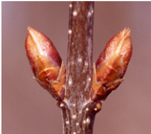

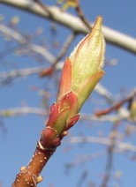
Important Definitions for Green-Up
Dormancy is a state of suspended growth and metabolism.
Swelling is seen when the bud is getting bigger.
Budburst is the emergence of new leaves on plants, which signals the beginning of a new growing season cycle.

Slide 11





Tree and Shrub Green-Up Protocol
Assemble Field Equipment
What You Need
Pencil or pen.
Camera
Compass
Fine-Tip Permanent Marker
Ruler with mm units
Tree ID Guide
Every Visit
Ruler with mm units
Pencil or pen
Documents Needed in the Field
Site Definition Sheet
Tree and Shrub Green-Up and Green-Down Site Selection
Tree and Shrub Green-Up Data Sheet
Tree and Shrub Green-Up Protocol Field Guide
Notes:
Check names of field guides and data sheets

Slide 12
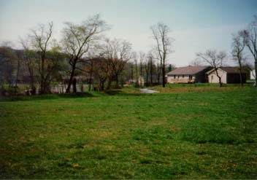
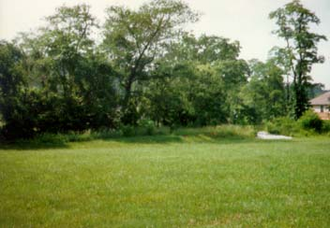
Tree and Shrub Green-Up Protocol (1/9 slides)
Overview
Define the site
Take GPS measurement
Tree and shrub species
Take pictures of study site
Tree or shrub data: four buds of the same branch
  date
  bud condition
  leaf length

Slide 13
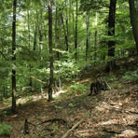

Site selection (2/9)
Site selection is important!
Choose plants that are indicative of the surrounding climate:
  Native species
  Not watered or fertilized
  Away from buildings
Choose a site that is accessible and can be visited repeatedly.
If possible, choose the same plant/s each year.
    To determine if the plant is too close to a building, stand at the plant and sight the top of the building through your clinometer. If the angle is greater than 45˚, the building is too close.

Slide 14
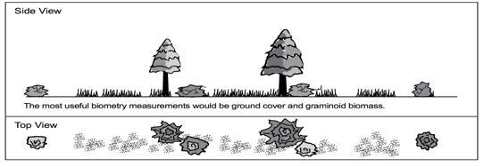
Other Site Selection Considerations (3/9)
Select one or more species that is common in your area. Think from the perspective of a satellite – what is the satellite “seeing”?
If you are also doing atmospheric or soil moisture protocols, select a site less than 2 km from your atmosphere or soil moisture site, and an elevation difference less than 100 meters. This is important because local topography affects weather significantly.
Satellite View

Slide 15
Site preparation: Trees and shrubs (4/9)
Before collecting data, set up the site using the Tree and Shrub Green- Up and Green-Down Site Selection Field Guide
Complete sections of Site Definition Sheet.
Select a shrub or tree- It should be a dominant native species, deciduous and easily accessible.
Select large and healthy branch. If a lower branch is chosen, it should
be on the edge of the stand of trees or shrubs since branches inside a stand may experience a different microclimate due to shading:
  North side of plant if living in Southern Hemisphere
  South side of plant if living in Northern Hemisphere
Identify genus and species.
Mark selected tree and branch with flagging tape.
Locate coordinates using your phone or the GPS Protocol.
Site preparation is done only once. This step can be done before or during first green up visit. You are done with this step!

Slide 16
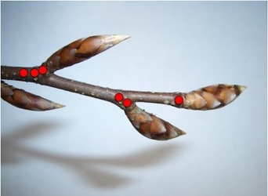
First Visit: Tree and Shrub Green-Up Protocol (5/9)
First time only: getting started
Complete the upper portion of your Tree and Shrub Green-Up Data Sheet.
2. For the selected tree or shrub, locate the bud at the end of the branch. Label this bud by marking one dot on the branch next to the bud.
3. Locate the three other buds closest to this bud. Label these buds by marking two, three, or four dots next to them.
Photo Credit: Markus Eugster

Slide 17
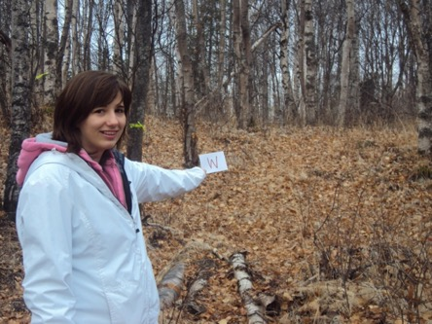
First Visit: Tree and Shrub Green-Up Protocol (6/9)
First time only: getting started
4. Take a photograph from the center of your site looking in the north, south, east, and west directions.

Slide 18
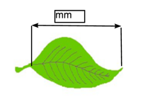
Every Visit: Tree and Shrub Green-Up Protocol (7/9)
1. Examine each bud.
Record “dormant” if the bud is unchanged.
Record “swelling” if the bud is getting bigger.
Record “budburst” the first day you see the green tips of leaves.
Record “lost” if something happens to the bud and you cannot continue observations.
2. After each budburst, use a ruler to measure the length of the leaf or leaves. Do not include leaf stem or petiole in your leaf measurements.
3. Measure the leaves until the leaf length stops increasing. Different leaves may stop growing at different dates

Slide 19
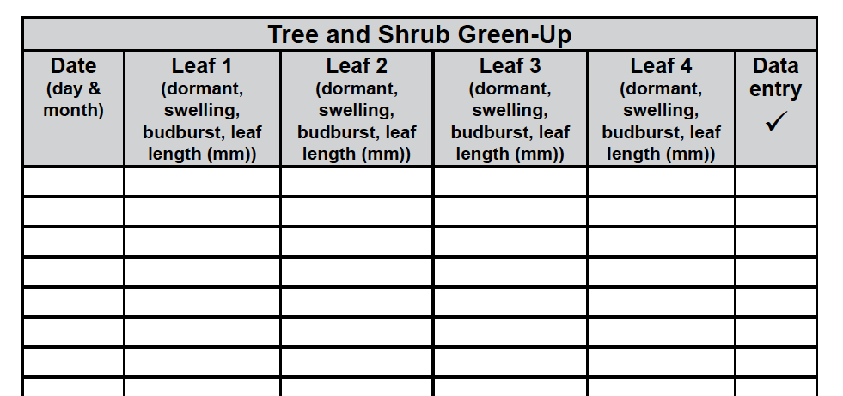
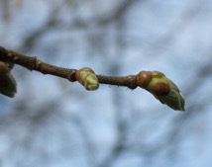
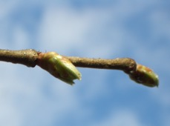

Every Visit: Tree and Shrub Green-Up Protocol (8/9)
Record the data on your datasheet.
Measure leaf length
swollen
budburst

Slide 20
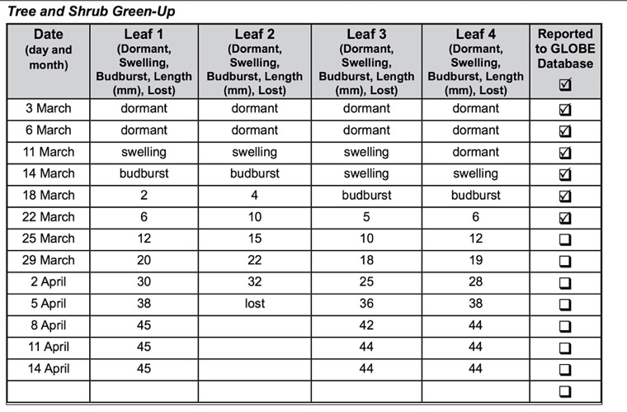
Example of Completed Data Sheet (9/9)

Slide 21
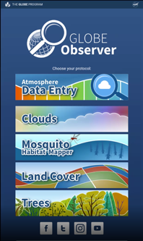
Report Your Data to GLOBE
Desktop Data Entry: Log environmental data directly on the GLOBE website.
Email Data Entry: If connectivity is an issue, data can also be entered via email.
GLOBE Observer App: The app allows users to enter data directly from an iOS or Android device for any GLOBE protocol.
Step 1: Confirm that a Green-Up Study Site has been defined
Step 2: Select “Green-Up” from the Phenology data entry menu
Step 3: Select your Study Site, enter the date and growing season cycle
Step 4: Enter data for the grass/ leaves/buds from each line of the data sheet, one at a time
Step 5: Confirm data entries on verification page

Slide 22
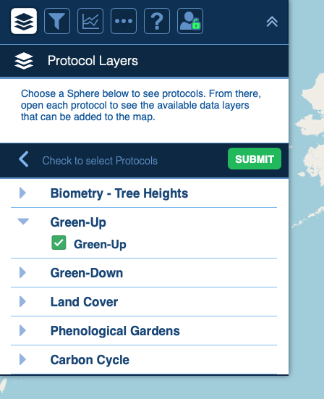
Visualize and Retrieve Data
GLOBE provides the ability to view and interact with data measured across the world. Use the visualization tool to map, graph, filter and export Green-Up data that have been measured across GLOBE protocols since 1995.
Click the layers icon.
Click Submit.
Select Green-up under the Biosphere drop down
See video tutorials on using the GLOBE Visualization system.

Slide 23
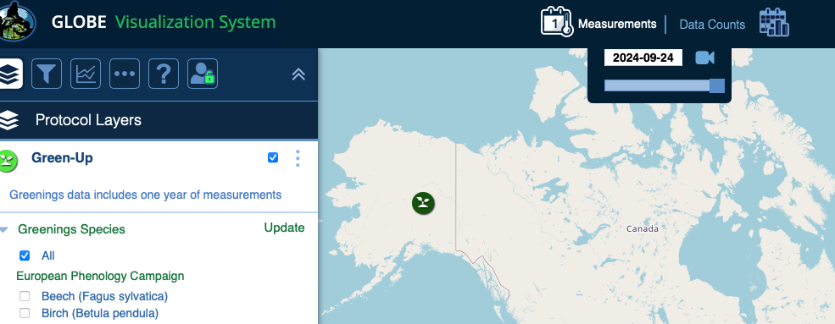
Visualize and Retrieve Data
Select the date for which you need Green-Up data.

Slide 24
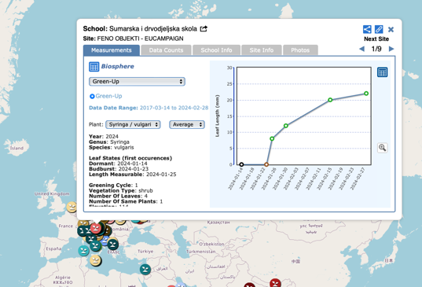
Visualize and Retrieve Data
Select the sampling site for which you need Green-Up Data, and a box will open with a data summary for that site.
Click on the table icon to view the data in a table and download it as a .csv for analysis.
Clicking on a location will open to a map note providing Green-Up data for that location and time.

Slide 25

Review questions to help you prepare to do the Tree and Shrub Green- Up Measurements as part of the GLOBE Phenology Protocols
Tree Green-Up measurements are part of what GLOBE Protocol area or Earth system sphere?
What is phenology?
Why is it important for scientists to know when Green-Up takes place in a location, year by year?
Define these terms: Dormancy, Swelling and Budburst.
Why is it important that your sampling site is not located close to a building?
Why do you think it is important to monitor green-up of a dominant native species?
Why is it important to identify your tree to genus and species?
How do you mark the buds so you know to measure the same buds throughout the green-up season?
When you measure the leaf, do you measure from the base of the leaf stem?

Slide 26
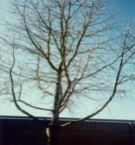
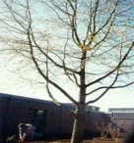
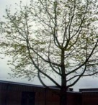
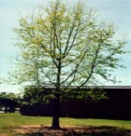
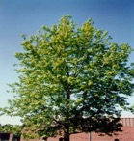
You have now completed the slide stack. Sign on to the GLOBE website, and take the assessment corresponding to Tree and Shrub Green-Up Protocol.
When you pass the assessment, you are ready to take Tree and Shrub Green-Up measurements!
Welcome to the Green-Up GLOBE community!

Slide 27
Frequently Asked Questions
Will the marker hurt the bud?
Do not mark the bud itself. Mark the woody branch next to it. That way you will not hurt the plant.
What do you mean by a relatively large branch?
Use your judgment. Each branch should be healthy and large relative to the other branches on the tree or shrub. You want the branch to still be there next year. Be careful not to damage the branch during the labeling and measurements.
What if a branch breaks during the study?
Continue your observations by teaming up with other students and observing their branch.
Will all the buds start to swell at the same time?
No. Some of the buds on your branch may not green-up on exactly the same day as the terminal bud.
Should I look at the same buds from year to year?
You should observe the same branch, which will typically have new terminal buds each year.

Slide 28
Frequently Asked Questions
What if needle-leaved trees are the abundant vegetation?
Usually there are understory deciduous shrubs that can be used instead. For example, Snowberry in Douglas Fir, Gamel Oak in Ponderosa Pine. Typically these deciduous plants are what the satellites are detecting as Green-up. The Green-up of conifers is a subtle process and not easily observed.
What if multiple leaves emerge from a single bud after the bud bursts open?
Choose one of the leaves and mark it with the permanent marker. Take measurements
of the marked leaf.

Slide 29
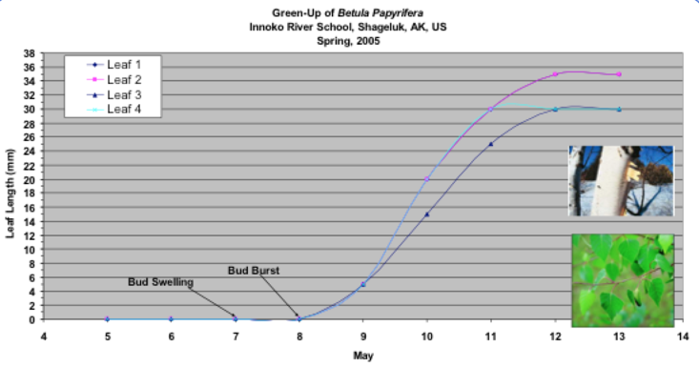
Data Analysis Example
Do leaves grow at the same rate for different species?
Will leaves of the same species grow at the same rate at different locations?
This graphic shows the green-up data of Betula papyrifera (paper birch) collected by the Innoko River School in Shagleuk, Alaska in May, 2005. Four different leaves were measured, but two of the leaves have the same green-up trend, so the lines lay on top of each other. You can see that the green-up of these paper birch leaves happened in a span of five days. It appears that the leaves have stopped growing because the curves have plateaued, but we need additional observations to be sure. Source: GLOBE.

Slide 30
Research Questions for Further Investigation:
How long does green-up take for a given species?
How does green-up differ among different species within a forested study area?
How does green-up relate to precipitation? To soil moisture?
Does temperature influence the rate of green-up?

Slide 31
For more information visit www.globe.gov or contact training@nasaglobe.org.

