Slide 1
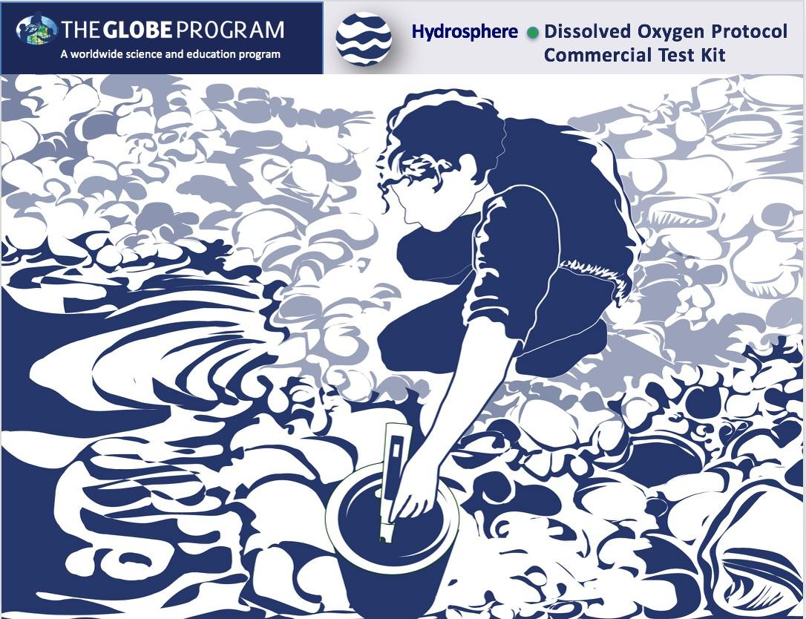


Slide 2

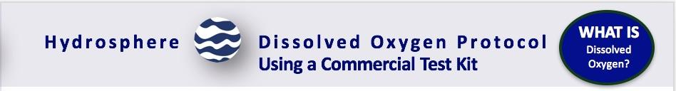
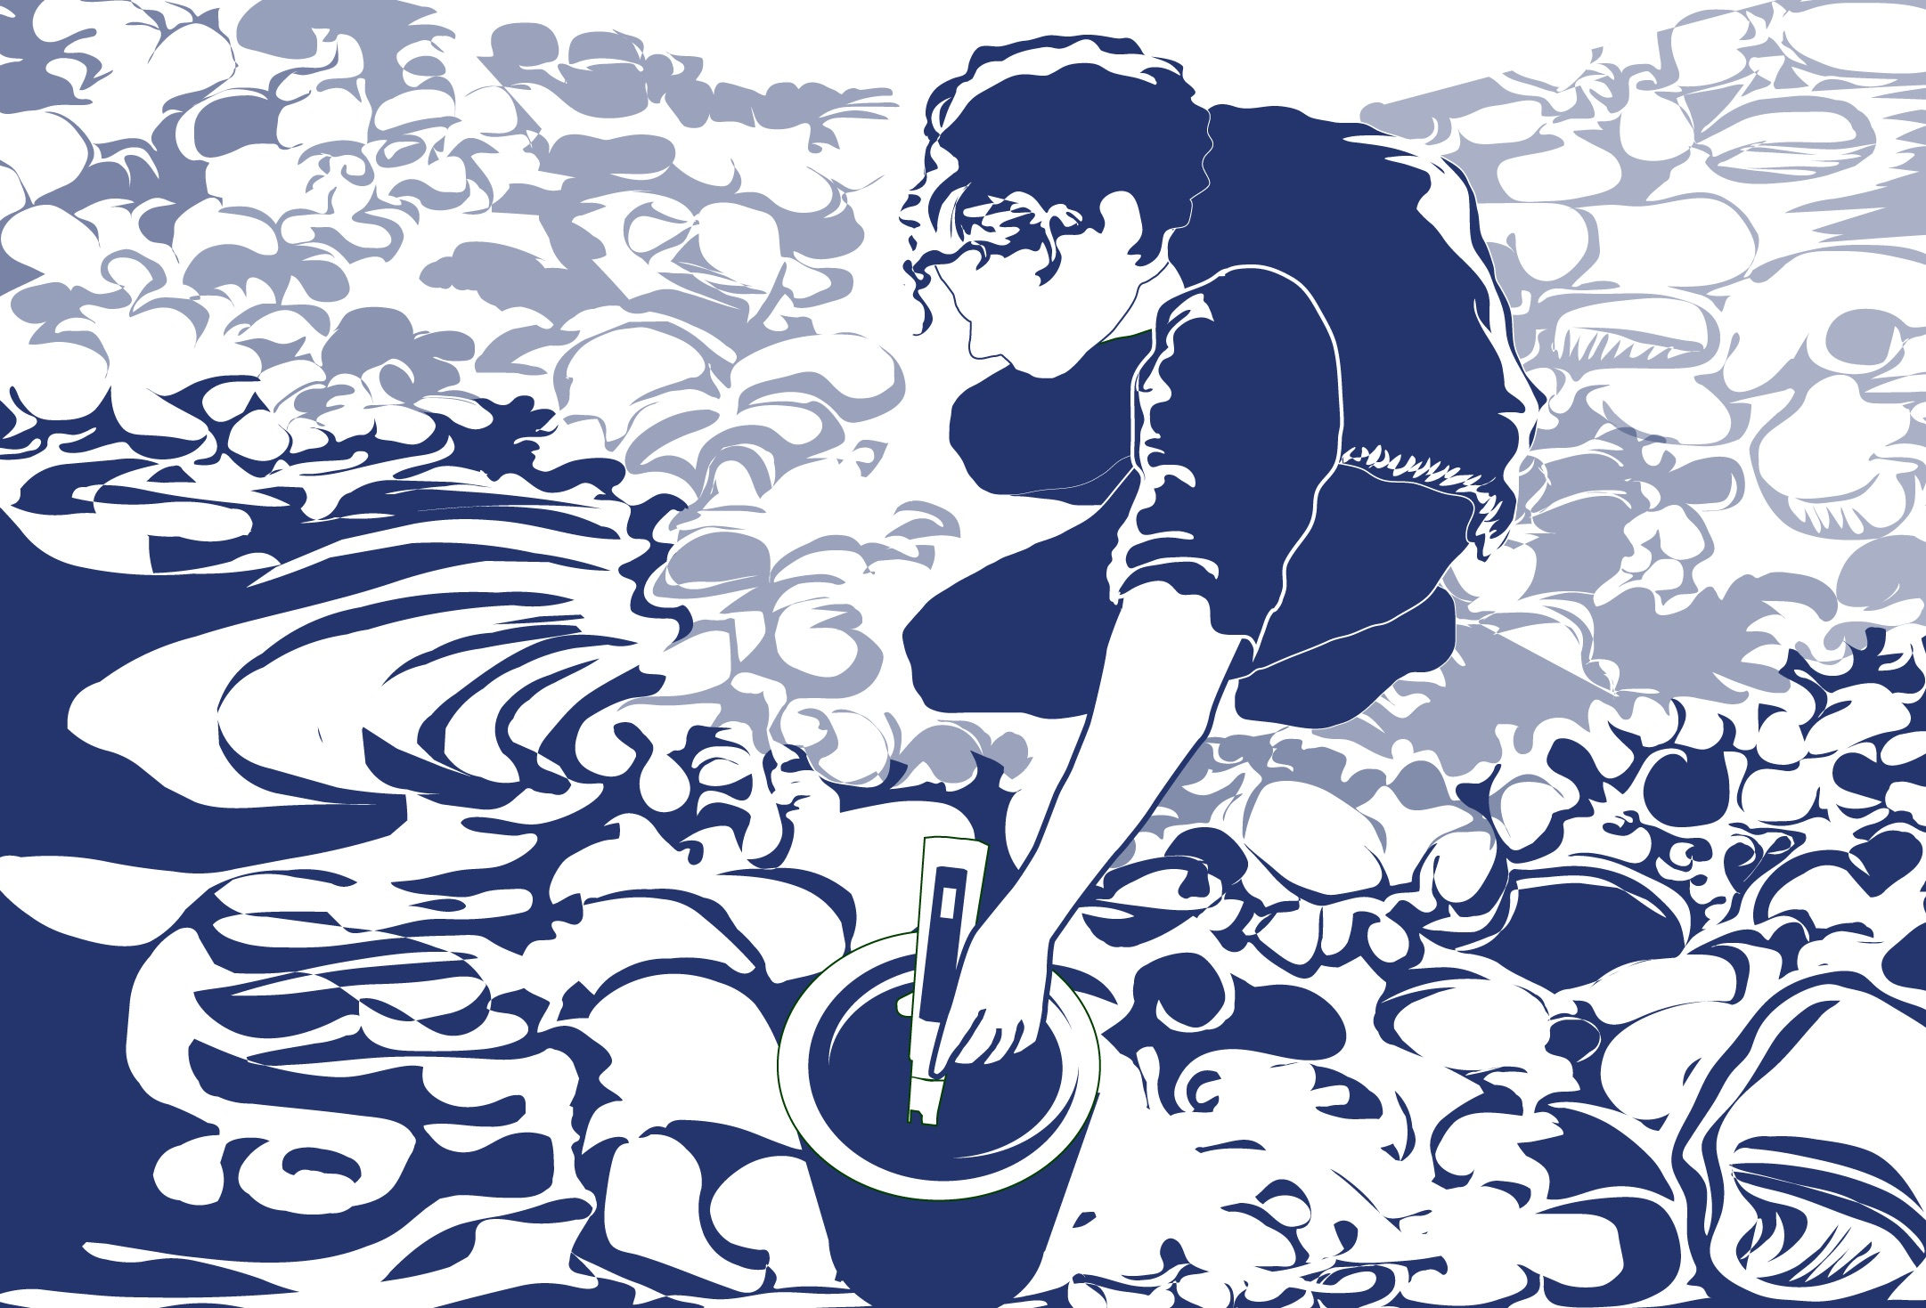
Overview
This module:
Reviews the selection of a GLOBE hydrology site
Reviews the water sampling technique used in GLOBE hydrology protocols
Provides a step by step introduction of the protocol method
Learning Objectives
After completing this module, you will be able to:
Define dissolved oxygen and explain how changing environmental conditions result in different measurements
Describe the importance of instrument calibration in the the collection of accurate data
Conduct dissolved oxygen measurements using a test kit
Upload data to the GLOBE portal
Visualize data using GLOBE’s Visualization System

Slide 3
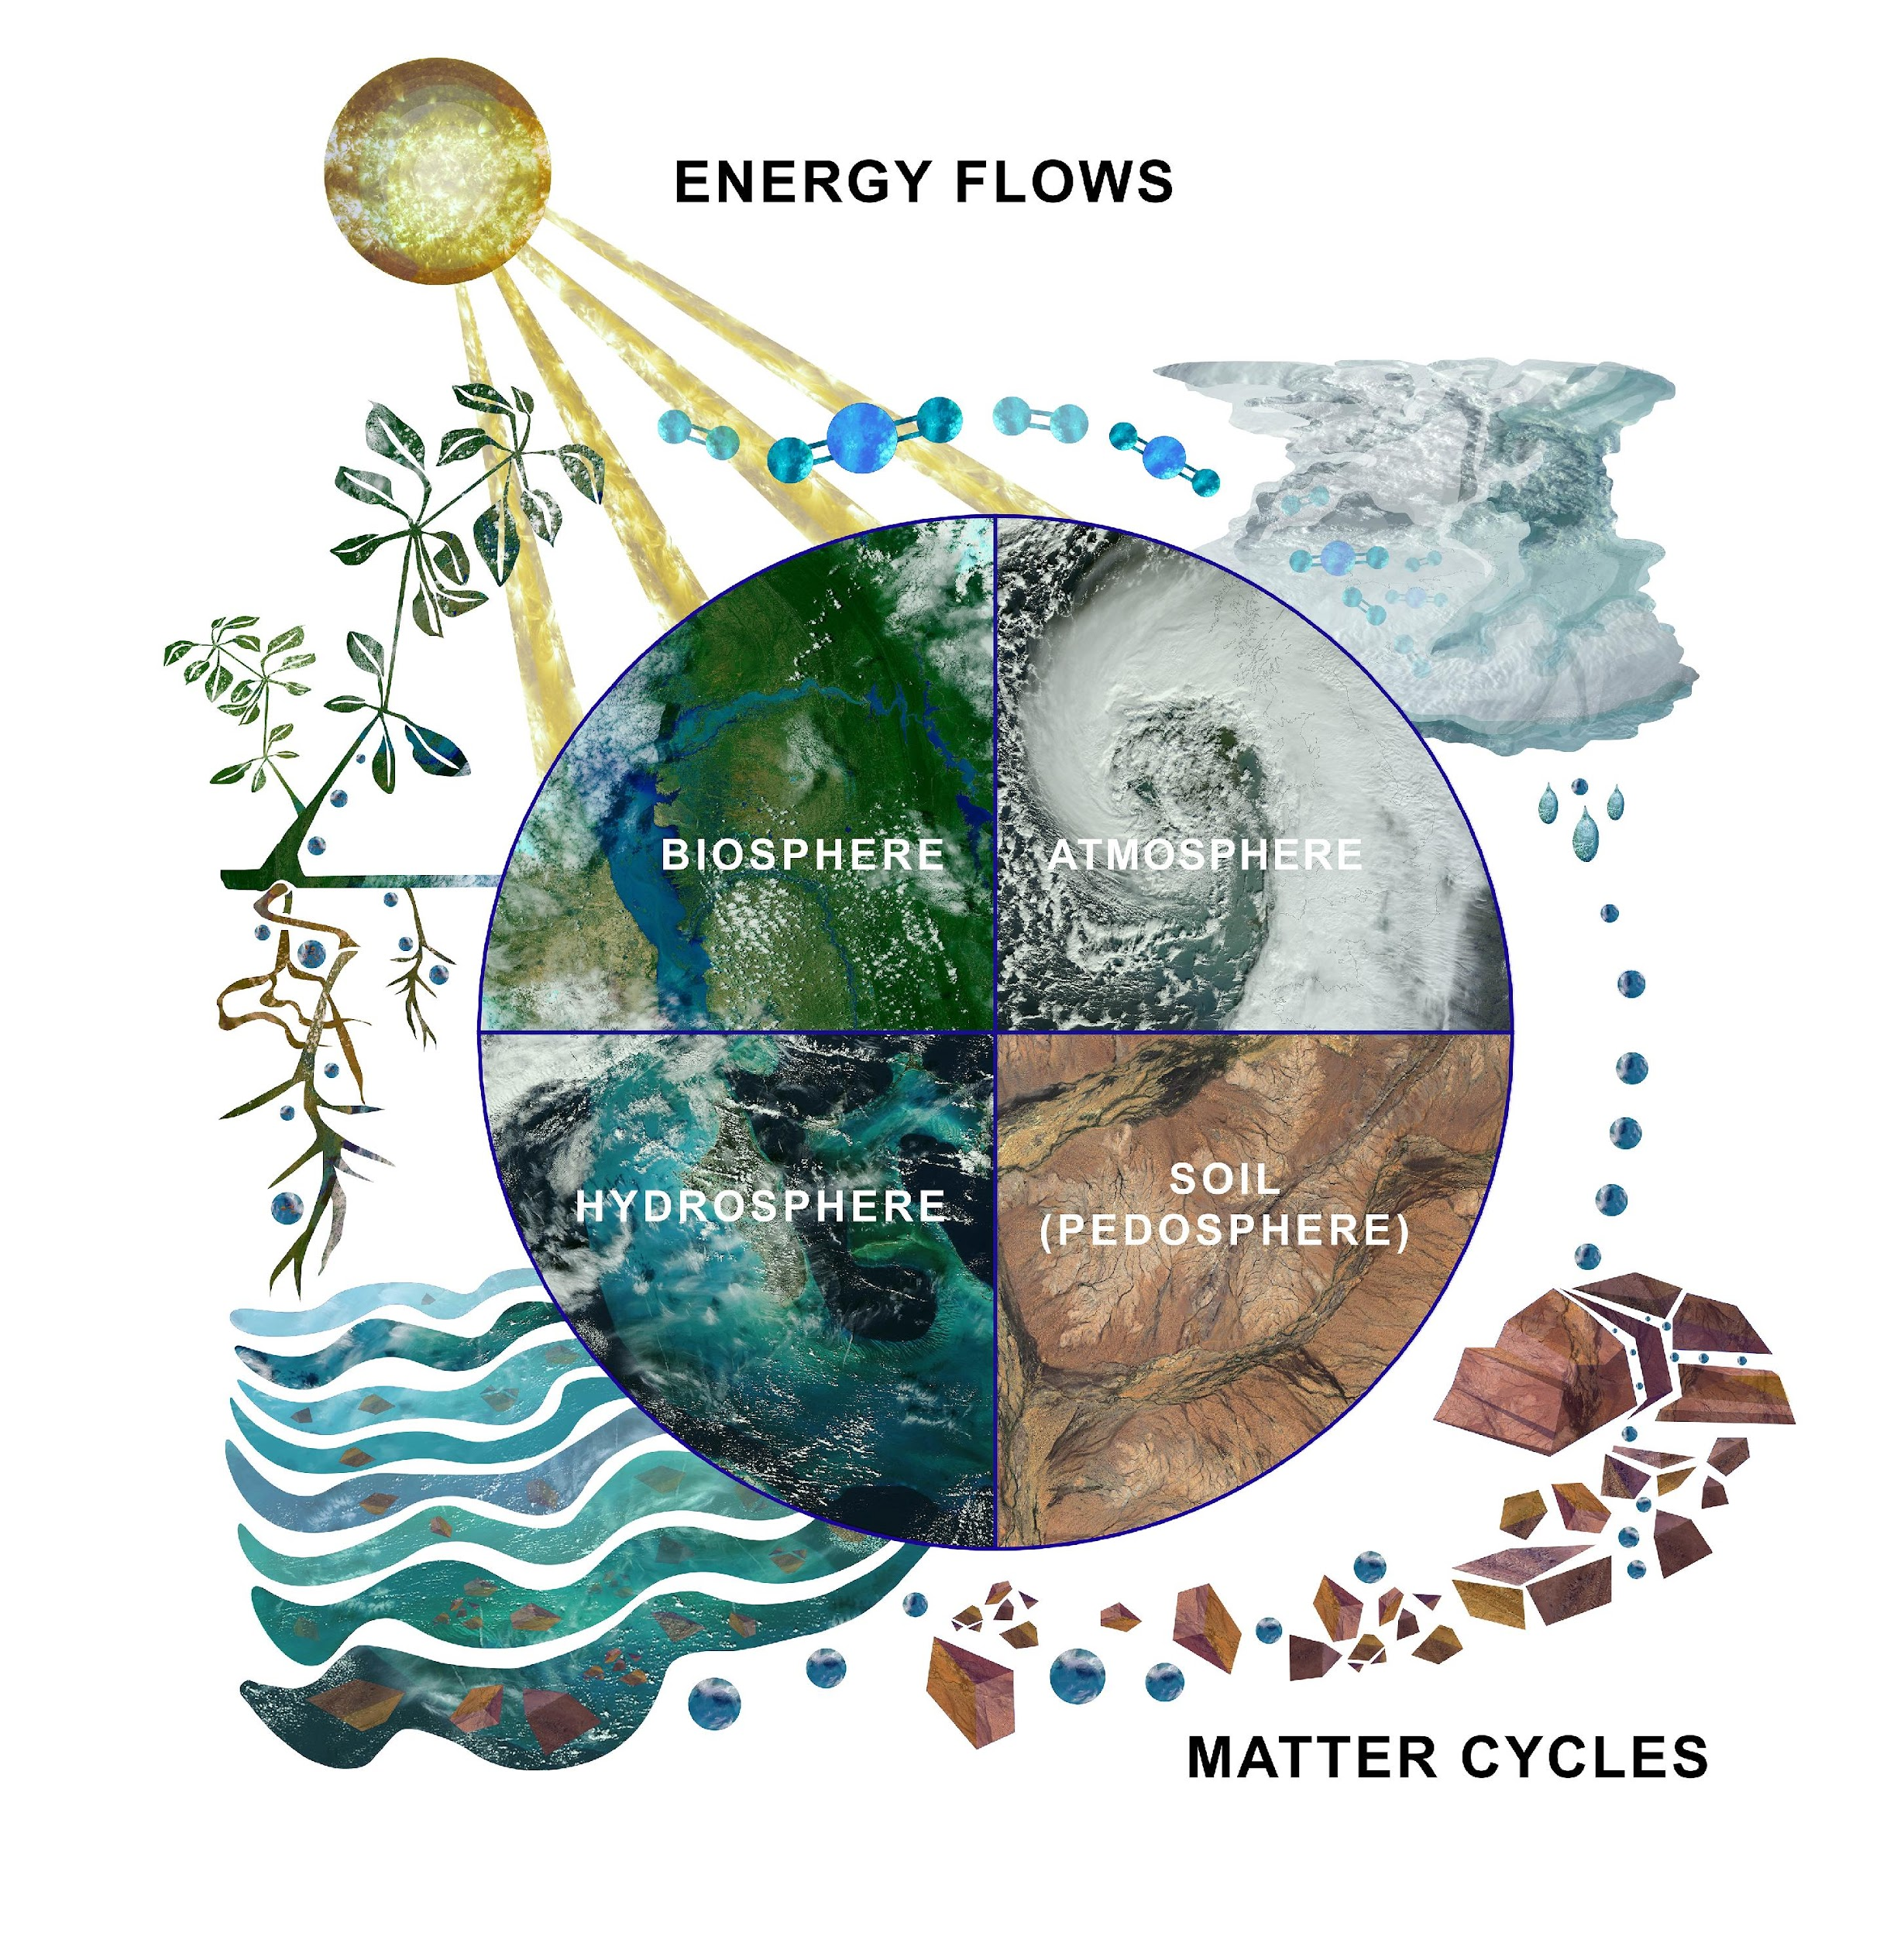
The Hydrosphere
The hydrosphere is the part of the Earth system that includes water, ice and water vapor. Water participates in many important natural chemical reactions and is a good solvent. Changing any part of the Earth system, such as the amount or type of vegetation in a region or from natural land cover to an impervious one, can affect the rest of the system. Rain and snow capture aerosols from the air. Acidic water slowly dissolves rocks, placing dissolved solids in water. Dissolved or suspended impurities determine water's chemical composition.
Current measurement programs in many areas of the world cover only a few water bodies a few times during the year. GLOBE Hydrosphere protocols will allow you to collect valuable data to help fill these gaps and improve our understanding of Earth's natural waters.
The Earth System: Energy flows and matter cycles.

Slide 4
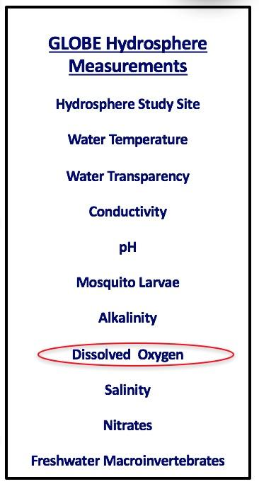
What is Dissolved Oxygen (DO)?
Dissolved oxygen (DO) is one of 10 measurements used by GLOBE to describe the characteristics of a water body. It measures the amount of molecular oxygen (O₂) in the water. It does not measure the amount of oxygen in the water molecule (H₂O).
We call the amount of dissolved oxygen the water will hold (under specific conditions) the solubility of dissolved oxygen. Factors affecting the solubility of dissolved oxygen include water temperature, atmospheric pressure, and salinity. Colder water can dissolve more oxygen than warmer water. Water at higher elevations holds less dissolved oxygen since the atmospheric pressure is less.

Slide 5
What to know about DO!
Dissolved oxygen (O₂) in water is measured in parts per million (ppm). The amount of O₂ in water is much less than in air. Roughly, two out of ten air molecules are molecular oxygen. In water, however, there are only five or six oxygen molecules for every million water molecules.
Dissolved oxygen can be added to water by plants during photosynthesis, through diffusion from the atmosphere, or by aeration. Aeration occurs when water is mixed with air. Such mixing occurs in waves, riffles, and waterfalls.
Dissolved oxygen can be consumed during respiration of biota (e.g., animals and bacteria). Many fish species require at least 5 ppm to survive and reproduce.
Hypoxia is a condition when there is less than 2 ppm of DO in the water. Anoxia is when there is little to no DO in the water.

Slide 6

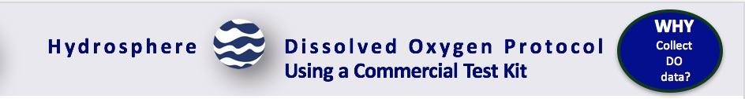
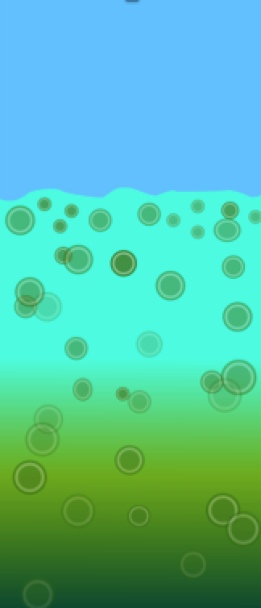
Why Collect Water DO Data?
Just like animals that live on land, animals that live in water need molecular oxygen to breathe.
Most organic matter in aquatic ecosystems is non-living and it is collectively referred to as detritus. The organic matter can be produced in situ or enter water bodies from the surrounding land (from both natural and human sources). The cycling of organic carbon between living and nonliving components is known as the carbon cycle. Organic matter is produced during photosynthesis and is consumed during respiration. During respiration, biota (fish, bacteria, etc.) consume dissolved oxygen.
Although plants and algae add valuable oxygen to the water, overgrowth can potentially lead to reduced light levels in the water body. As plants and algae die and decay, bacteria multiply and use the dissolved oxygen in the water. The amount of available dissolved oxygen in the water may become very low and harm fish and other aquatic animals.
Conceptual Diagram: Eutrophic water column with microscopic algae enlarged for emphasis.

Slide 7

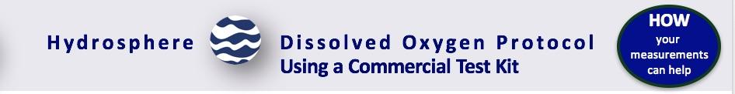
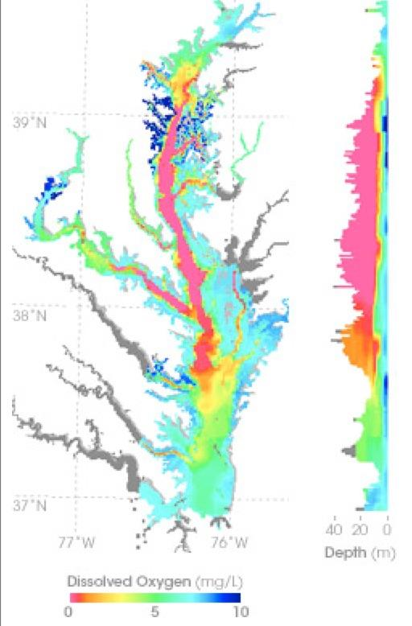
Case Study: Chesapeake Bay, USA-1
In summer 2004, a dead zone spanned more than a third of the Chesapeake Bay floor. Around the world, similar dead zones are occurring with increasing frequency in estuaries and near the mouths of major rivers. Local pork and chicken production creates manure, which runs off into tributaries feeding the Chesapeake Bay. nitrogen in the water makes algae and other single-celled plants (phytoplankton) grow excessively. As the excess algae die, bacteria that decompose the plant matter may use up virtually all the dissolved oxygen in the water, creating bottom-hugging, low-oxygen “dead zones.” This map shows measurements of dissolved oxygen for July 15–30, 2004. The graph on the right shows dissolved oxygen levels between the surface and a depth of 40 meters through the center of the Bay. Orange and red colors correspond to the dead zone.
When you monitor the nitrate concentration at your study site, you are providing exactly the kind of information that is needed to understand how dead zones are created in our aquatic systems.

Slide 8
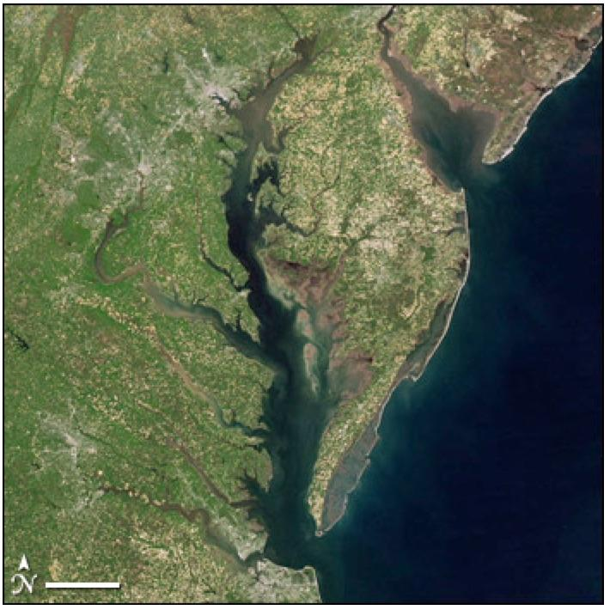
Case Study: Chesapeake Bay, USA-2
Researchers use satellite measurements of ocean color to estimate the amount of microscopic plant life that lives in the Chesapeake Bay and other bodies of water. Ocean color depends on what is in the water. When large numbers of plants are growing in the water, the chlorophyll and other plant pigments affect the water’s color, making it greener, sometimes even with shades of red. The kinds and amounts of plant life are indicators of the health of marine ecosystems.
Read more here: Earth Observatory
(NASA image courtesy Jeff Schmaltz, MODIS Rapid Response)

Slide 9

Let’s Test your Knowledge! Question 1
True or False: The dissolved oxygen measurement measures oxygen found in the water molecule

Slide 10
Let’s Test your Knowledge! Answer to Question 1
True or False: The dissolved oxygen measurement measures oxygen found in the water molecule
Answer: False. The measurement does not measure the oxygen in water molecules ☺

Slide 11
Let’s Test your Knowledge! Question 2
True or False: All other things being equal, colder water can dissolve more oxygen than warmer water.

Slide 12
Let’s Test your Knowledge! Answer to Question 2
True or False: All other things being equal, colder water can dissolve more oxygen than warmer water.
Answer: True ☺

Slide 13
Let’s Test your Knowledge! Question 3
Which of the following is a way that oxygen can be added to an aquatic system?
By plants during photosynthesis
Through diffusion from the atmosphere
By aeration, which is the mixing of water by air, through things like waves and waterfalls.
A and B only
A, B, and C

Slide 14
Let’s Test your Knowledge! Answer to Question 3
Which of the following is a way that oxygen can be added to an aquatic system?
By plants during photosynthesis
Through diffusion from the atmosphere
By aeration, which is the mixing of water by air, through things like waves and waterfalls.
A and B only
A, B, and C- correct ☺

Slide 15
Let’s Test your Knowledge! Question 4
When is water considered to be hypoxic? Hypoxia is a condition where there is:
Less than 2 ppm of dissolved oxygen in the water
When here is no dissolved oxygen in the water
When there is too much dissolved oxygen in the water

Slide 16
Let’s Test your Knowledge! Answer to Question 4
When is water considered to be hypoxic? Hypoxia is a condition where there is:
Less than 2 ppm of dissolved oxygen in the water- correct! ☺
When here is no dissolved oxygen in the water
When there is too much dissolved oxygen in the water

Slide 17

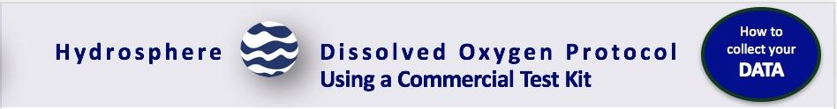
Protocol at a Glance
Where | Hydrology study site
Time Needed | Kit Quality Control: 20 minutes; Kit measurements 20 minutes
Prerequisites | Hydrology Investigation Study Site Definition. Salinity Protocol, if investigating ocean or brackish waters
Key Instrument | Dissolved Oxygen Kit
Skill Level | Middle and Secondary
Frequency | Ideally, weekly. Quality Control Procedure every 6 months. Probe calibration every time probe is used

Slide 18
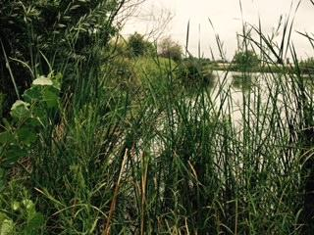
Simultaneous or Prior Investigations Required Prior to Doing the Dissolved Oxygen Protocol
The Water DO Protocol will allow you to determine the amount of dissolved oxygen of a water body. This protocol is conducted at your GLOBE Study Site. You will need to define your GLOBE Study Site where you will conduct your Hydrosphere Investigation prior to beginning this protocol. The Hydrosphere Investigation Data Sheet is used to record all the hydrosphere measurements, including DO. You will also want to map your Hydrosphere Site at some point.
Dissolved Oxygen Data Sheet
GLOBE Study Site Definition Sheet
Hydrosphere All Protocols Data Sheet
Mapping your Hydrosphere Study Site Field Guide

Slide 19
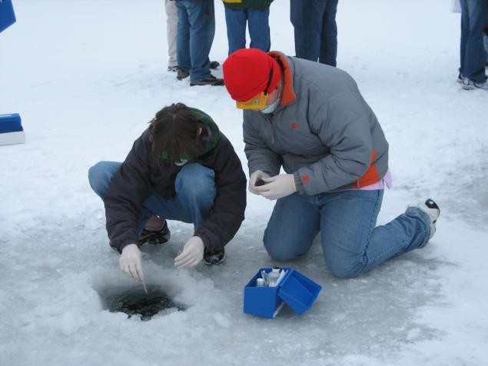
Site Selection: Hydrosphere Study Requirements
All your hydrosphere measurements are taken at the same Hydrosphere Study Site. This may be any surface water site that can be safely visited and monitored regularly, although natural waters are preferred. Sites may include (in order of preference):
1. Stream or river
2. Lake, reservoir, bay or ocean
3. Pond
4. An irrigation ditch or other water
body, if natural body is not available
Students measure nitrate, pH and DO through ice covering the Volga River.

Slide 20
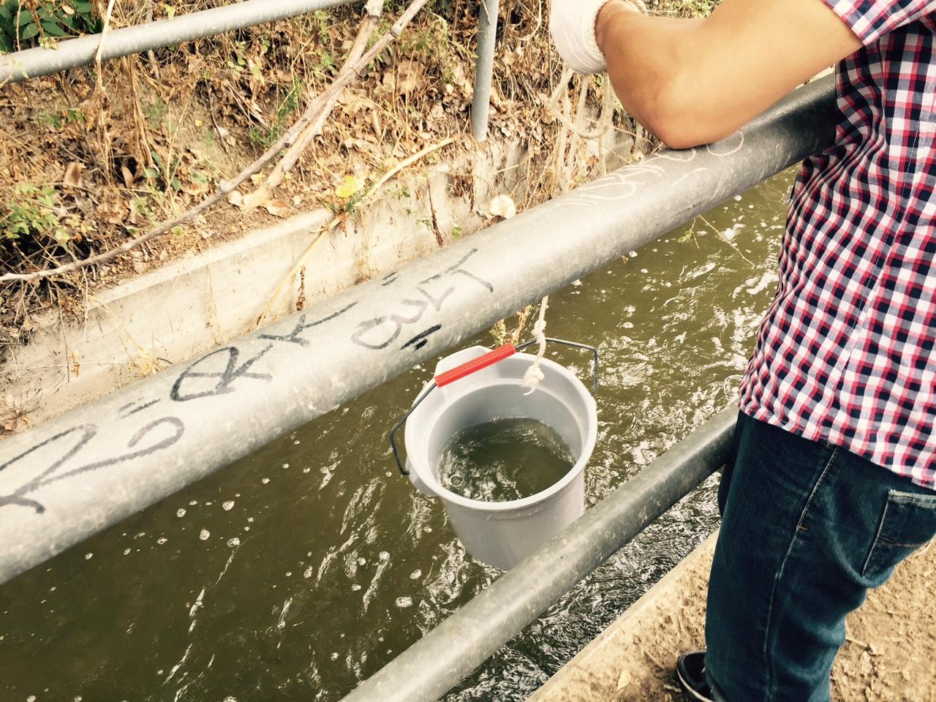
Site Selection: Hydrosphere Study Site
Select a specific site where the hydrosphere measurements (water temperature, dissolved oxygen, nitrate, pH, alkalinity, turbidity, and either conductivity or salinity) will be taken. If the selected study site is a moving body of water (i.e. stream or river), locate your sampling site at a riffle area as opposed to still water or rapids. This will provide a more representative measurement of the water in the stream or river. If the selected study site is a still body of water i.e. a lake or reservoir), find a sampling site near the outlet area or along the middle of the water body. Avoid inlet areas. A bridge or a pier are good choices. If your water body is brackish or salty, you will need to know the times of high and low tide at a location as close as possible to your study site.

Slide 21

Overview of Water DO Protocol
You can collect DO by using DO test kits or probes. The instructions here will focus on the test kits.
To test for the accuracy of the procedure and the precision of the kit (e.g., the components and chemicals), a quality control procedure should be conducted.
The kits have two main parts: sample preservation (stabilization or fixing) and sample testing. Preservation involves the addition of a chemical to the sample that precipitates in the presence of dissolved oxygen, followed by the addition of a chemical that produces a colored solution. Testing involves adding drops of a titrant solution until the color disappears. The dissolved oxygen value is calculated from the volume of titrant added.
The amount of DO can change rapidly after a sample is collected. It is important to preserve the water sample shortly after collecting. After sample preservation, sample testing can be done either in the field or taken back to the lab to determine the amount of DO in the water.

Slide 22

Sources for Equipment You Need for the Water DO Protocol
The following resources summarize the measurements associated with each protocol, associated skill level, scientific specifications for the instruments, and how to access the equipment you need (purchase, build, or download).
Where to find specifications for instruments used in GLOBE investigations
Where to find scientific instruments used in GLOBE investigations
.

Slide 23
Overview: Quality Control Procedure for Dissolved Oxygen
Kits (slide 1/7)
For the quality control procedure, you compare the measured dissolved oxygen in your standard solution with the saturated value from a table in order to determine if your kit and procedures are correct.
To make a saturated standard, you saturate distilled water by shaking a partially filled bottle of distilled water for 5 minutes. Since the solubility decreases with increasing temperature, increasing salinity, and decreasing air pressure, you control these variables in your dissolved oxygen standard by using distilled water, and correcting for the water temperature and elevation (an indirect measure of air pressure). You need to know the elevation where the procedure will be done. Table HY-DO-2 contains the correction values for various atmospheric pressures and elevations.
Pay close attention to your quality control procedure. Without the quality control steps your DO data will not be meaningful or comparable to data collected by others!
.

Slide 24
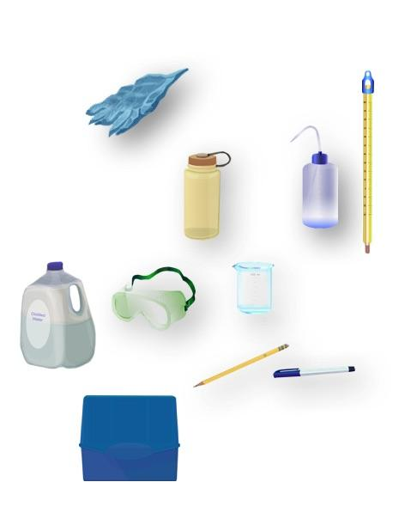
Quality Control Procedure for Dissolved Oxygen (2/7)
Assemble Equipment:
Distilled water
100-mL graduated cylinder
250-mL polyethylene bottle with lid
Thermometer
Waste bottle with cap for discarding used chemicals
Dissolved oxygen test kit
Latex gloves
Goggles
Pen or pencil
Clock or watch
Assemble Necessary Documents:
Dissolved Oxygen Protocol (Test Kit)
Quality Control Procedure Data Sheet
Quality Control Procedure for DO Kits Lab Guide

Slide 25

Quality Control Procedure for Dissolved Oxygen (3/7)
Put on your gloves and protective goggles.
2. Rinse the 250-mL bottle twice with distilled water.
3. Pour 100 mL of distilled water into the 250-mL bottle.
4. Put the lid on the bottle. Shake the bottle vigorously for 5 minutes. This is the standard you will use to test your kit.
5. Uncap the bottle and take the temperature of the water (see Water Temperature Protocol Field Guide). Be sure the tip of the thermometer does not touch the bottom or sides of the bottle.
6. Record the temperature of the distilled water standard on the Hydrosphere Investigation Quality Control Data Sheet.

Slide 26
Quality Control Procedure for Dissolved Oxygen (4/7)
7. Pour the standard into the sample bottle in your dissolved oxygen kit. Fill the sample bottle completely to the top. Put the lid on the sample bottle. Turn the bottle upside down while it is capped. There should not be any air bubbles.
Note: It is not necessary to immerse the sample bottle in the water to collect your sample when you are doing the quality control procedure.
8. Follow the directions in your dissolved oxygen kit to measure the dissolved oxygen of your standard.
9. Record the amount of dissolved oxygen (mg/L) in your standard on your Hydrosphere Investigation Quality Control Data Sheet.

Slide 27
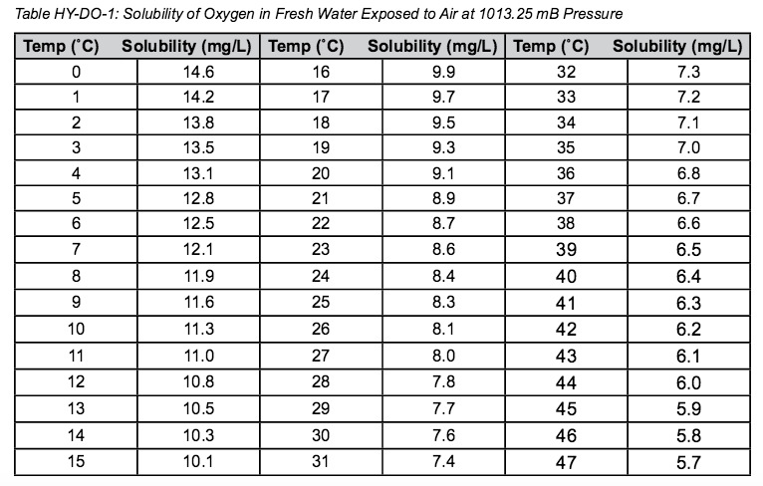
Quality Control Procedure for Dissolved Oxygen (5/7)
10. Look up the temperature you recorded earlier on the Solubility of Oxygen Table. See Table HY-DO-1.
11. Record the solubility for your water temperature.

Slide 28
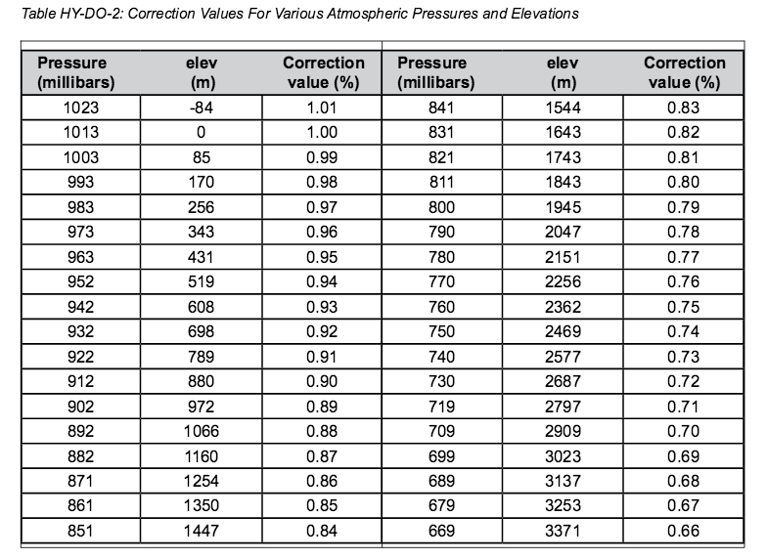
Quality Control Procedure for Dissolved Oxygen (6/7)
12. Find the elevation closest to yours on the Correction for Elevation/Pressure Table. See Table HY-DO-2.
13. Record the correction value for your elevation.

Slide 29
Quality Control Procedure for Dissolved Oxygen (7/7)
14. Multiply the solubility of your standard times the correction value. This is the expected amount of dissolved oxygen in your standard.
15. Compare the amount of dissolved oxygen you measured with the kit to the expected amount for your standard.
16. If the measurement is within ±1mg/L, record the dissolved oxygen value on the Hydrosphere Investigation Quality Control Procedure Data Sheet. If the measurement is not within this range, repeat the entire quality control procedure.
17. If your measurements are still not in range, your kit may not be working properly.
18. Pour all used chemicals into the waste bottle. Clean your kit with distilled water.
You are done with the Dissolved Oxygen Quality Control procedure and can now move to the Dissolved Oxygen Protocol.

Slide 30
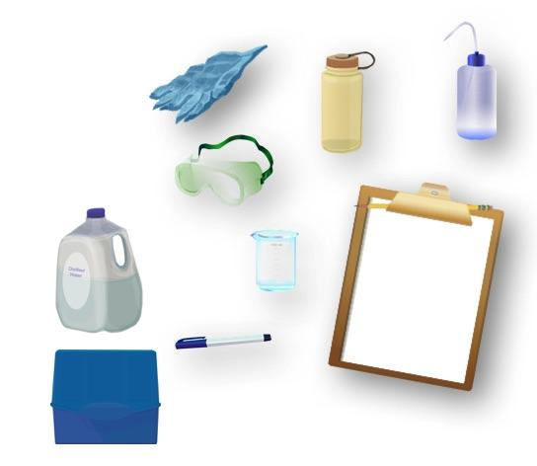
Dissolved Oxygen Protocol Using a Commercial Test Kit (1/3)
Objective: Measure dissolved oxygen of water sample with test kit.
What You Need
Distilled Water
Waste Bottle with Cap for used chemicals
Latex Gloves
Pen or Pencil
Goggles
Dissolved Oxygen Test Kit

Slide 31
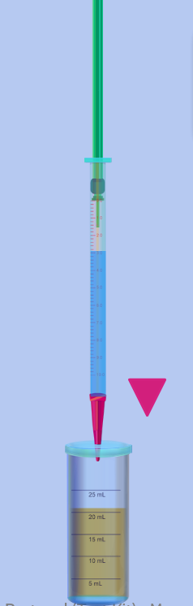
Dissolved Oxygen Protocol Using a Commercial Test Kit (2/3)
In the field
Fill out the top of the Hydrosphere Investigation Data Sheet
Put on protective gear (gloves and goggles), prior to working with chemicals
Rinse the sample bottle and hands with sample water three times
Place cap on sample bottle and submerge in sample water
Remove the cap and allow bottle to fill (agitate the bottle to remove air bubbles)
Replace cap while bottle is submerged
Remove sample bottle and turn upside down to check for air bubbles (if present discard sample water and repeat process)
Follow the measurement instructions included with the kit.

Slide 32
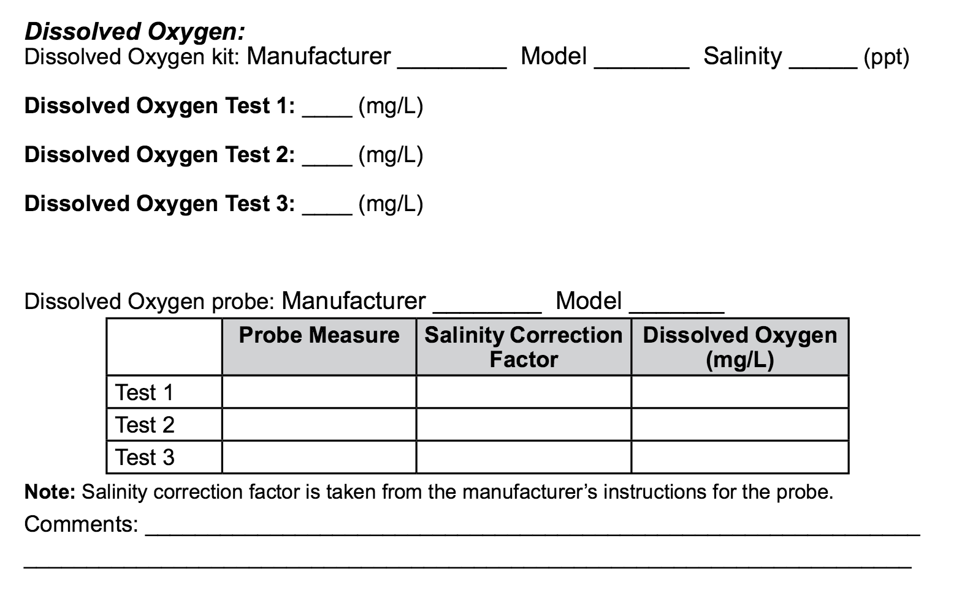
Dissolved Oxygen Protocol Using a Commercial Test Kit (3/3)
9. Record dissolved oxygen on data sheet as test 1
10. Have two others repeat the process with different water samples each time and record on data sheet as test 2 and test 3
11. Calculate the average of the three measurements
Note: Each measurement should be within 1 mg/L of the average. If one measurement is not take the average of the two remaining measurements.
12. Discard all used chemicals into waste container and clean kit with distilled water.
You have now completed the Dissolved Oxygen Protocol Using a Commercial Test Kit!

Slide 33
Let’s test your knowledge! Question 5
How often should you conduct the quality control procedure?
Every time you conduct the Dissolved Oxygen Protocol
Once every 6 months
Every 48 hours

Slide 34
Let’s test your knowledge! Answer to Question 5
How often should you conduct the quality control procedure?
Every time you conduct the Dissolved Oxygen Protocol
Once every 6 months- correct! ☺
Every 48 hours

Slide 35
Let’s test your knowledge! Question 6
When you calculate dissolved oxygen you need to correct for
Use of distilled water
Water temperature
Atmospheric pressure and elevations
All of the above
B and C only

Slide 36
Let’s test your knowledge! Answer to Question 6
When you calculate dissolved oxygen you need to correct for
Use of distilled water
Water temperature
Atmospheric pressure and elevations
All of the above
B and C only- correct!

Slide 37
Let’s test your knowledge! Question 7
No greater than ±1mg/L difference in measured value is acceptable for:
Each of the three dissolved oxygen measurements you take on your sample
The difference between the amount of dissolved oxygen expected using the kit and the measurement using the standard
None of the above
A and B

Slide 38
Let’s test your knowledge! Answer to Question 7
No greater than ±1mg/L difference in measured value is acceptable for:
Each of the three dissolved oxygen measurements you take on your sample
The difference between the amount of dissolved oxygen expected using the kit and the measurement using the standard
None of the above
A and B –correct! ☺

Slide 39


Hydrosphere Site Creation
If this is your first time making hydrosphere observations at this location, you will need to create a new Hydrosphere study site before entering data.
To do this, please review the Introduction to Hydrosphere training.

Slide 40
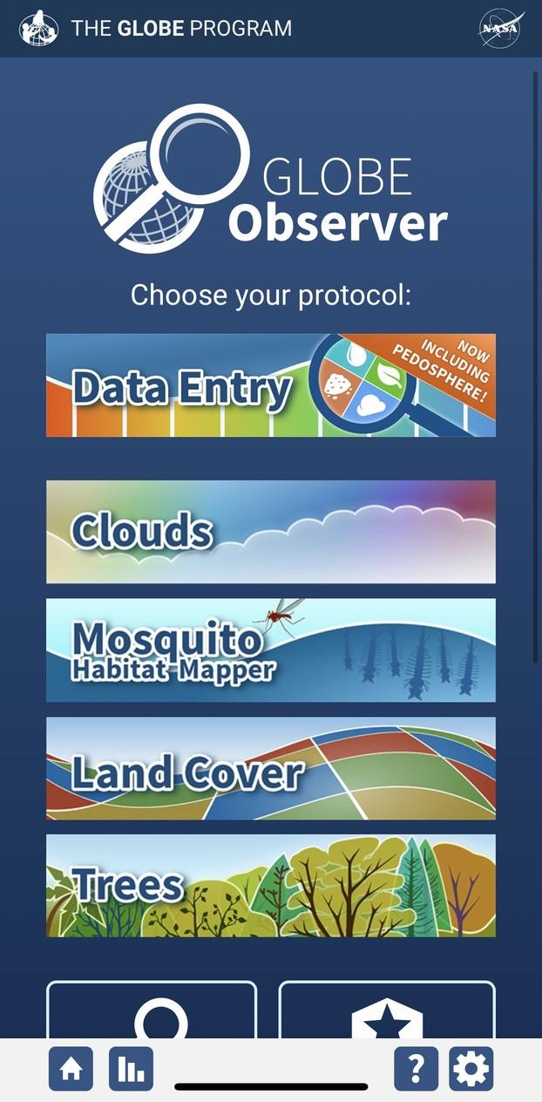
Submit Your Data to GLOBE
1.Desktop Data Entry: Log environmental data directly on the GLOBE website.
2.GLOBE Observer App: The app allows users to enter data directly from an iOS or Android device for any GLOBE protocol.

Slide 41

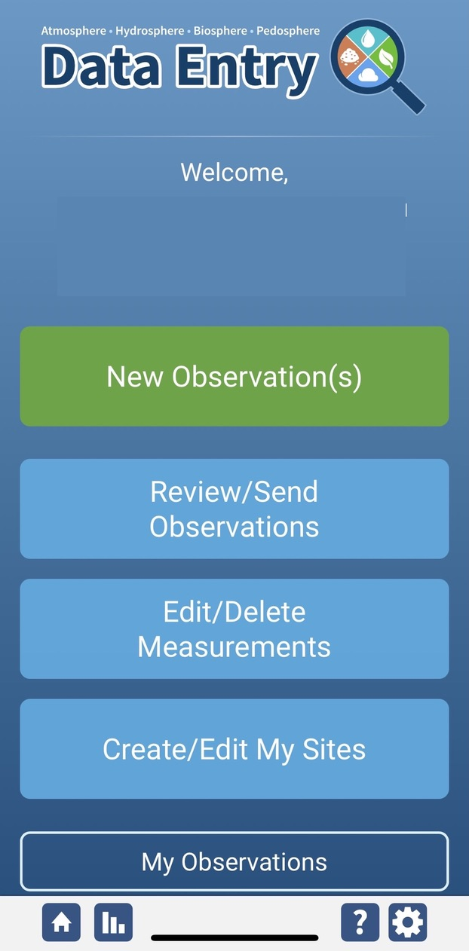
Dissolved Oxygen Protocol Data Entry
To enter data, first return to GLOBE Observer main page by clicking the home button in the bottom left.
Select “Data Entry”.
Next, click “New Observation(s)”

Slide 42
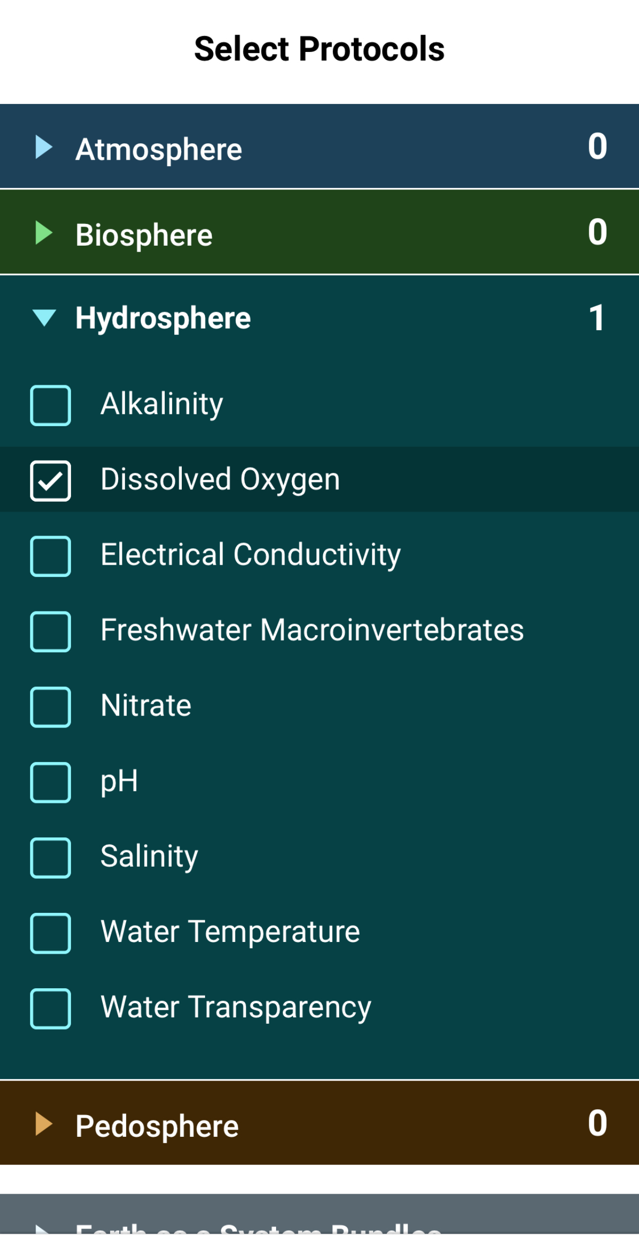
Dissolved Oxygen Protocol Data Entry
Select Dissolved Oxygen from the list of Hydrosphere protocols and click Continue at the bottom of the screen.

Slide 43
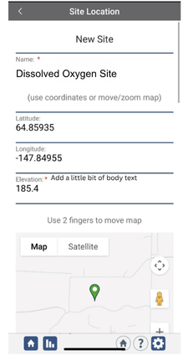
Dissolved Oxygen Protocol Site Information
If you have not already created a Hydrosphere site, create one now.
Click “New Site” at the bottom of the site location screen and choose a name for your new site.

Slide 44
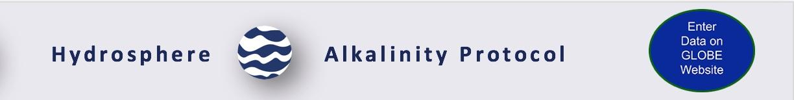
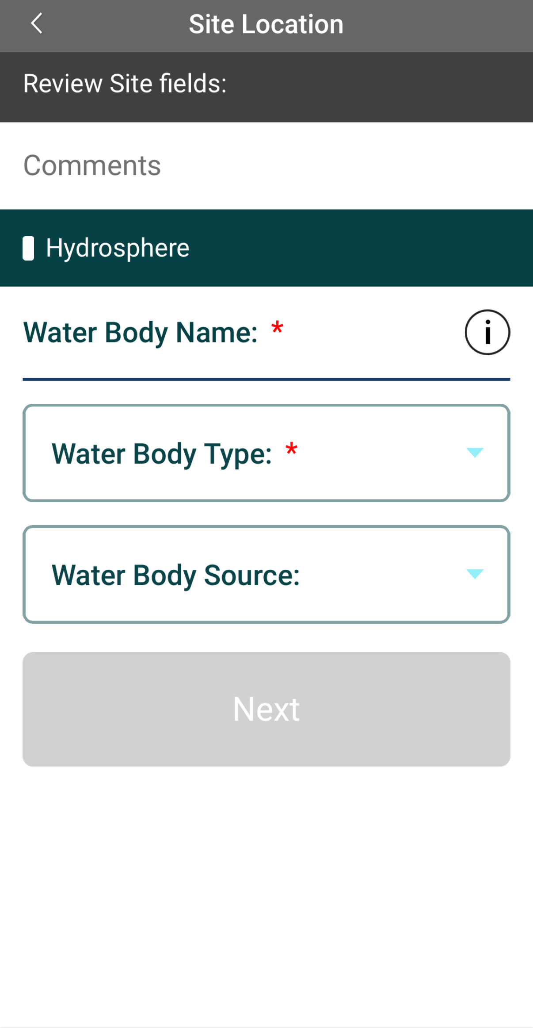
Dissolved Oxygen Protocol Site Information
Enter the Water Body Name.
Select the Water Body Type and Water Body Source from the dropdown list of options.

Slide 45
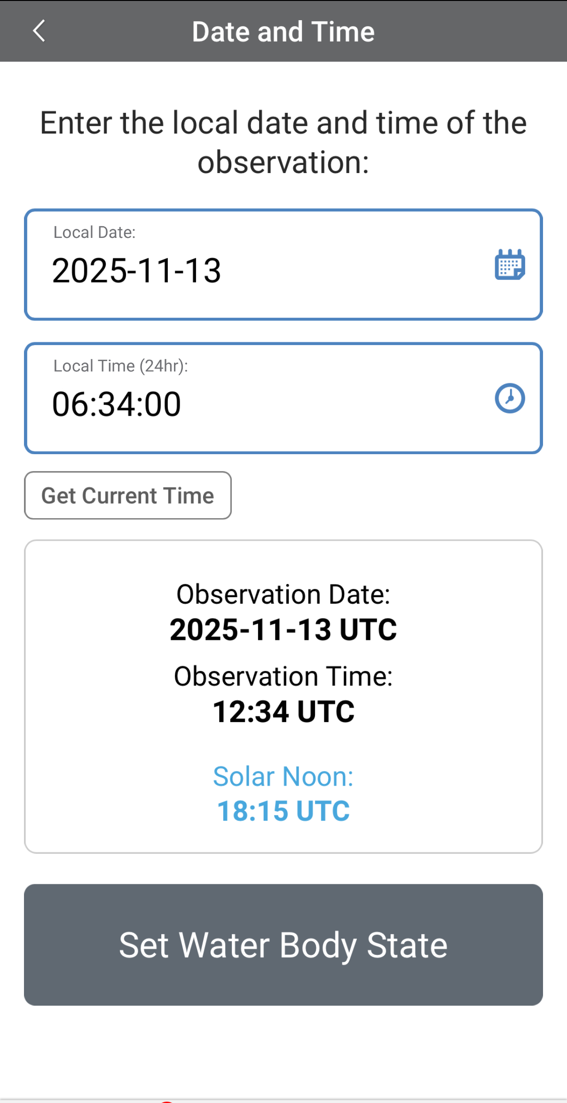
Entering Measurement Data
Enter the date and time you took the measurements.
Once you enter the date, select Set Water Body State to enter your data.

Slide 46
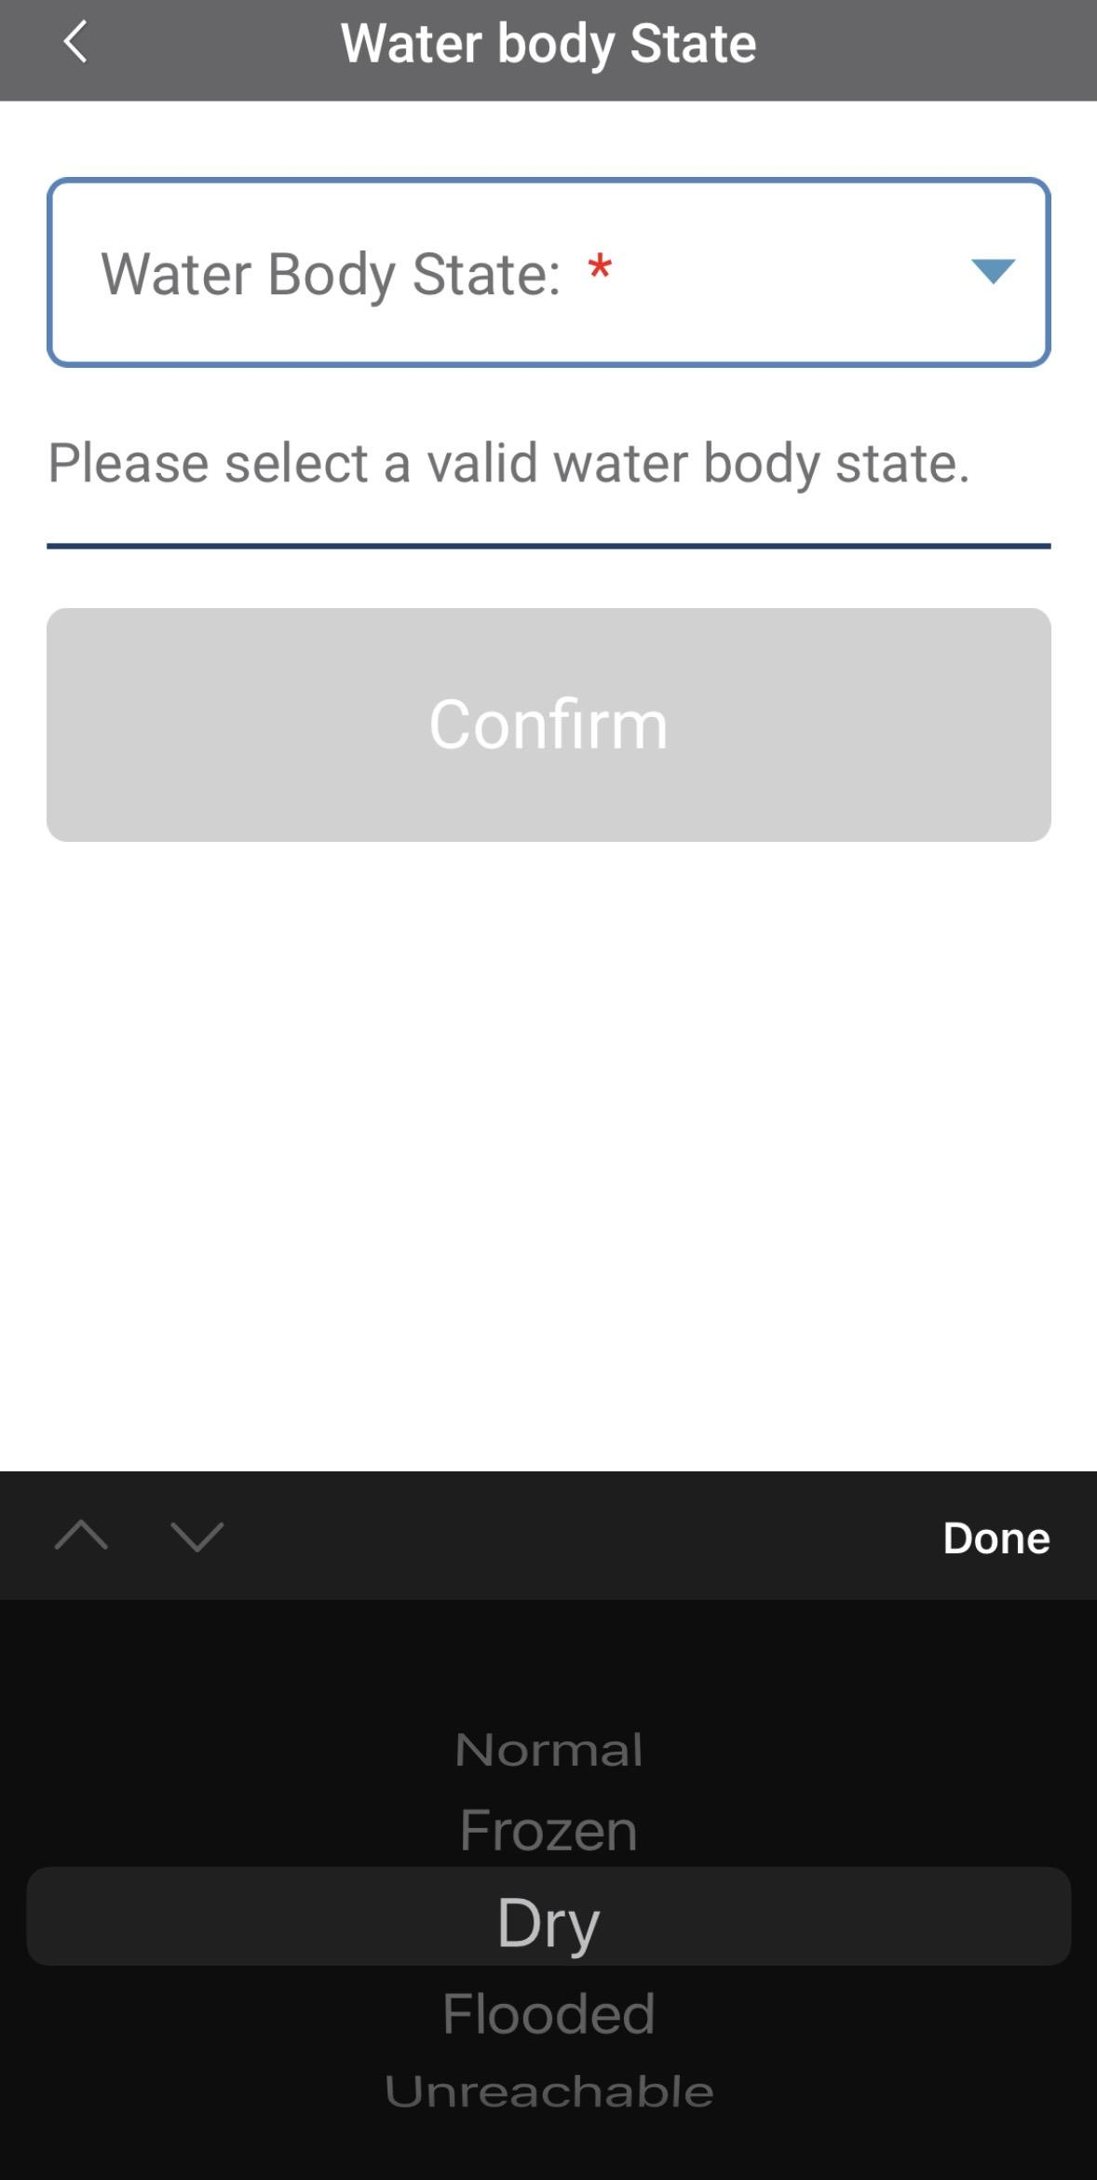
Enter the Water Body State
Select the Water Body State from the dropdown list of options.

Slide 47
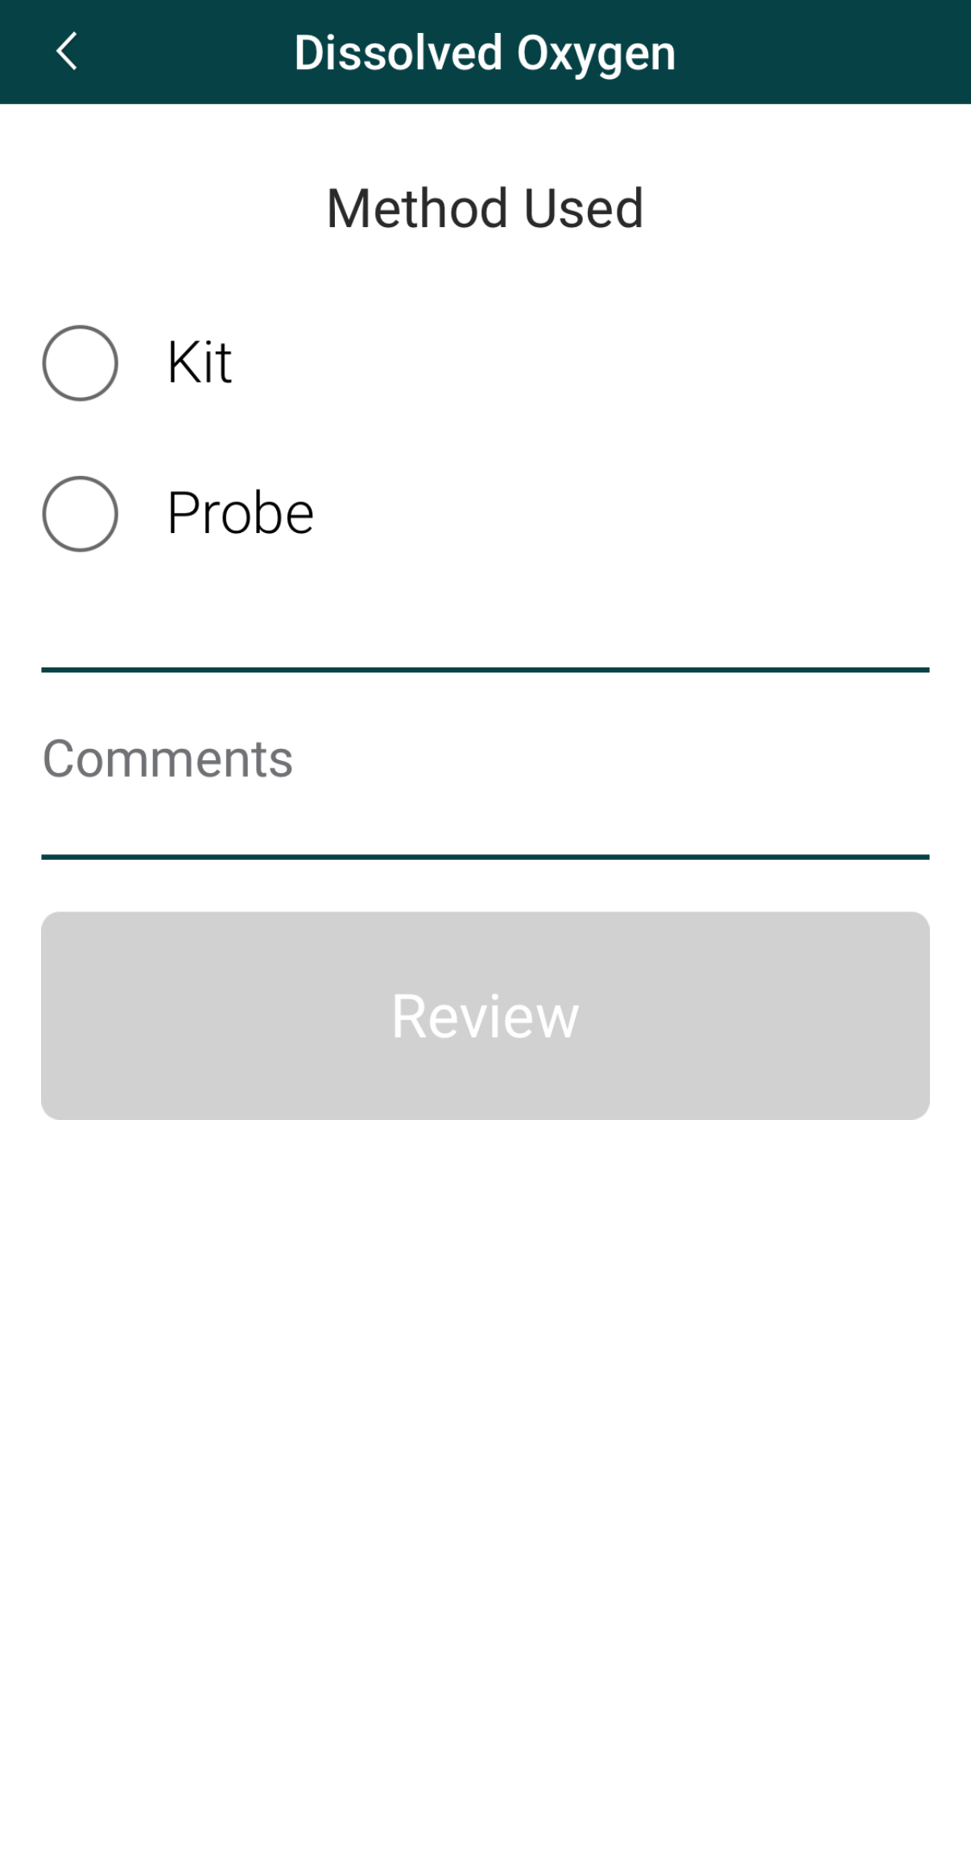
Select the Method Used to Measure Dissolved Oxygen
Select the method used to collect the dissolved oxygen measurement.

Slide 48
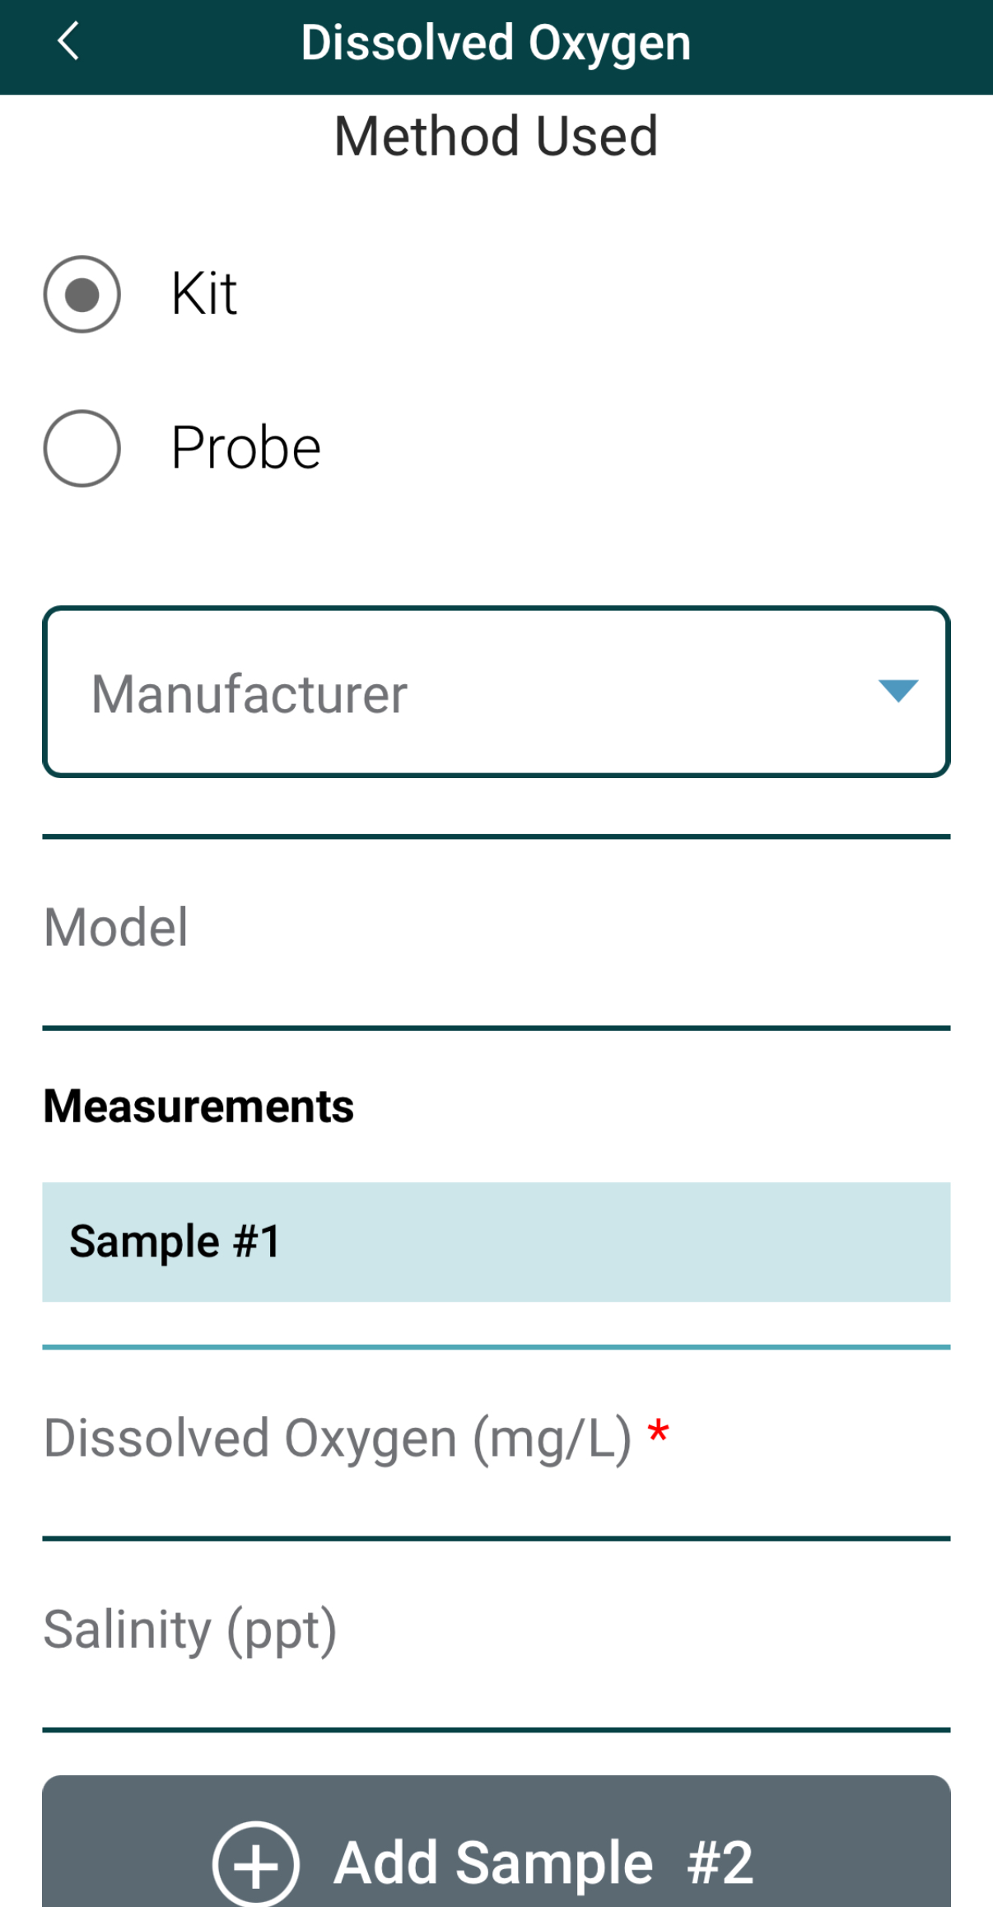
Enter Test Kit Measurement Data
Select the test kit manufacturer from the dropdown list of options.
Enter dissolved oxygen measurement in mg/L.
Optional: Enter salinity (ppt)

Slide 49
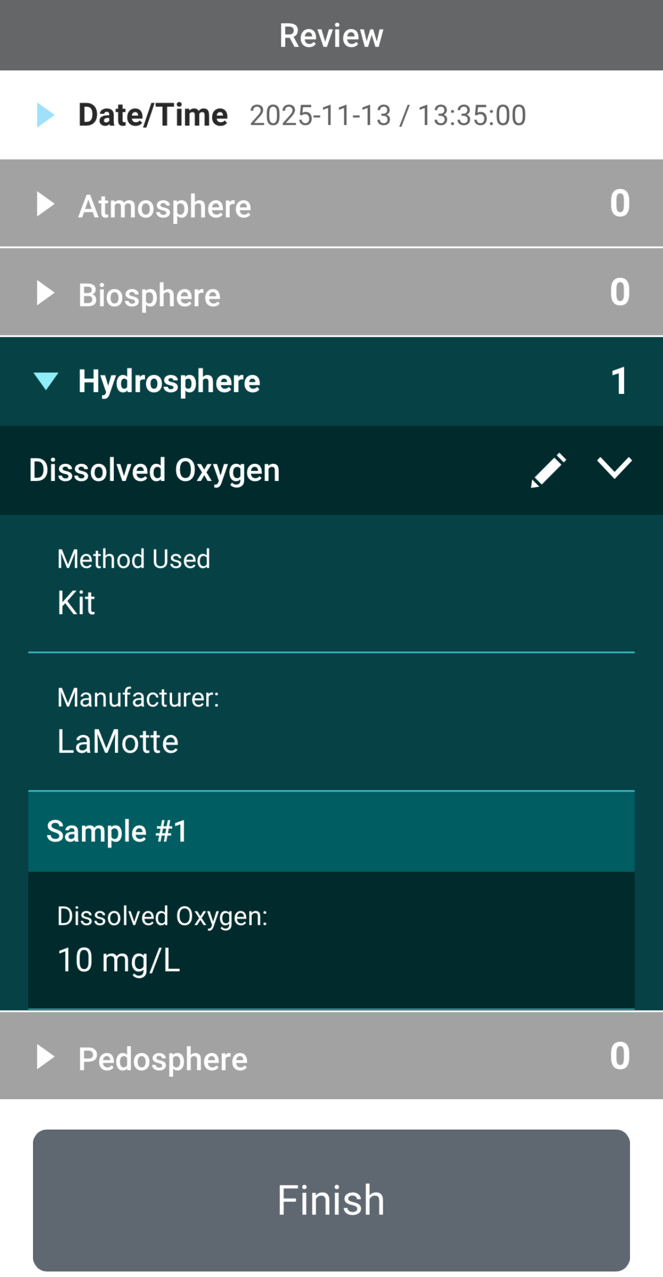
Review Data Entry and Send Data
Review the data you entered and check for errors.
When complete, select Finish to complete the send the observation to GLOBE.

Slide 50
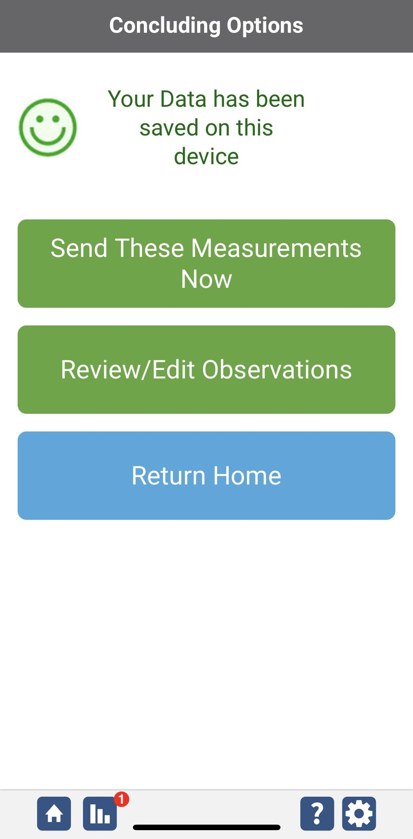
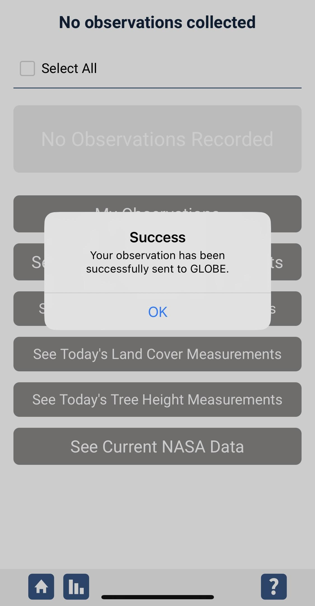
Data System Responses
If your observations are within the appropriate ranges, you will see a green smiley face.
You can review or edit your observation if needed.
When ready, select “Send these measurements now” to send your data to GLOBE. When it has been sent, you will see a “Success” message.

Slide 51

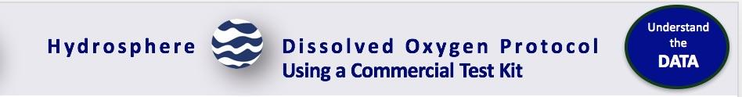
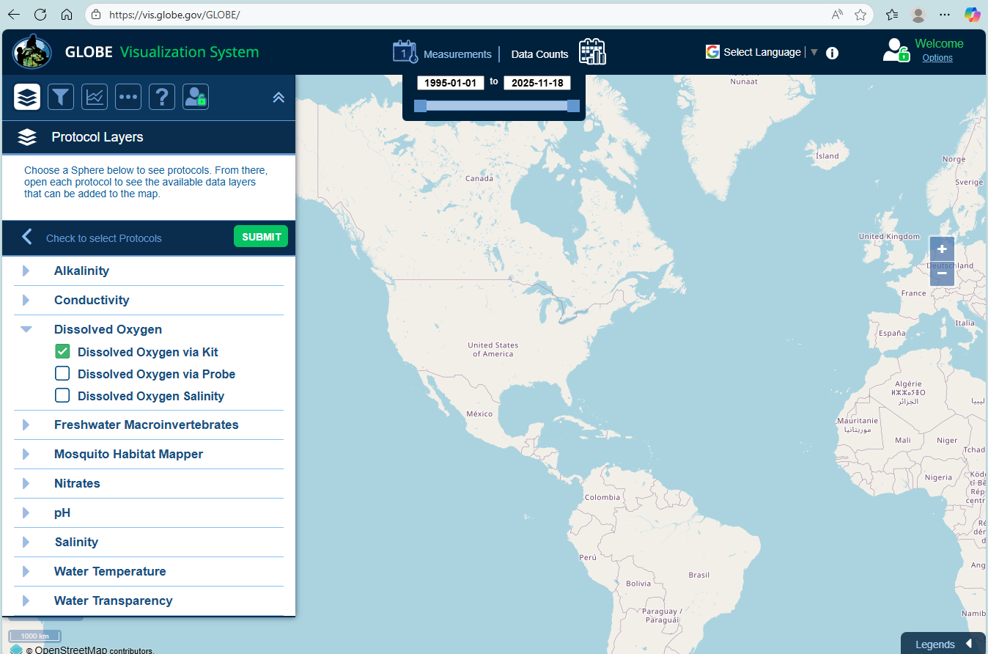
Visualize and Retrieve Water DO Data-1
From dropdown menu, select dissolved oxygen as the data layer you wish to view. Click “Submit”
GLOBE provides the ability to view and interact with data measured across the world. Select our visualization tool to map, graph, filter and export DO data that have been measured across GLOBE protocols since 1995. Here are screenshots steps you will use when you use the visualization tool.
Link to step-by-step tutorials on Using the Visualization System will assist you in finding and analyzing GLOBE data: PDF verson

Slide 52
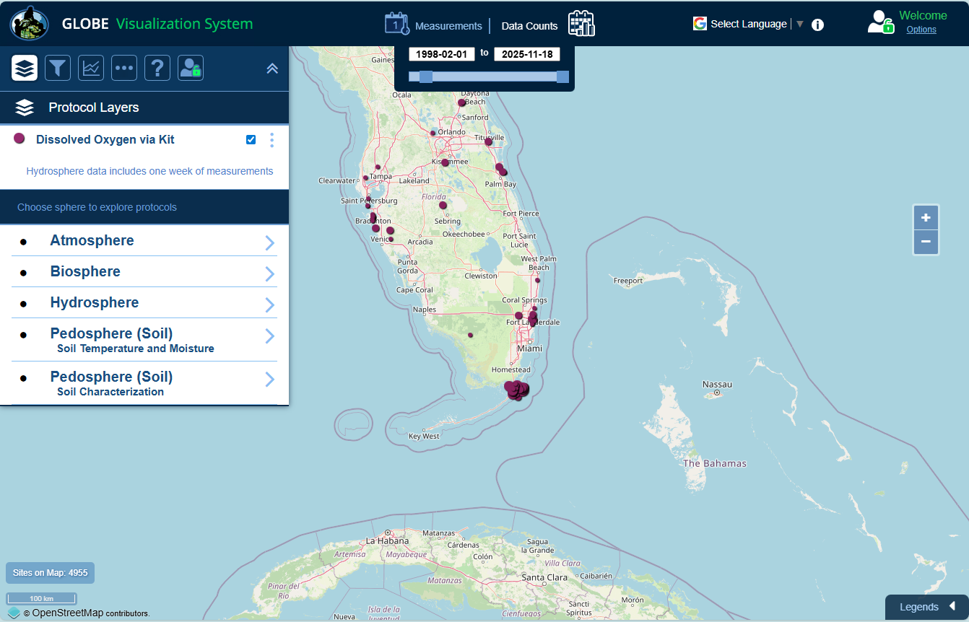
Visualize and Retrieve Water DO Data-2
Select the date for which you need DO data, add layer and you can see where data is available.

Slide 53
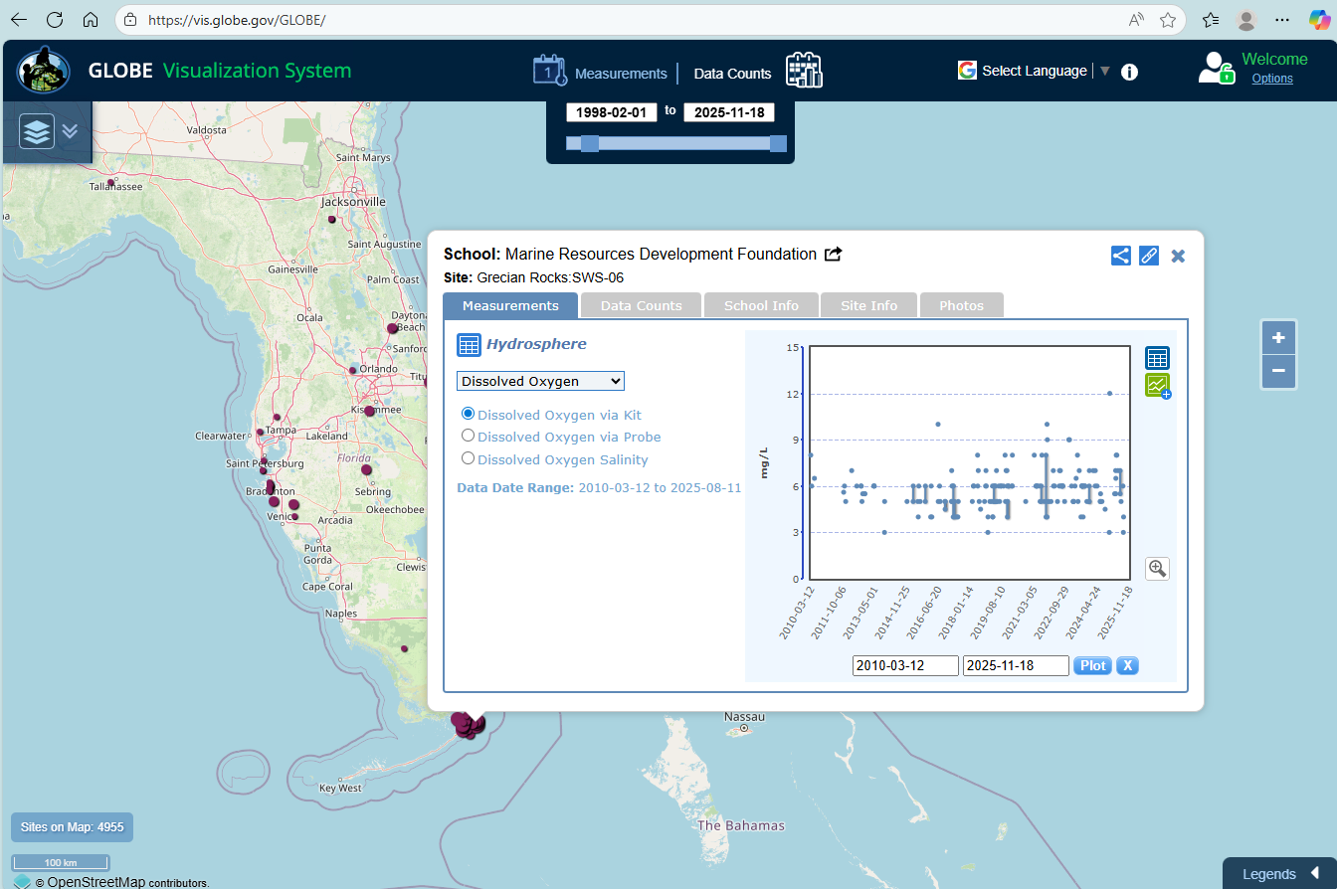
Visualize and Retrieve Water DO Data-3
Select the sampling site for which you need DO data, and a box will open with data summary for that site.
Clicking on an icon on the map will open to a map note providing DO data for that location and time.

Slide 54

Review questions to help you prepare to conduct the Hydrosphere Dissolved Oxygen Protocol
Does the dissolved oxygen protocol also measure the oxygen in water (H2O)?
Which temperature holds more dissolved oxygen: warm water or cold water?
Does salinity affect the solubility of oxygen?
How does atmospheric pressure affect the solubility of oxygen?
What is hypoxia?
How many ppm of dissolved oxygen is in the water when the water is anoxic?
Why do you need to stabilize the dissolved oxygen sample immediately after collecting?
What are the safety precautions you should take when doing any of the hydrology protocols?
What is the acceptable range of error of the three replicate samples you take, in ppm?
What step do you need to complete before starting the Dissolved Oxygen protocol?

Slide 55

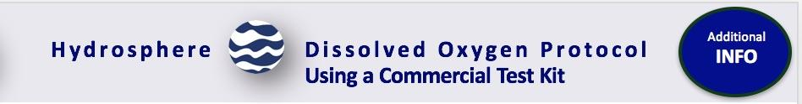
You are done!
You have now completed the slide stack. If you are ready to take the quiz, sign on and take the quiz corresponding to Dissolved Oxygen Protocol.
You can also review the slide stack, post questions on the discussion board, or look at the FAQs on the next page.
When you pass the quiz, you are ready to take Dissolved Oxygen Protocol measurements!

Slide 56
FAQ: Frequently Asked Questions-1
Why do we have to do the measurements at the same time of day?
The amount of dissolved oxygen may change during the day as the water begins to warm up. More light penetrating the water causes more photosynthesis to occur. This can also increase the amount of dissolved oxygen. For this reason it is important to do your Hydrosphere measurements at the same time of day each week.
What will make my dissolved oxygen levels change over the year?
Besides seasonal differences in temperature, seasonal changes in the flow of your stream, changes in transparency, or changes in productivity (amount of growth of plants and animals in the water) will cause changes in dissolved oxygen levels.
What is saturated DO?
Saturated DO refers to the maximum oxygen that water can hold at a particular temperature, pressure and salinity. When you calibrate your DO probe, the 100% saturation point is saturated Dissolved Oxygen or saturated
Why do we need to measure salinity each time?
In arid and semi-arid areas, salinity or conductivity levels vary depending on whether it is a dry or rainy season. In estuaries, salinity can vary depending on the time of the tide or even in dry or wet years.

Slide 57
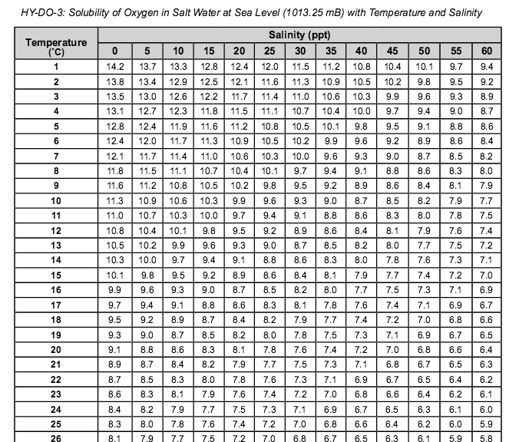
FAQ: Frequently Asked Questions-2
Why does salt concentration affect oxygen saturation?
As the salt content increases in water, fewer oxygen molecules can be dissolved. Therefore, as salinity increases, saturated DO decreases in a water sample under the same temperature and pressure.

Slide 58
FAQ: Frequently Asked Questions-3
Why does the amount of dissolved oxygen I measured not agree with the amount I calculated?
There are two reasons why these numbers may not match. First, you may not have followed the instructions on your kit exactly or you may have made small errors in the procedure you used. Here are some troubleshooting tips:
Make sure you do not have any air bubbles in your sample bottle or your titrator (for kits that use a titrator). To check for air bubbles in the sample bottle, turn the bottle upside down while it is capped and look for bubbles.
Measure accurately. If you are adding drops from a bottle, hold the bottle vertically so that all of the drops are the same size.
Allow all of the precipitate to settle. If you shake the bottle too hard before the precipitate settles, it may take 10minutes or more for the settling to happen.
Record accurately. If your kit asks you to count drops, have two people count to insure accuracy. If your kit asks you to read a titrator, make sure to read the instructions for accurately reading the titrator that come with your kit.
If you are testing in salt waters make sure you refer to Table HY-DO-3 to determine the maximum amount of oxygen that waters with your salinity can hold. Salt waters can hold less oxygen when fully saturated than can freshwaters.
Another reason your measured value may not be the same as your calculated value is that there may be something wrong with the chemicals in your kit. In this case, you will need to get new chemicals.

Slide 59
Questions for Research Investigations
How would a change in the amount of dissolved oxygen affect what lives in a water body?
How could warming or cooling of the atmosphere affect the amount of dissolved oxygen in your water?
How could changes in the land cover around your water site affect the amount of dissolved oxygen in your water?

Slide 60

We want your Feedback!
Please provide us with feedback about this module. This is a community project and we welcome your comments, suggestions and edits! Please take a minute to comment here: Training@nasaglobe.org
Credits:
Slides:
Russanne Low, Ph.D., University of Nebraska-Lincoln, USA
Rebecca Boger, Ph.D., Brooklyn College, NYC, USA
Photos: Russanne Low
Art: Jenn Glaser, ScribeArts
More Information:
GLOBE Program, NASA Earth Science
NASA Global Climate Change: Vital Signs of the Planet
The GLOBE Program is sponsored by these organizations:
Version 11/17/25. Modified by GLOBE Implementation Office – Science, Training, Education, and Public Engagement. If you edit and modify this slide set for use for educational purposes, please note “modified by (and your name and date)" on this page. Thank you.

