Slide 1



Slide 2

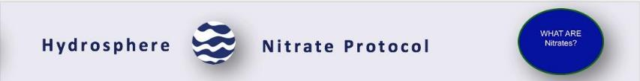
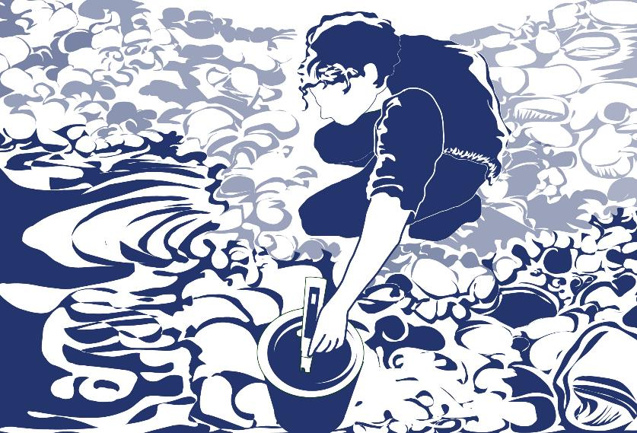
Overview
This module:
Reviews the selection of a GLOBE hydrology site
Reviews the water sampling technique used in GLOBE hydrology protocols
Provides a step by step introduction of the protocol method
Learning Objectives
After completing this module, you will be able to:
Define water nitrates and explain how environmental variables can result in different measurements
Describe the importance of instrument calibration in the collection of accurate data
Conduct water nitrate measurements using a nitrates test kit
Upload data to the GLOBE portal
Visualize data using GLOBE’s Visualization Site
Estimated time for completion of this module: 1.5 hours

Slide 3
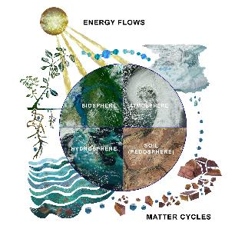
Overview 2
The hydrosphere is the part of the Earth system that includes water, ice and water vapor. Water participates in many important natural chemical reactions and is a good solvent. Changing any part of the Earth system, such as the amount or type of vegetation in a region or from natural land cover to an impervious one, can affect the rest of the system. Rain and snow capture aerosols from the air. Acidic water slowly dissolves rocks, placing dissolved solids in water. Dissolved or suspended impurities determine water's chemical composition.
Current measurement programs in many areas of the world cover only a few water bodies a few times during the year. GLOBE Hydrosphere protocols will allow you to collect valuable data to help fill these gaps and improve our understanding of Earth's natural waters.
The Earth System:
Energy flows and matter cycles.

Slide 4

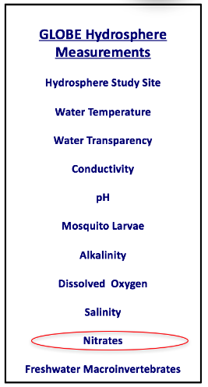
Nitrates
Nitrogen can be found in many chemical forms in water. Biological and physical processes transform the chemical forms as part of the nitrogen cycle. The GLOBE Nitrate Protocol targets nitrate (NO₃⁻). Nitrate (NO₃⁻) is usually the most important inorganic form of nitrogen because it is an essential nutrient for the growth and reproduction of many algae and other aquatic plants. Nitrite (NO₂⁻) is usually found only in waters with low dissolved oxygen levels, called suboxic waters.

Slide 5
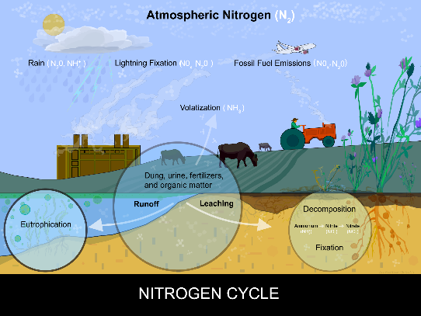
Nitrogen Cycle
The nitrate form of nitrogen found in natural waters comes from the atmosphere in rain, snow, fog or dry deposition by wind, from groundwater inputs, and from surface and below surface run-off that flows off and through surrounding land cover and soils. Decay of plant or animal matter in soil or sediments creates nitrates. Human activities can greatly affect the amounts of nitrate in water bodies. Illustration of a farmer on a tractor, with nitrogen-fixing legume plants in the foreground. These plants have a symbiotic relationship with nitrogen fixing-bacteria in their roots that obtain nitrogen from the atmosphere and change it into a form that can be used by plants.

Slide 6
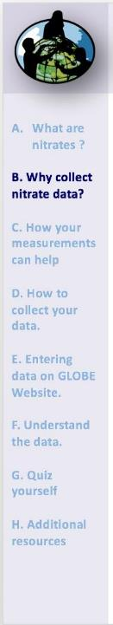
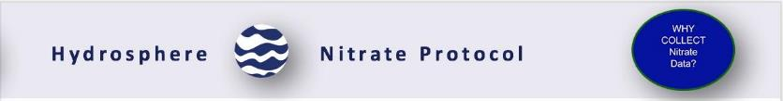
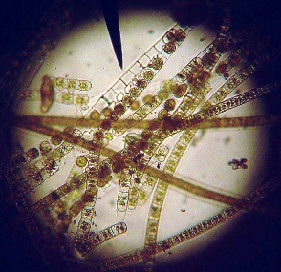
Why Collect Water Nitrate Data?
Scientists often call nitrogen a “limiting nutrient” because when nitrogen is found in low amounts, plants use up all the available nitrogen in the water and cannot grow or reproduce anymore. So, it “limits” the amount of plants in the water. Many plants that use nitrogen are microscopic algae, or phytoplankton. Additional amounts of nitrogen added to the water may allow the plants to grow and reproduce more.
Freshwater green algae, 100x.
Credit: Rozzychan~enwiki , Creative Commons.

Slide 7
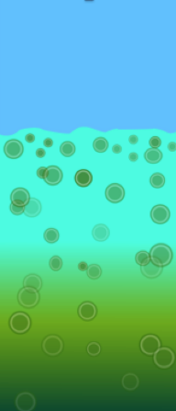
Nitrates play a role in Cultural Eutrophication of Water Bodies
When an excess amount of a limiting nutrient such as nitrogen is added to a lake, stream, or estuary the water becomes highly productive. This may cause tremendous growth of algae and other plants. This process of enriching the water is called eutrophication. The resulting excess plant growth can cause taste and odor problems in lakes used for drinking water or can cause nuisance problems for users of the water body.
Although plants and algae add valuable oxygen to the water, overgrowth can potentially lead to reduced light levels in the water body. As plants and algae die and decay, bacteria multiply and use the dissolved oxygen in the water. The amount of available dissolved oxygen in the water may become very low and harm fish and other aquatic animals.
Conceptual Diagram: Eutrophic water column
with microscopic algae enlarged for emphasis.

Slide 8
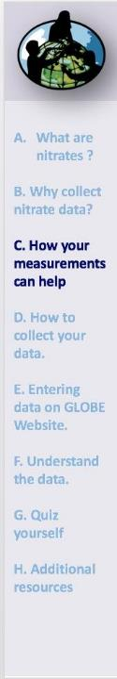
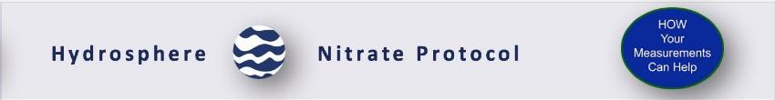
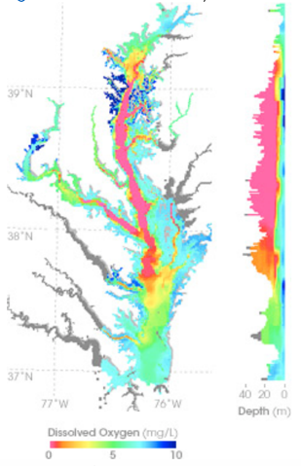
Case Study: Chesapeake Bay, USA-1
The Chesapeake Bay is the largest estuary in the United States, located on the Mid-Atlantic Seaboard (Delaware, Maryland, Virginia). In summer 2004, a dead zone spanned more than a third of the Chesapeake Bay floor. Around the world, similar dead zones are occurring with increasing frequency in estuaries and near the mouths of major rivers.
Here, local pork and chicken production creates manure, which runs off into tributaries feeding the Chesapeake Bay. Nitrogen in the water makes algae and other single-celled plants (phytoplankton) grow excessively. As the excess algae die, bacteria that decompose the plant matter may use up virtually all the dissolved oxygen in the water, creating bottom-hugging, low-oxygen “dead zones.” This map shows measurements of dissolved oxygen for July 15–30, 2004. The graph on the right shows dissolved oxygen levels between the surface and a depth of 40 meters through the center of the Bay. Orange and red colors correspond to the dead zone.
When you monitor the nitrate concentration at your study site, you are providing exactly the kind of information that is needed to understand how dead zones are created in our aquatic systems.
Text: Earth Observatory,
Map copyright Chesapeake Bay Program.

Slide 9
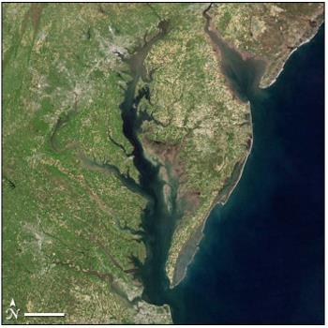
Case Study: Chesapeake Bay, USA -2
Researchers use satellite measurements of ocean color to estimate the amount of microscopic plant life that lives in the Chesapeake Bay and other bodies of water. Ocean color depends on what is living in the water.
When large numbers of plants are growing in the water, the chlorophyll and other plant pigments affect the water’s color, making it greener, sometimes even with shades of red. The kinds and amounts of plant life are indicators of the health of marine ecosystems.
Read more here: Earth Observatory
NASA image courtesy Jeff Schmaltz, MODIS Rapid Response

Slide 10

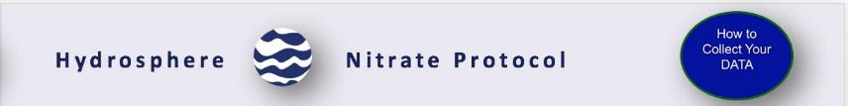
Protocol at a Glance
When | Weekly, if possible
Where | Hydrosphere Study Site
Time Needed | 20 minutes
Prerequisites | Hydrosphere Study Site is described Make Nitrate Standard Solution (this slide set) Follow Nitrate Quality Control Procedure (this slide set)
Key Instrument | Commercial Nitrate Test Kit
Skill Level | Intermediate
References | Nitrate Protocol

Slide 11
Before you Begin: Simultaneous or Prior Investigations Required to Conduct the Nitrate Protocol
The Nitrate protocol is conducted at your GLOBE Study Site. You will need to define your GLOBE Study Site where you will conduct your Hydrosphere Investigation prior to beginning this protocol. The Hydrosphere Investigation Data Sheet is used to record all the hydrosphere measurements, including Nitrates. You will also want to map your Hydrosphere Site at some point.
Find your documents here:
GLOBE Study Site Definition Sheet
Hydrosphere Investigation Data Sheet
Mapping your Hydrosphere Study Site Field Guide
Since there can be a connection between dissolved oxygen (DO) and nitrates, DO measurements could lead to interesting investigations.

Slide 12
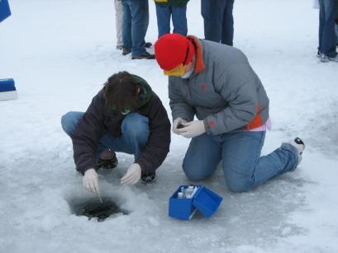

Site Selection: Preferred Study Sites
All your hydrosphere measurements are taken at the same Hydrosphere Study Site. This may be any surface water site that can be safely visited and monitored regularly, although natural waters are preferred. Sites may include (in order of preference):
1. Stream or river
2. Lake, reservoir, bay or ocean
3. Pond
4. An irrigation ditch or other water
body, if natural body is not available
Data entry: Measurement data from under the ice cannot be entered into the GLOBE database because the water state must be “normal,” not frozen. However, if “frozen” is the normal state for that time, set the state to “normal” and write in the comments that the water was frozen.
Students measure nitrate through ice covering the Volga River. Image: GLOBE.

Slide 13
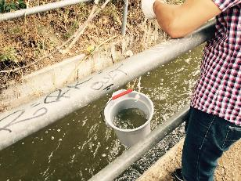
Site Selection: Hydrosphere Study Site
Select a specific site where the hydrosphere measurements (water temperature, dissolved oxygen, nitrate, pH, alkalinity, turbidity, and either conductivity or salinity) will be taken. If the selected study site is a moving body of water (i.e. stream or river), locate your sampling site at a riffle area as opposed to still water or rapids. This will provide a more representative measurement of the water in the stream or river.
If the selected study site is a still body of water {i.e. a lake or reservoir), find a sampling site near the outlet area or along the middle of the water body. Avoid inlet areas. A bridge or a pier are good choices. If your water body is brackish or salty, you will need to know the times of high and low tide at a location as close as possible to your study site.

Slide 14
Overview of the Water Nitrate Protocol
The GLOBE Nitrate Protocol uses a chemical based test kit. Always look at the manufacturer’s instructions on how to perform the test.
Although nitrate (NO₃⁻) is the chemical form of nitrogen of interest, it is difficult to measure directly. So, nitrate test kits have you perform a chemical reaction where the nitrate in the sample of water will be transformed into nitrite (NO₂⁻) which is a form more easily measured.
You will add a chemical (such as cadmium) to the water sample, and this will change the nitrate (NO₃⁻) in the water to nitrite (NO₂⁻). A second chemical is then added to the water sample and reacts with the nitrite (NO₂ ⁻) to cause a color change. The resulting color change of the water sample is proportional to the amount of nitrite in the sample.
The chemical reaction that causes nitrate (NO₃⁻) to change to nitrite (NO₂⁻) is called an oxidation – reduction reaction. Often, the kits will say that they use a cadmium reduction method. This means that the cadmium has removed electrons from nitrate (NO₃⁻) to form nitrite (NO₂⁻).

Slide 15
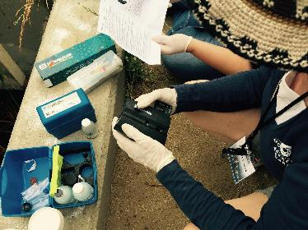
Understand your Nitrate Kit
Most natural waters have nitrate levels under 1.0 mg/L NO₃⁻ -N, but concentrations over 10 mg/L NO₃⁻ -N are found in some areas. If your kit has a low range (0-1 mg/L ) and a high range (1-10 mg/L ), most likely you will only use the low range test. If you are not sure what the nitrate levels are, first use the low range. Values above 10 mg/L NO₃⁻ -N may be rejected unless a school indicates that their results are valid above this level.
If your site has brackish or salt water, you need to make sure that you have a Nitrate Test Kit that can be used in brackish or salt water.

Slide 16
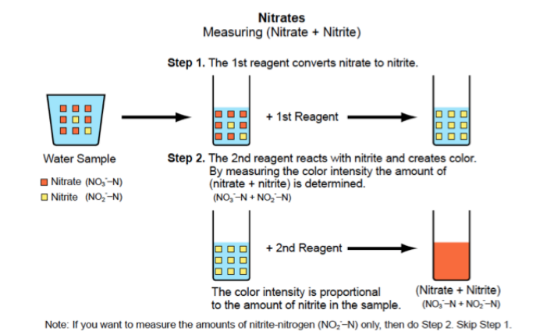
Measuring Nitrates and Nitrites using a Commercial Test Kit
These are the chemical reactions that you will be using in the Nitrate Protocol:

Slide 17
Optional: Additional Chemistry Information
The cadmium reduction method will give you a quantity of nitrites (NO₂⁻) that includes nitrates (NO₃⁻) that have been converted to nitrites plus any nitrites that were already in the water before you added any chemicals. We ask you to report the combined nitrate and nitrite forms. If the water at your site has very low dissolved oxygen levels, we encourage you to measure the nitrite (NO₂⁻) amount. To measure nitrite (NO₂⁻) , you do not add the first chemical (such as cadmium). Instead, you only add the second chemical that reacts with the nitrite (NO₂⁻) to cause a color change. The instructions in the nitrate kit should explain what to do.
For GLOBE, concentrations of nitrate are expressed as the amount of elemental nitrogen in the form of nitrate. Concentrations are expressed as nitrate-nitrogen (NO₃⁻ -N) in milligrams per liter (mg/L). Check with your kit to see what form of nitrogen the test kit results provide. If it gives test results in the form of mg/L nitrate, simply multiply your measured value by 4.4. This value is the ratio of nitrate/nitrogen molecular weights (62g/14g).

Slide 18

Time for a quick review before we move onto data collection! Question 1
Why do we measure nitrates in a water system?
Nitrate is usually the most important inorganic form of nitrogen in aquatic environments and serves as a nutrient for aquatic plants and algae
Nitrite is usually only found in waters with low dissolved oxygen levels
Nitrate is a limiting nutrient
All of the above

Slide 19
Time for a quick review before we move onto data collection! Answer to Question 1
Why do we measure nitrates in a water system?
Nitrate is usually the most important inorganic form of nitrogen in aquatic environments and serves as a nutrient for aquatic plants and algae
Nitrite is usually only found in waters with low dissolved oxygen levels
Nitrate is a limiting nutrient
All of the above- correct! ☺

Slide 20
Time for a quick review before we move onto data collection! Question 2
Which of the following is a possible result of an imbalance of nitrates in a water system?
Eutrophication (or Cultural Eutrophication, which means eutrophication by human activity)
Dead zone
Both of the above
None of the above

Slide 21
Time for a quick review before we move onto data collection! Answer to Question 2
Which of the following is a possible result of an imbalance of nitrates in a water system?
Eutrophication (or Cultural Eutrophication, which means eutrophication by human activity)
Dead zone
Both of the above- correct! ☺
None of the above

Slide 22
Time for a quick review before we move onto data collection! Question 3
True or False: The nitrate test kits create a chemical reaction where nitrate in your sample is transformed into nitrite, and a chemical is added to the water sample to react with the nitrite, whose concentration is then measured.

Slide 23
Time for a quick review before we move onto data collection! Answer to Question 3
True or False: The nitrate test kits create a chemical reaction where nitrate in your sample is transformed into nitrite, and a chemical is added to the water sample to react with the nitrite, whose concentration is then measured.
Answer: True is correct! ☺

Slide 24

Sources for Equipment You Need for the Water Nitrate Protocol
The following resources summarize the measurements associated with each protocol, as well as the associated skill level, scientific specifications for the instruments, and how to access the equipment you need (purchase, build, or download).
Where to find specifications for instruments used in GLOBE investigations
Where to find scientific instruments used in GLOBE investigations
All chemicals should be kept tightly capped and away from direct heat. Replace chemicals after one year.
Glassware in the kit should be rinsed with distilled water before storing.
Perform the quality control procedure with the kit every 6 months to ensure that chemicals are still good.

Slide 25
Ensuring Accurate Nitrate Test Measurements:
Quality Control Procedure-1
Your results are only as good as the chemicals you use. Prior to doing the Nitrate Protocol, you will need to ensure that your commercial test kit is providing accurate readings. To do this, you will need to test it with a solution with a known quantity of nitrate.
To perform the quality control procedure, you need to buy a standard nitrate-nitrogen. You can use either a liquid standard solution or a dry stock standard solution. The liquid standard you buy has a high concentration of NO₃⁻ -N (1000 mg/L ). Option 1 and Option 2 lab guides explain two techniques on how to dilute a concentrated liquid standard to 2 mg/L. You can then measure the concentration of the NO₃⁻ -N in the standard and compare your result to the expected standard value of 2 mg/L . A third lab guide shows you how to make the 1000 mg/L Nitrate standard using KNO₃ (potassium nitrate). Choose the one option that suits your situation.
Nitrate quality control lab guides
Be sure to pay close attention to the quality control procedure- without it, the data you collect using the Nitrate Protocol will not be meaningful and cannot be compared with the data sets collected by others.

Slide 26
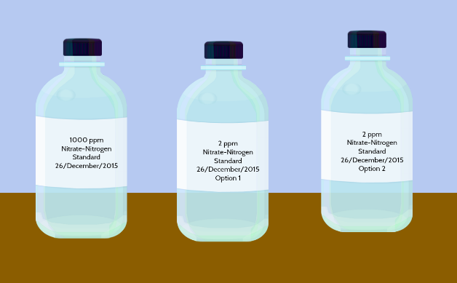
Ensuring Accurate Nitrate Test Measurements:
Quality Control Procedure- 2
There are 3 options for creating your Nitrate Nitrogen Standard. Look at the three different methods following in this slide stack. You can choose any one of the three to prepare to do the GLOBE Nitrate Protocol, depending on what reagents you have available.

Slide 27
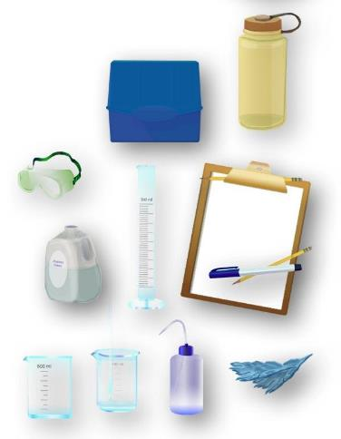
Option 1: Equipment to make the Nitrate Standard (2 ppm)
Make the nitrate-nitrogen standard for the quality control procedure using 5 mL stock nitrate-nitrogen solution.
Assemble Equipment:
Standard nitrate-nitrogen solution (1000 ppm)
100-mL beaker (or larger)
100-mL graduated cylinder
500-mL beaker or flask
500-mL graduated cylinder
Latex gloves
Goggles
Pipette
Stirring rod (optional)
Distilled water
250-mL bottle or jar with lid
Assemble Necessary Documents:
Hydrosphere Investigation Data Sheet
Nitrate Water Protocol

Slide 28
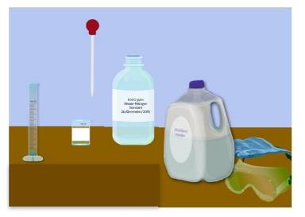
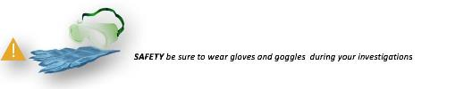
Option 1: Making the 2 ppm Nitrate Standard (1/2)
In the Lab
Put on gloves and goggles.
Rinse a 100 mL cylinder and 100 mL beaker with distilled water. Dry.
Using a pipette (if possible), measure 5 mL of the 1000 stock nitrate solution into the 100-mL graduate cylinder. Dilute with distilled water to 50 mL.
Pour into a 100 mL beaker and mix (swirl or use clean stirring rod). Label this 100-ppm nitrate standard.

Slide 29
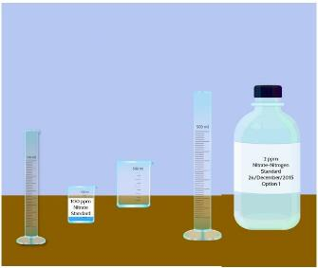
Option 1: Making the 2 ppm Nitrate Standard (2/2)
In the Lab
5. Rinse 100-mL graduated cylinder with distilled water.
6. Measure out 10 mL of the 100 ppm nitrate standard using the 100-mL graduated cylinder. Pour into 500 mL flask or beaker. Measure out 490 mL of distilled water in the 500 mL graduate cylinder. Add to the 500 mL flask or beaker.
7. Carefully swirl the solution to mix. Pour into a bottle with a lid and label as 2.0 ppm nitrate-nitrogen standard.
8. Rinse all glassware and pipettes with distilled water and store.
9. You have made your standard.
Follow the Nitrate Quality Control Procedure to determine that the test kit measures the standard solution accurately.

Slide 30
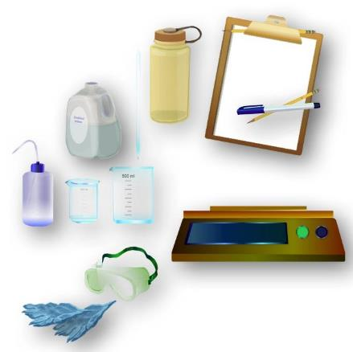
Option 2: Equipment to make the Nitrate Standard (2 ppm)
Make the nitrate-nitrogen standard for the quality control procedure using 1 mL stock nitrate-nitrogen solution.
Assemble Equipment:
Standard nitrate-nitrogen solution (1000 ppm)
100-mL beaker (or larger)
500-mL beaker or flask
Latex gloves
Goggles
Pipette
Distilled water
250-mL bottle or jar with lid
Balance
Assemble Necessary Documents:
Hydrosphere Investigation Data Sheet
Nitrate Water Protocol

Slide 31
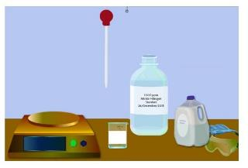

Option 2: Making the 2 ppm Nitrate Standard (1/2)
In the Lab
1. Put on the gloves and goggles.
2. Rinse a 100 mL beaker and a 500 mL cylinder with distilled water. Dry.
3. Measure the mass of the 100 mL beaker with a balance. Leave the beaker on the balance.
4. Using a pipette, add 1.0 g of 1000 ppm nitrate-nitrogen solution to the beaker on the balance.
5. Take beaker off balance and fill to the 100 mL line with distilled water. Stir the solution. Label this solution 10 ppm nitrate standard.
6. Measure the mass of the 500-mL graduated cylinder. Leave the cylinder on the balance.

Slide 32

Option 2- Making the 2 ppm Nitrate Standard (2/2)
In the Lab
Measure 40 g of the 10 ppm nitrate standard into the 500-mL graduated cylinder. Use a clean pipette to add the last few grams of standard so you do not exceed 40 g.
Add distilled water until there is 200 g (10 ppm nitrate standard + distilled water) in the graduated cylinder. Use a clean pipette to add the last few grams of water so you do not exceed 200 g.
Swirl to mix. Pour into a bottle with a lid and label as 2.0 ppm nitrate-nitrogen standard.
Rinse all glassware and pipettes with distilled water and store.
You have made your standard!
Follow the Nitrate Quality Control Procedure to determine that the test kit measures the standard solution accurately.

Slide 33
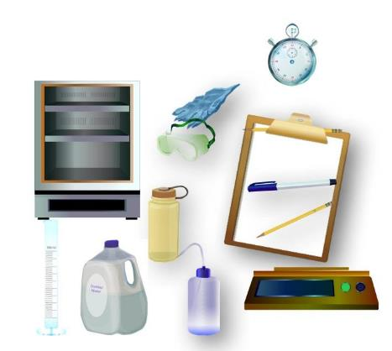
Option 3: Making the 1000 ppm Nitrate Stock Solution
In the Lab
Make the 1000 ppm nitrate-nitrogen stock solution for the quality control procedure using KNO₃ (potassium nitrate).
Assemble Equipment:
Potassium nitrate (KNO₃)
Drying oven
500-mL graduated cylinder
Latex gloves
Goggles
Chloroform (optional)
Distilled water
500-mL bottle or jar with lid
Balance
Assemble Necessary Documents:
Hydrosphere Investigation Data Sheet
Nitrate Water Protocol

Slide 34
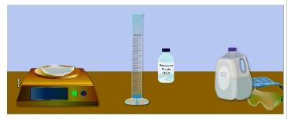

Option 3: Making the 1000 ppm Nitrate Standard (1/2)
In the Lab
Put on gloves and goggles
Dry KNO3 (potassium nitrate) in an oven for 24 hours at 105 degrees C.
Measure 3.6 g of KNO3
Dissolve 3.6 g of KNO3 in 100 mL of distilled water.
Pour solution into a 500 mL graduated cylinder. Fill cylinder to the 500 mL line with distilled water.
NOTE: To calculate nitrate-nitrogen (NO₃-N), take into account the molecular composition of KNO₃ (the ratio of the molecular weight of N to NO₃ is 0.138): 7200 mg/L KNO₃ x 0.138 =1000 mg/L nitrate nitrogen solution.

Slide 35
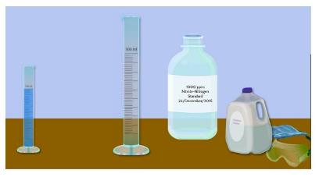
Option 3: Making the 1000 ppm Nitrate Standard (2/2)
In the Lab
6. Carefully swirl to mix. (Do not shake).
7. Pour into a jar and label as 1000 mg/L nitrate-nitrogen solution. Put the date on the label.
The stock nitrate solution can be preserved for up to six months using chloroform (CHCl₃). To preserve a stock nitrate standard, add 1 mL of chloroform to 500 mL of stock nitrate solution.
You have made your standard!
Follow the Nitrate Quality Control Procedure to determine that the test kit measures the standard solution accurately.

Slide 36
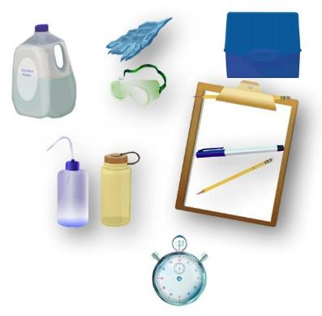
Nitrate Quality Control Procedure
You will need to complete this step before conducting the GLOBE Nitrate Protocol
Assemble Equipment:
Nitrate Test Kit
2 ppm Nitrate standard
Latex gloves
Goggles
Clock or watch
Distilled water
Surgical mask (if using powdered reagents)
Chemical waste bottle
Assemble Necessary Documents:
Hydrosphere Investigation Data Sheet
Nitrate Water Protocol
Hydrosphere Investigation Quality Control Data Sheet

Slide 37

How to Collect your Data: Nitrate Quality Control Procedure (1/2)
In the Lab
Fill out the top portion of the Hydrosphere Investigation Quality Control Data Sheet. In the Nitrate section fill in the name of the kit manufacturer and model.
Put on gloves and goggles.
Follow the directions in the nitrate test kit to measure the nitrate-nitrogen in the 2 ppm standard. If your test kit has directions for both a Low Range (0-1) and High Range (0-10) test, use the High Range directions for the calibration. Use the standard where it says ‘sample water’. If using powdered reagents, use the surgical mask when opening these products. Use clock or watch to measure the time if your kit requires you to shake your sample.
Match the color of the treated sample water with a color in the test kit. Record the value as ppm nitrate-nitrogen for the matching color on the Hydrosphere Investigation Quality Control Data Sheet. NOTE: If you are not sure about the best matching color ask other students for their opinions.

Slide 38

How to Collect your Data: Nitrate Quality Control Procedure (2/2)
In the Lab
Repeat steps 3 and 4 with fresh water samples. You will have a total of three nitrate-nitrogen measurements.
Calculate the average of the three measurements.
If your measurement is not + or – 1 ppm (high range) of the standard, repeat the measurement. If your measurement is still not within range, talk with your teacher or a GLOBE Master Trainer about possible problems.
Put used chemicals in a waste container. Rinse glassware with distilled water. Cap all chemicals tightly.
You have now completed your quality control procedure and are ready to use the Nitrate Protocol.

Slide 39
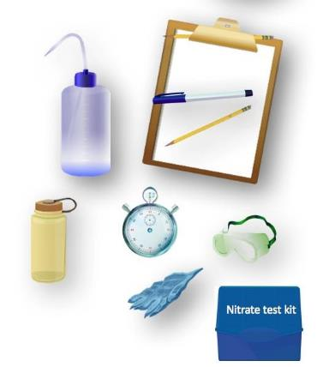
Water Nitrate Protocol
Assemble Equipment:
Nitrate test kit
Latex gloves
Clock or watch
Goggles
Distilled water
Surgical mask (if using powdered reagents)
Chemical waste bottle
Assemble Necessary Documents:
Hydrosphere Investigation Data Sheet
Hydrosphere Investigation Quality Control Data Sheet
Nitrate Water Protocol

Slide 40
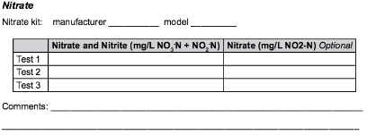

How to Collect your Data: Nitrate Protocol (1/3)
Fill out the top portion of your Hydrosphere Investigation Data Sheet. In the Nitrate section fill in the kit manufacturer and model.
Put on gloves and goggles.
Follow the instructions in your kit to measure the nitrate nitrogen. You should use the Low Range Test (0 – 1 mg/L) unless previous results indicate that your site typically has greater than 1 mg/L nitrate nitrogen. If using powdered reagents, use the surgical mask when opening these products. Use clock or watch to measure the time if your kit requires you to shake your sample.

Slide 41

How to Collect your Data: Nitrate Protocol (2/3)
Match the color of the treated sample water with a color in the test kit. Record the value as ppm nitrate-nitrogen for the matching color. Have two other students match a color with the treated sample water for a total of three observations. Record all three nitrate-nitrogen values on the Data Sheet.
Calculate the average of the three measurements.
Check to see if each of the three measurements is within 0.1 ppm of the average (or within 1.0 ppm of the average if using the high range test). If they are, record the average on the Data Sheet. If they are not, read the color measurements again (Note: do not read again if it has been more than 5 minutes). Calculate a new average. If the measurements are still not within range, data quality is questionable.

Slide 42
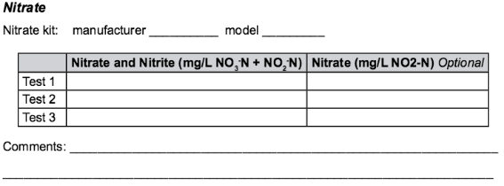
How to Collect your Data: Nitrate Protocol (3/3)
If there are low values of dissolved oxygen (e.g., less than 3.0 mg/L) and you have detected amounts of nitrate nitrogen (NO₃⁻ -N), you may want to measure the amounts of nitrite nitrogen (NO₂⁻-N).
Do not report any value if the water was not tested for nitrate- leave the box on the data sheet blank. A value of 0.0 mg/L indicates that the water was tested and no nitrate was detected.

Slide 43
Here’s a quick review before we move onto data entry! Question 4
True or False: It is necessary to conduct quality control procedures using each of the three different methods for creating Nitrate Nitrogen standard

Slide 44
Here’s a quick review before we move onto data entry! Answer to Question 4
True or False: It is necessary to conduct quality control procedures using each of the three different methods for creating Nitrate Nitrogen standard
Answer: False! You can use any one of the three methods to prepare your standard ☺

Slide 45
Here’s a quick review before we move onto data entry! Question 5
When you report your data to GLOBE you will:
Report all three trials
Report the calculated average of your three trials
Report the range of the three trials
Report the number you like the best

Slide 46
Here’s a quick review before we move onto data entry! Answer to Question 5
When you report your data to GLOBE you will:
Report all three trials
Report the calculated average of your three trials- correct ☺
Report the range of the three trials
Report the number you like the best

Slide 47
Here’s a quick review before we move onto data entry! Question 6
To ensure accuracy and precision, each of the three measurements you obtain should be within
10 ppm for a high range test
1 ppm for a high range test
.1 ppm for a low range test
.01 ppm for a low range test
A and D
B and C

Slide 48
Here’s a quick review before we move onto data entry! Answer to Question 6
To ensure accuracy and precision, each of the three measurements you obtain should be within
10 ppm for a high range test
1 ppm for a high range test
.1 ppm for a low range test
.01 ppm for a low range test
A and D
B and C- correct! ☺

Slide 49
Here’s a quick review before we move onto data entry! Question 7
True/False: You don’t need to wear gloves and goggles with the Nitrate Protocol because it is a chemical kit prepared commercially and therefore safe to use without safety precautions.

Slide 50
Here’s a quick review before we move onto data entry! Answer to Question 7
True/False: You don’t need to wear gloves and goggles with the Nitrate Protocol because it is a chemical kit prepared commercially and therefore safe to use without safety precautions.
Answer: False! Always use gloves and goggles when conducing all GLOBE hydrosphere protocols.
Now, let’s move onto data entry and visualization!

Slide 51
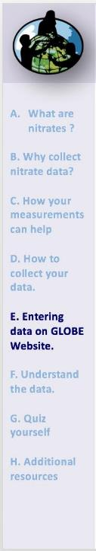
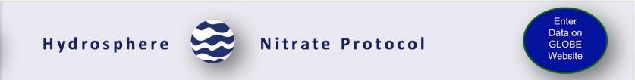
Hydrosphere Site Creation
If this is your first time making hydrosphere observations at this location, you will need to create a new Hydrosphere study site before entering data.
To do this, please review the Introduction to Hydrosphere training.

Slide 52
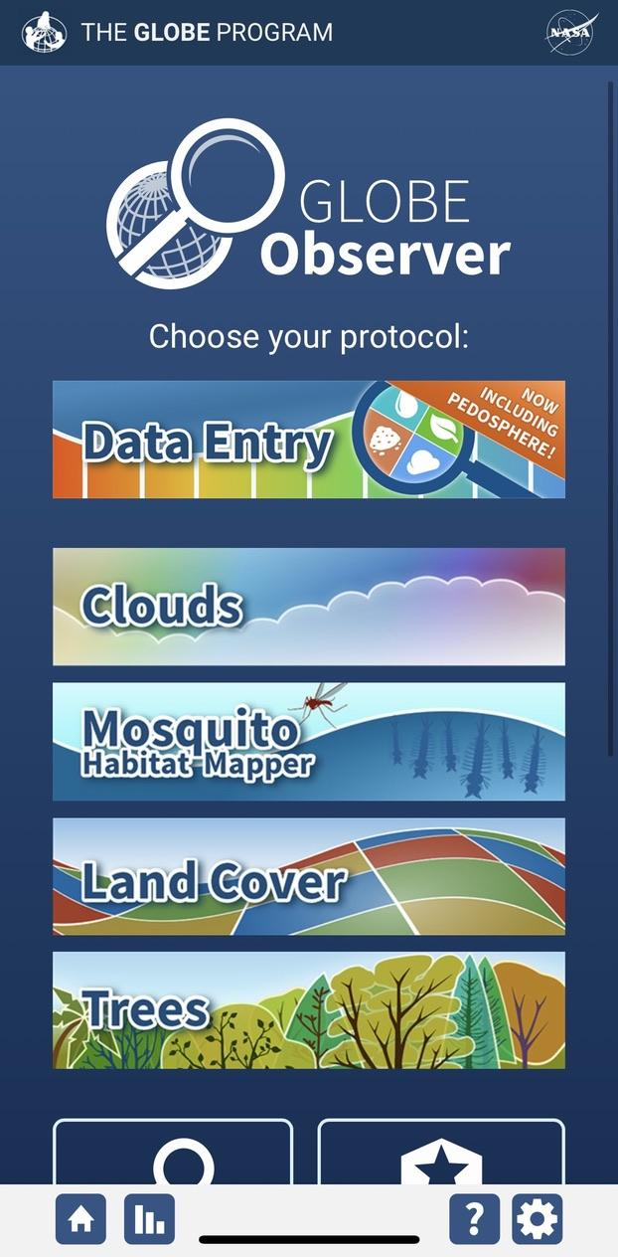
Submit Your Data to GLOBE
1.Desktop Data Entry: Log environmental data directly on the GLOBE website.
2.GLOBE Observer App: The app allows users to enter data directly from an iOS or Android device for any GLOBE protocol.

Slide 53
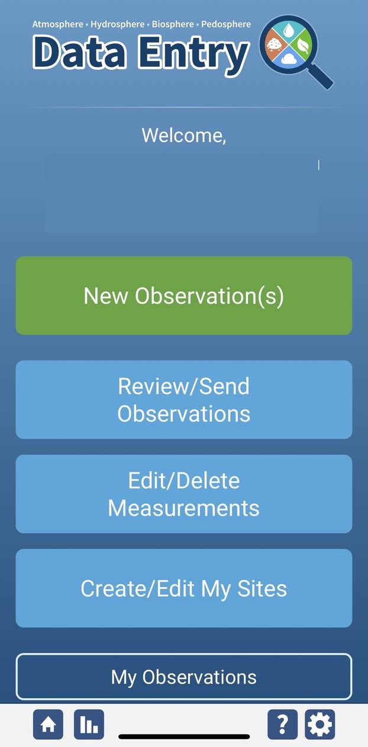
Nitrate Protocol Data Entry
To enter data, first return to GLOBE Observer main page by clicking the home button in the bottom left.
Select “Data Entry”.
Next, click “New Observation(s)”

Slide 54
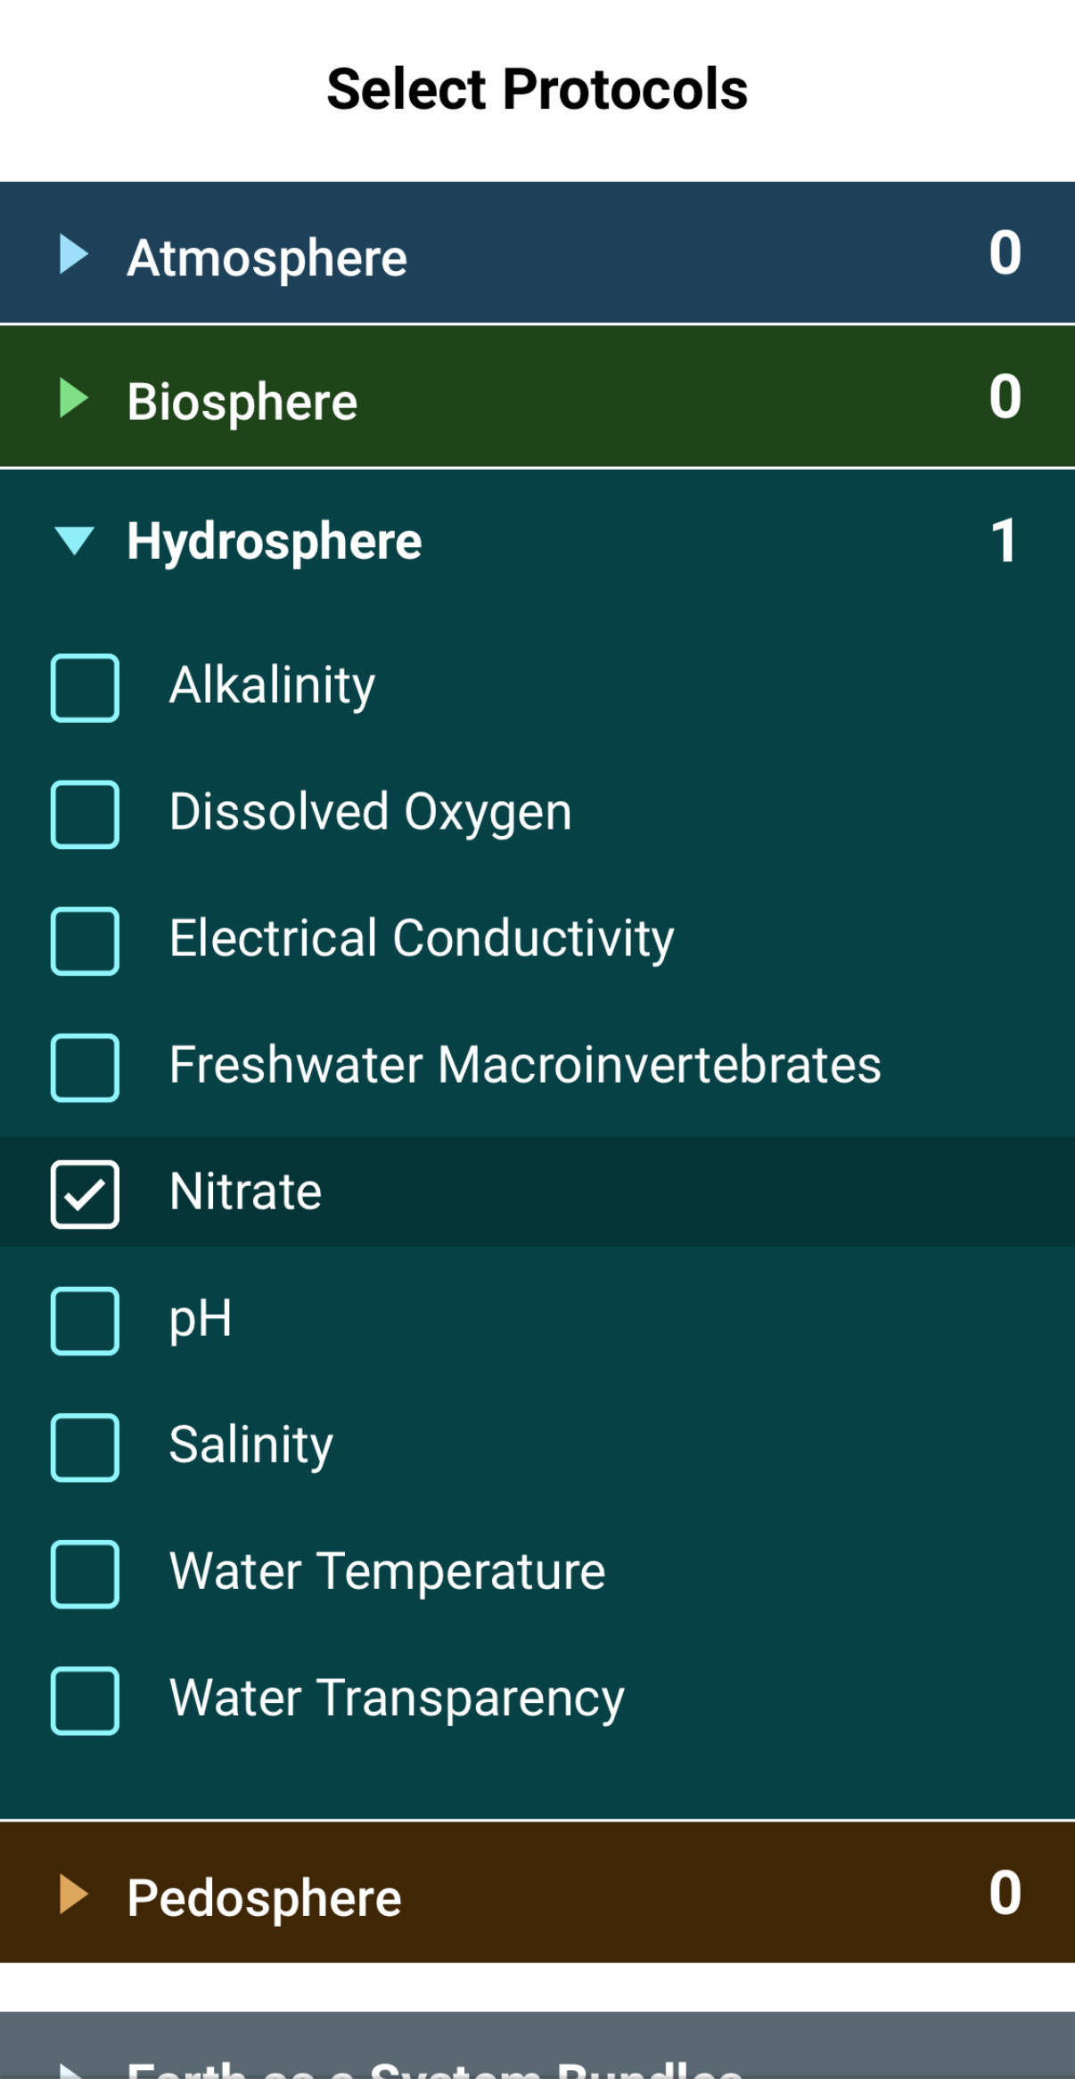
Nitrate Protocol Data Entry
Select Nitrate from the list of Hydrosphere protocols. Click Continue at the bottom of the screen.

Slide 55
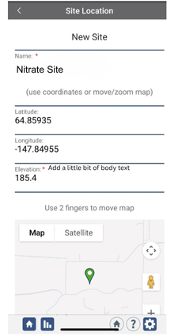
Nitrate Protocol Site Information
If you have not already created a Hydrosphere site, create one now.
Click “New Site” at the bottom of the site location screen and choose a name for your new site.

Slide 56
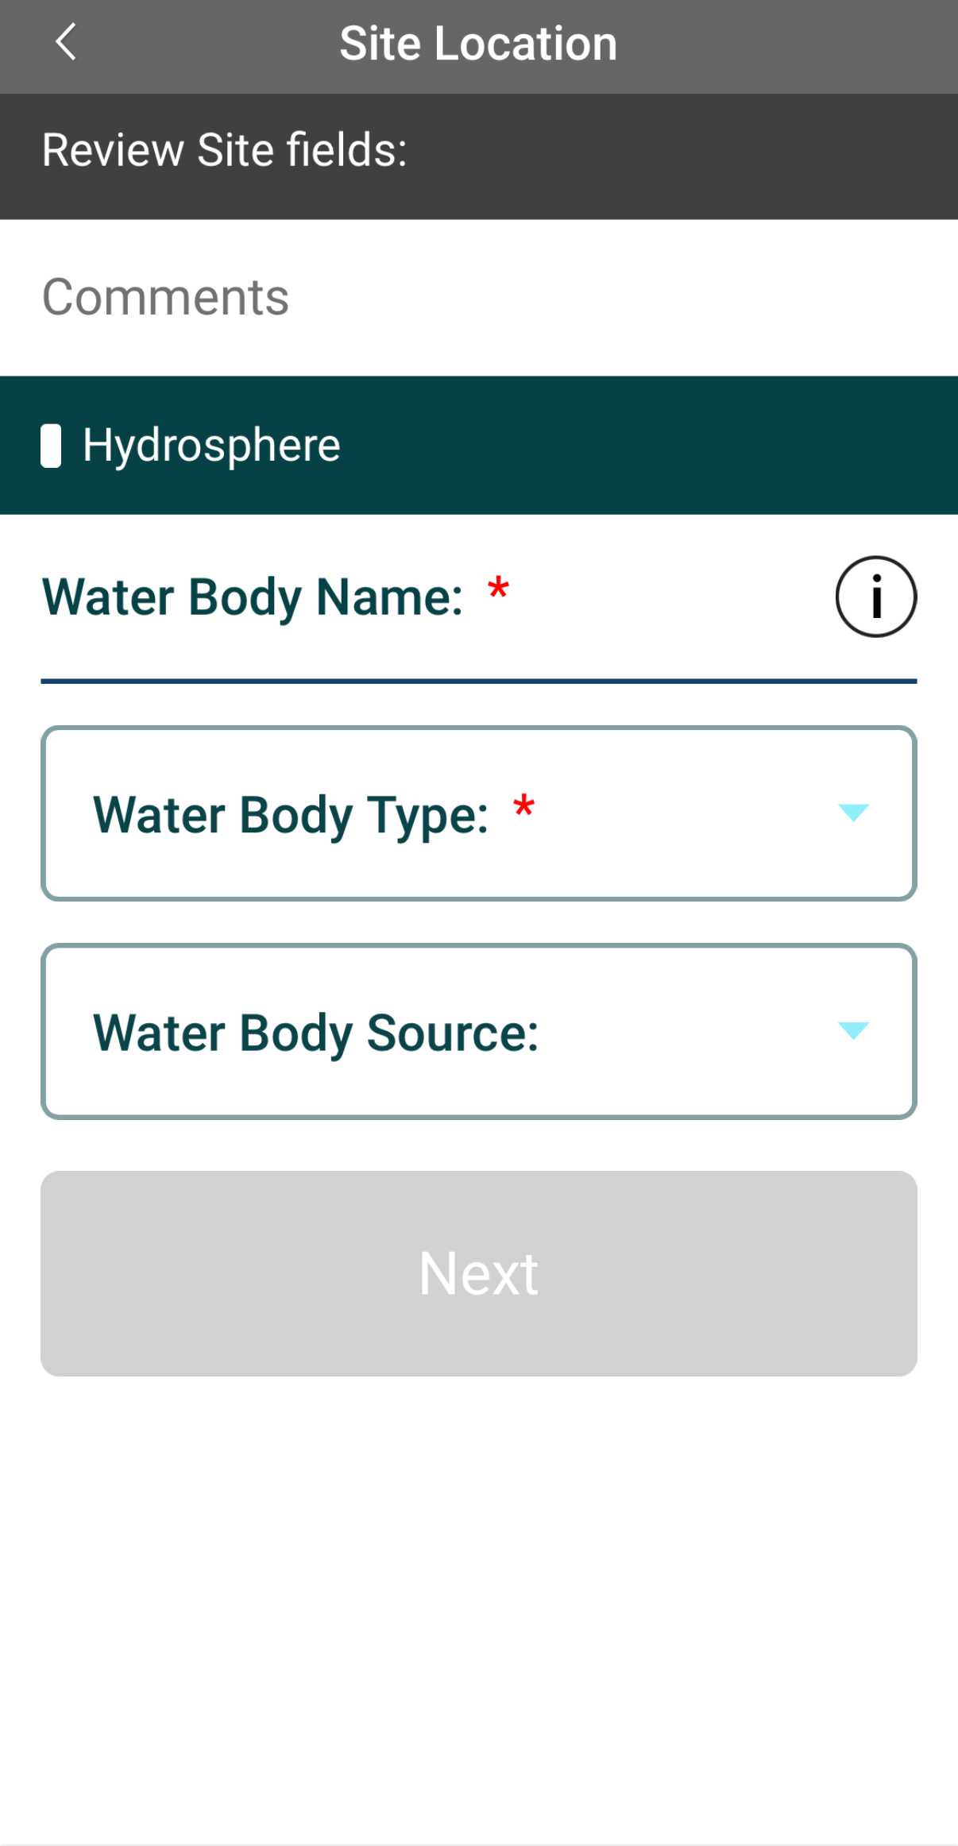
Nitrate Protocol Site Information
Enter the Water Body Name.
Select the Water Body Type and Water Body Source from the dropdown list of options.

Slide 57
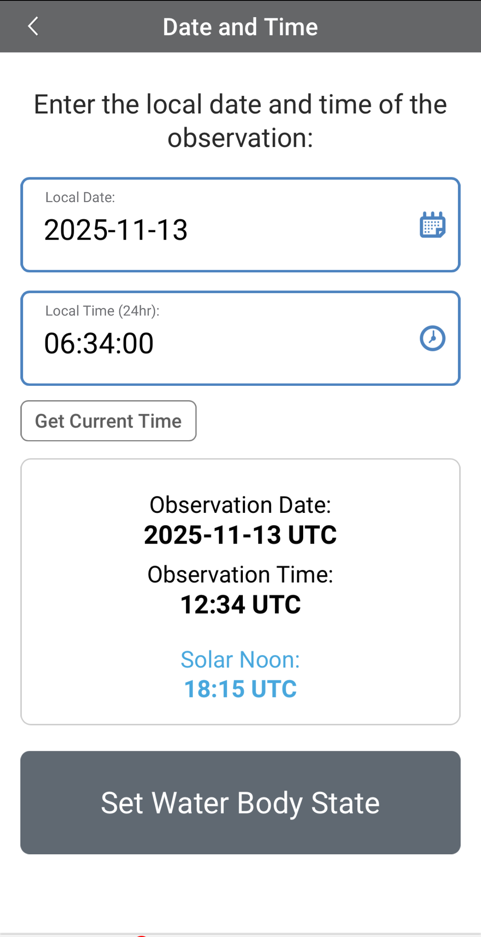
Entering Measurement Data
Enter the date and time you took the measurements.
Once you enter the date, select Set Water Body State to enter your data.
Measurement data from under the ice cannot be entered into the GLOBE database because the water state must be “normal,” not frozen. However, if “frozen” is the normal state for that time, set the state to “normal” and write in the comments that the water was frozen.

Slide 58
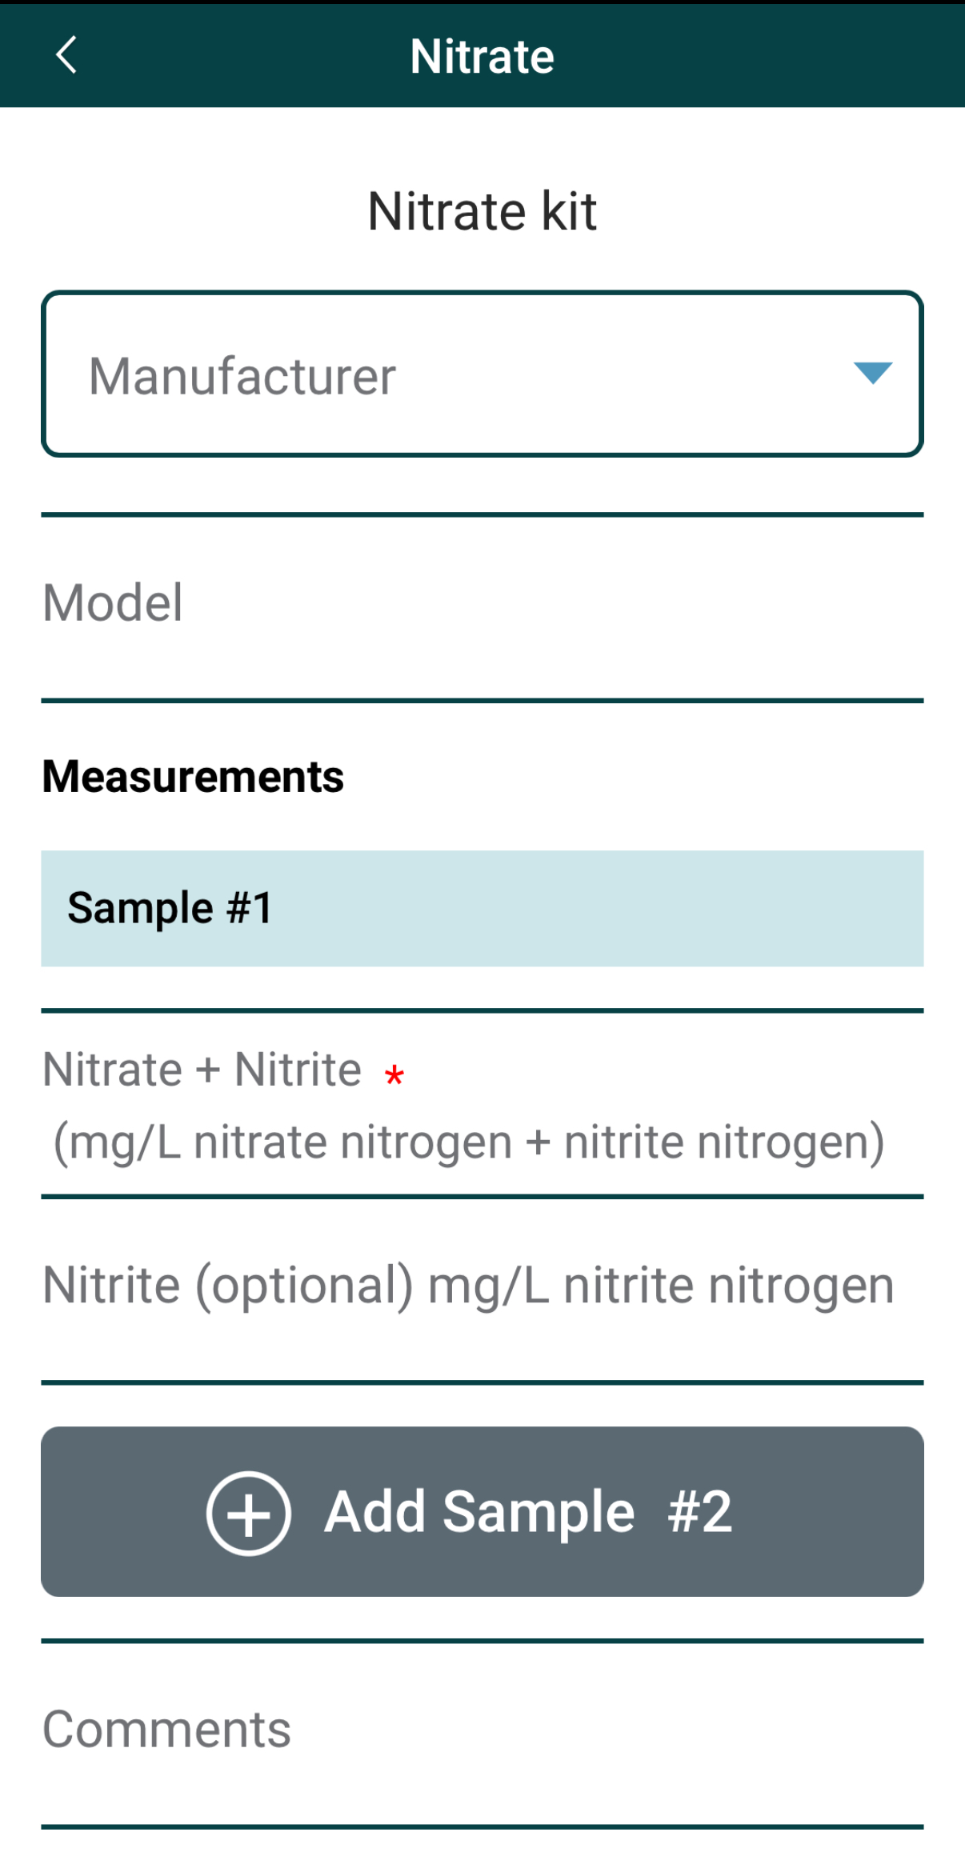
Enter Nitrate Measurement Data
Select the Nitrate test kit manufacturer from the dropdown list of options.
Enter the nitrate + nitrite measurement.
Enter the nitrite measurement (optional).

Slide 59
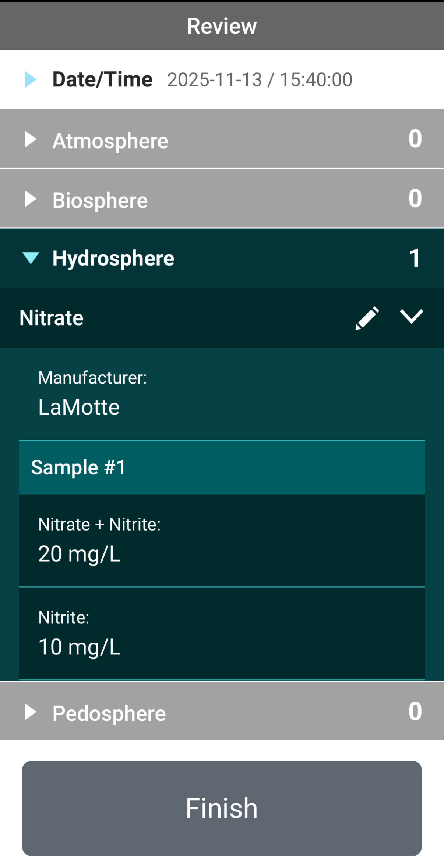
Review Data Entry and Send Data
Review the data you entered and check for errors.
When complete, select Finish to complete the send the observation to GLOBE.

Slide 60
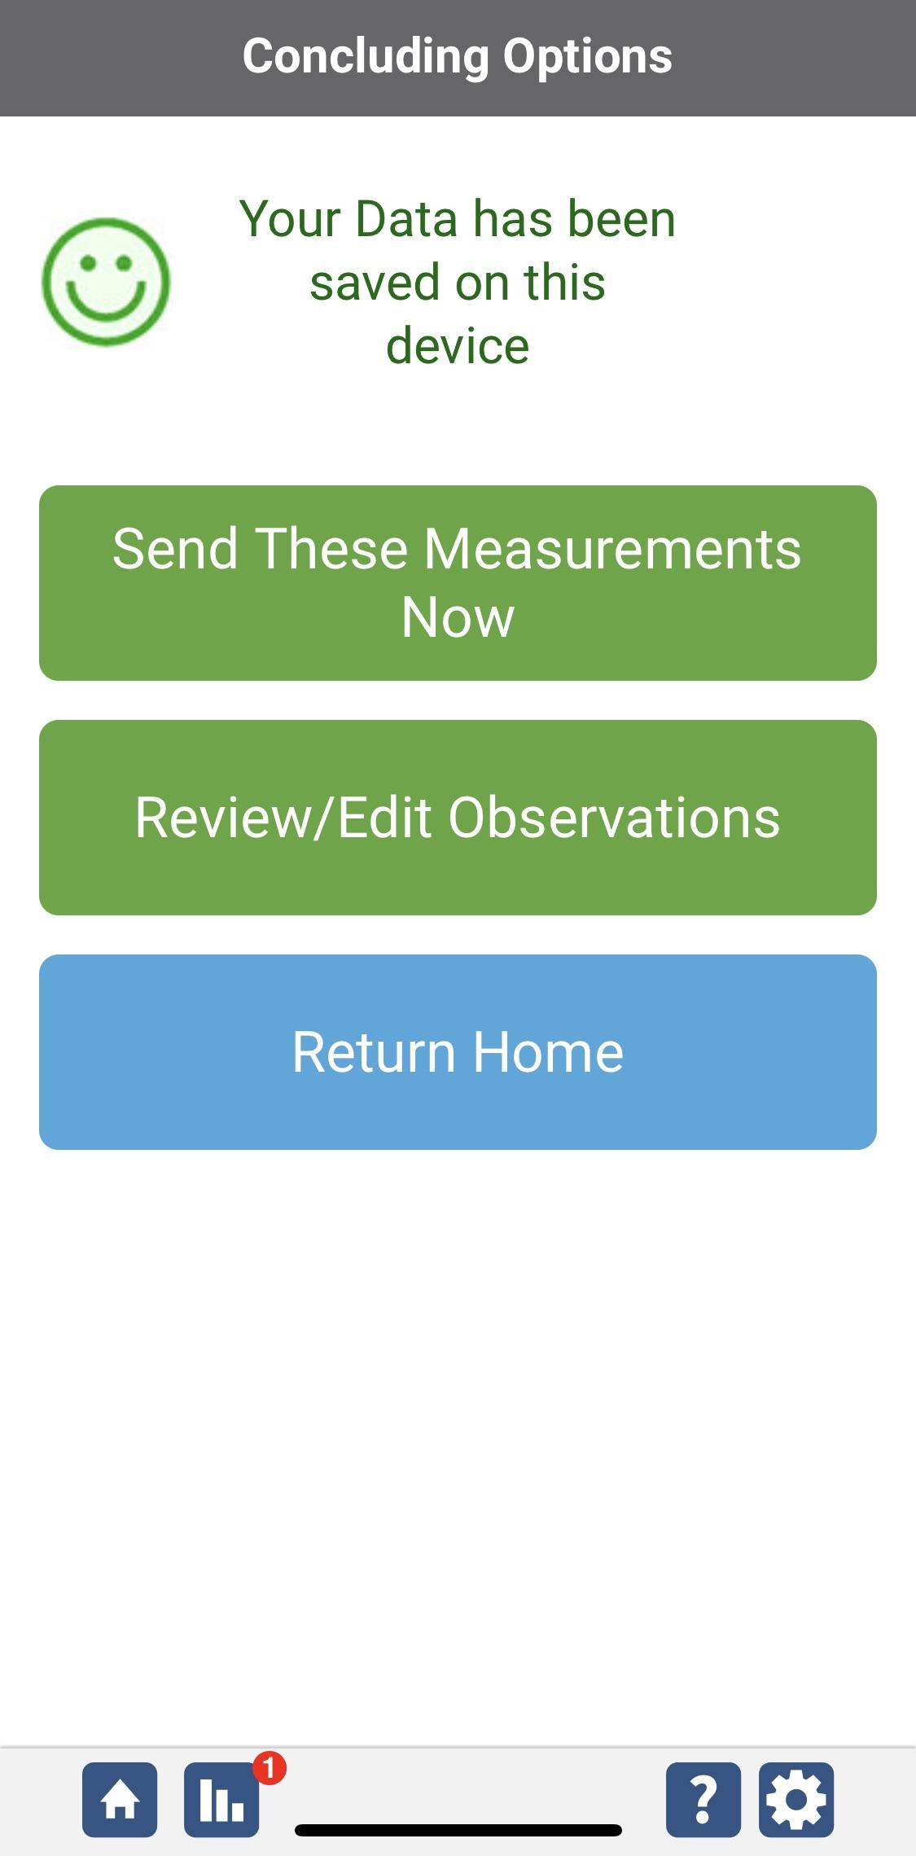
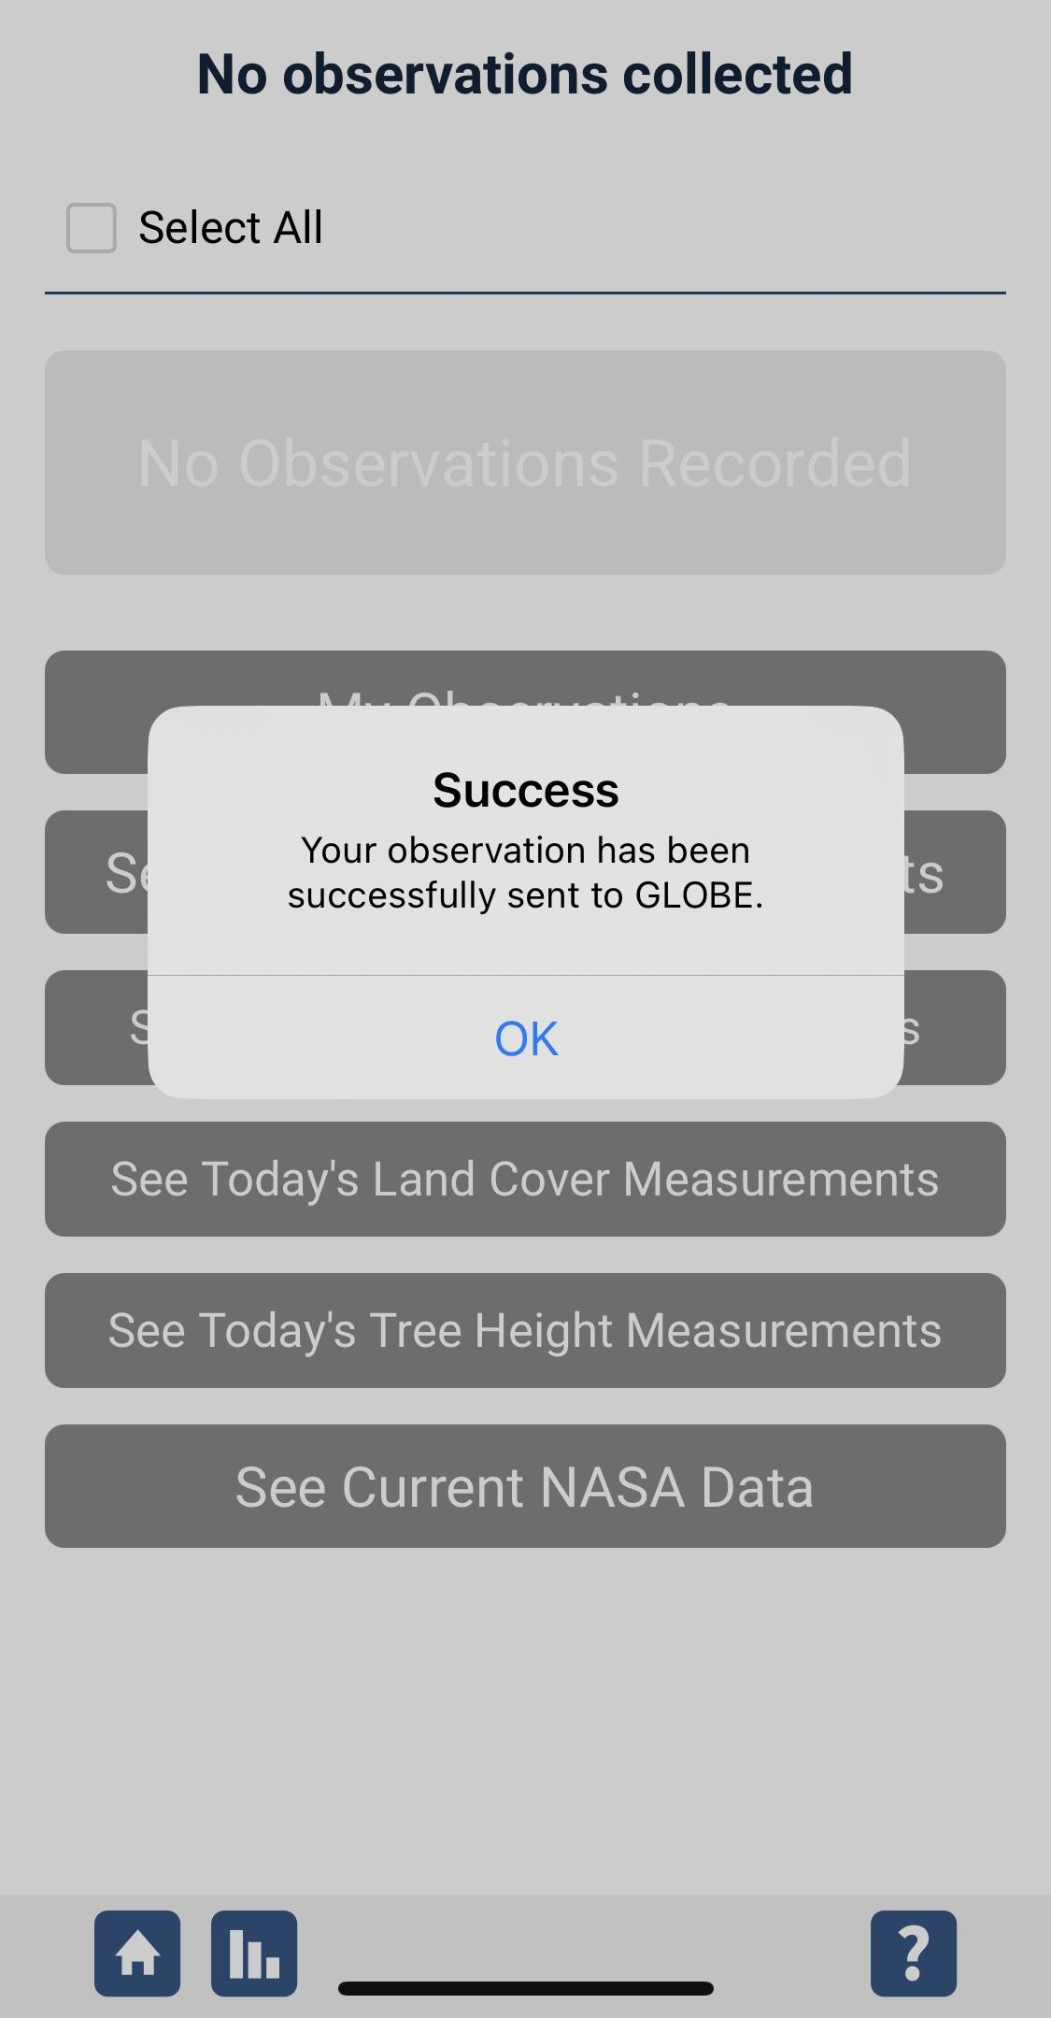
Data System Responses
If your observations are within the appropriate ranges, you will see a green smiley face.
You can review or edit your observation if needed.
When ready, select “Send these measurements now” to send your data to GLOBE. When it has been sent, you will see a “Success” message.

Slide 61

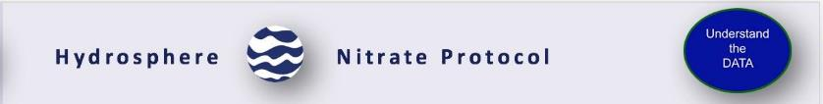
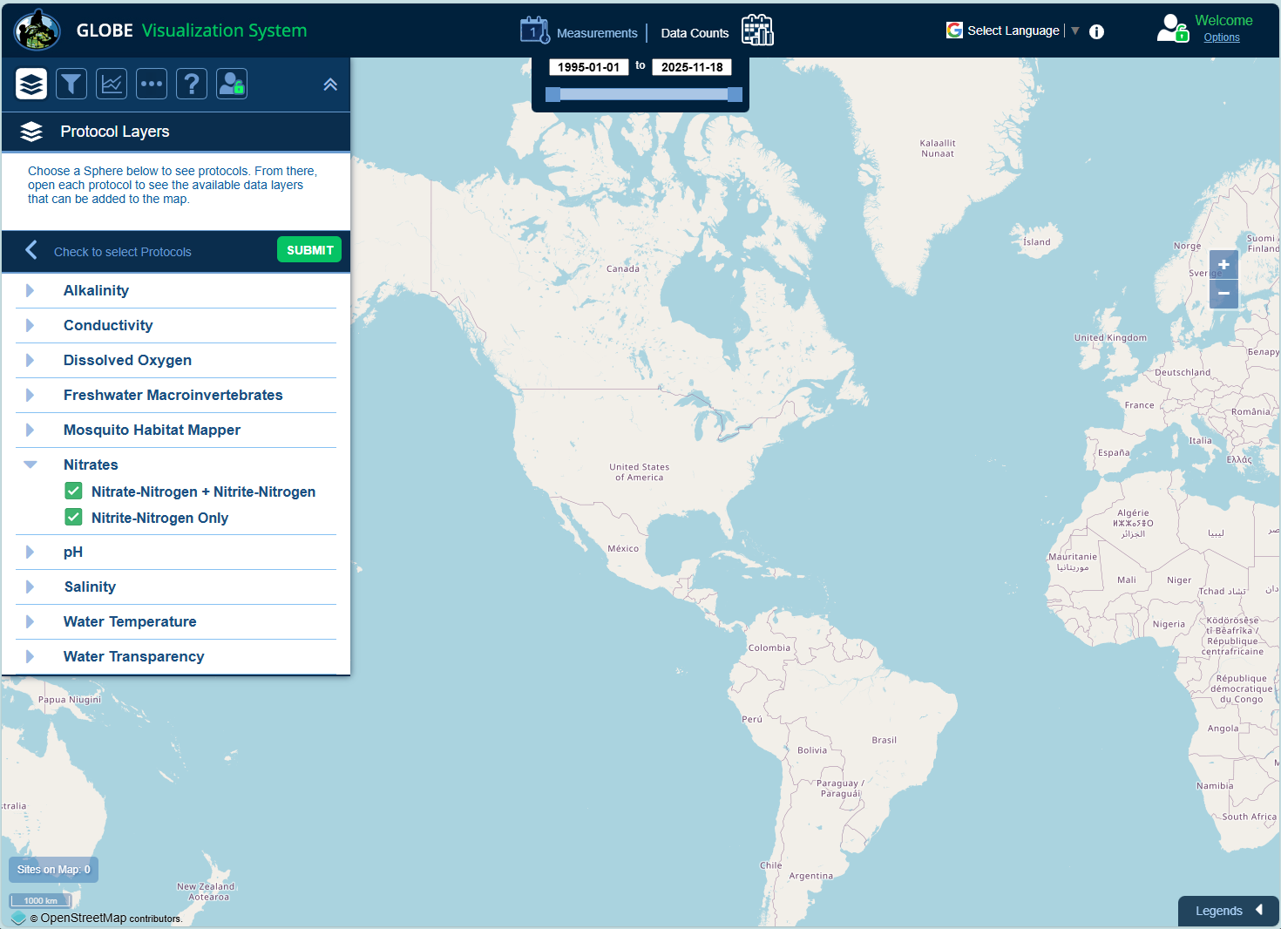
Visualize and Retrieve Nitrate Data: 1/3
GLOBE provides the ability to view and interact with data measured across the world. Select our visualization tool to map, graph, filter and export nitrate data that have been measured across GLOBE protocols since 1995. Here are screenshots steps you will use when you use the visualization tool:
Select desired Nitrate options
Link to step-by-step tutorials on Using the Visualization System will assist you in finding and analyzing GLOBE data: PDF version

Slide 62
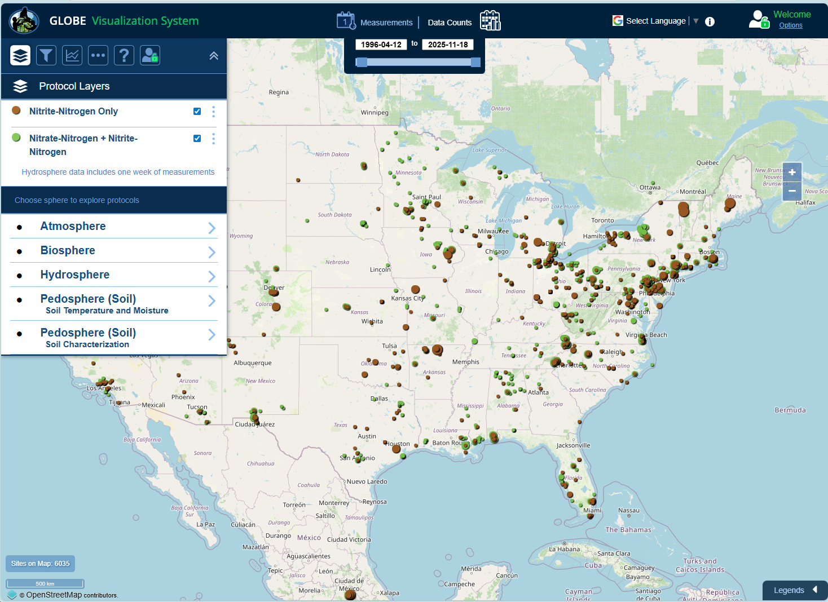
Visualize and Retrieve Nitrate Data: 2/3
Select the sampling site for which you need nitrate data, and a box will open with data summary for that site.
Green and brown points are locations where nitrate data is available for the time period you selected

Slide 63
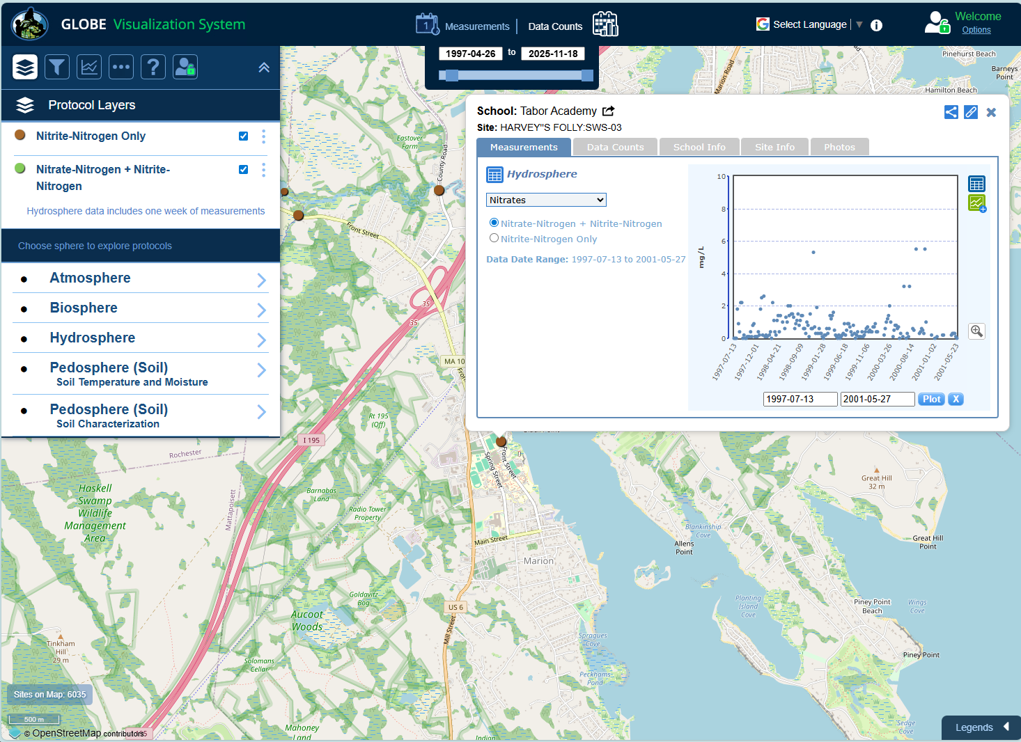
Visualize and Retrieve Nitrate Data: 3/3
Clicking on a location will open to a map note providing nitrate data for that location and time.

Slide 64


Review questions to help you prepare to conduct the Nitrate Protocol
Why are scientists interested in nitrates in water bodies?
True/false Nitrogen is found in the atmosphere, biosphere, lithosphere and hydrosphere.
What is eutrophication? What role might nitrates have in the creation of eutrophic waters?
What happens to dissolved oxygen in highly eutrophic waters?
What are the safety precautions you should take when doing any of the hydrology protocols?
Most natural waters have nitrate levels lower than/ more than 0 mg/L NO₃⁻ -
Why do you need to test your kit against a nitrate-nitrogen control standard?
Your three measurements should be within ___ ppm of the average if you are conducting a low range test.
What do you think could cause an increase in nitrogen in a water body? What would you look for?

Slide 65
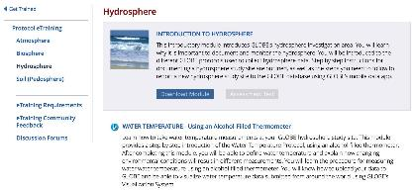
You are done!
You have now completed the slide stack. If you are ready to take the quiz, sign on and take the quiz corresponding to Water Nitrate Protocol.
You can also review the slide stack, post questions on the discussion board, or look at the FAQs on the next page.
When you pass the quiz, you are ready to take Water Nitrate Protocol measurements!
When you are done, please complete the eTraining feedback form so that we can improve this product! Thank you!

Slide 66


FAQ: Frequently Asked Questions
Is it okay for my water to have a nitrate measurement of 0?
Yes, a 0 ppm value indicates that the amount of nitrate (if any) in the water is below the detection limit (usually 0.1 ppm N-NO3) of the nitrate kit you are using. Many water bodies may have 0 ppm N-NO3 most of the year.
What happens if my water turns a different color, instead of pink, during the testing process?
You probably cannot use the kit you are currently using, as the chemicals have expired.
Is it okay for nitrate values to fluctuate a lot in a short period of time? Yes, after precipitation events runoff from surrounding land cover and soils containing nitrates can go into a stream, lake, or estuary and cause the nitrate levels to rise. After the storm or snow melt, the levels may decline.
Is it OK to use a zinc-based nitrate kit? Yes. While the cadmium-based kits give more accurate values in the low nitrate waters, we realize that school regulations do not allow some GLOBE schools to use the cadmium-based kits. If this is the situation at your school, use the zinc-based kits. Please designate on the site definition page the type of kit you are using.

Slide 67
Questions for Further Research and Investigation
Why do you think there may be a seasonal pattern in nitrate data?
Is there a relationship between the amount of nitrate at your site and the type of land cover in your watershed?
Does temperature affect the amount of nitrate in water?
Is there are relationship between the types of soil in the watershed and the amount of nitrate in the water body?

Slide 68

We want your Feedback!
Please provide us with feedback about this module. This is a community project and we welcome your comments, suggestions and edits! Comment here:
Training@nasaglobe.org
Questions about module content? Contact GLOBE: help@nasaglobe.org
Credits
Slides:
Russanne Low, Ph.D., University of Nebraska-Lincoln, USA
Rebecca Boger, Ph.D., Brooklyn College, NYC, USA
Photos: Russanne Low
Art: Jenn Glaser, ScribeArts
More Information:
GLOBE Program, NASA Earth Science
NASA Global Climate Change: Vital Signs of the Planet
The GLOBE Program is sponsored by these organizations:
Version 11/17/25. Modified by GLOBE Implementation Office – Science, Training, Education, and Public Engagement. If you edit and modify this slide set for use for educational purposes, please note “modified by (and your name and date)" on this page. Thank you.

